Slide 1
Fundamentals of TB
New Mexico Department of Health
Tuberculosis Program

Slide 2
Overview
Transmission, pathogenesis and epidemiology of tuberculosis
Screening for tuberculosis infection
Review TST Health History and TST Consent Form
Administering, reading and interpreting TST
Patient referral information

Slide 3
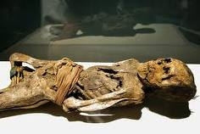
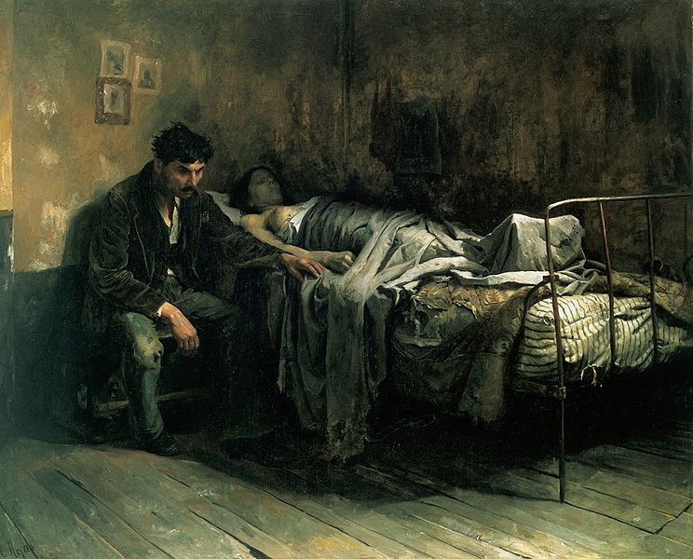
TB: An Ancient Disease
Tuberculosis has plagued humanity for centuries.
Has been known by a variety of names:
Phthisis (Hippocrates 450 BC)
Consumption
Wasting disease
White plague
Evidence of TB has been found in ancient mummies over 4,000 years old.
Albert R. Zink, Christophe Sola, Udo Reischl, Waltraud Grabner, Nalin Rastogi, Hans Wolf and Andreas G. Nerlich. Characterization of Mycobacterium tuberculosis Complex DNAs from Egyptian Mummies by Spoligotyping. Journal of Clinical Microbiology. 2003 Jan; 41(1);359-367
La Miseria by Cristóbal Rojas (1886).

Slide 4
TB History in New Mexico
Between 1880 – 1940
people sought the cure for TB in NM due to the arid climate
Up to 60 Sanatoriums
By 1920:
10% of the New Mexico population were residents seeking health remedies
ST. ANTHONY'S SANATORIUM and HOSPITAL A fully equipped Sanatorium for the treatment of pulmonary, gland, bone, joint and laryngeal tuberculosis. Rates $50.00 to $60.00 per month. Medical care extra. Operated by the "Sisters of Charity of Leavenworth, Kansas." EAST LAS VEGAS, NEW MEXICO [March 1935 advertisement in the CHEST Journal]

Slide 5
TB: A Silent Public Health Epidemic
In 2014,
6 million new TB cases reported to WHO
TB killed 1.4 million people
(1.1 million HIV neg., 0.4 HIV positive)
2-3 billion people infected with TB
30,000 people die EACH Week
4100 people per day
Leading infectious disease killer of adults worldwide
Economic Impact
Toll on global economy
- $12 billion/year
By 2050 cost to global economy
- $16.7 trillion
Personal Impact
Loss 4 months of work
30% of annual income
Isolation
World Health Organization Global Tuberculosis Report 2015 http://www.who.int/tb/publications/global_report/en/
Notes:
In 1993, WHO declared Tb a global health emergency

Slide 6
TB Anywhere is TB Everywhere
3 out of every 5 New Mexico TB cases occur among foreign born persons

Slide 7
TB Anywhere is TB Everywhere
The 22 countries shown on map have
80% of the TB cases in the world!
Notes:
The 22 countries shown on the map accounts for 80% of the tuberculosis cases in the world; India & China

Slide 8
Can a person with a previous positive TST be retested?
No, repeated TST will “sensitize” the client
No, once verbal history of positive TST never retest.
Yes, if client does not have written document.

Slide 9
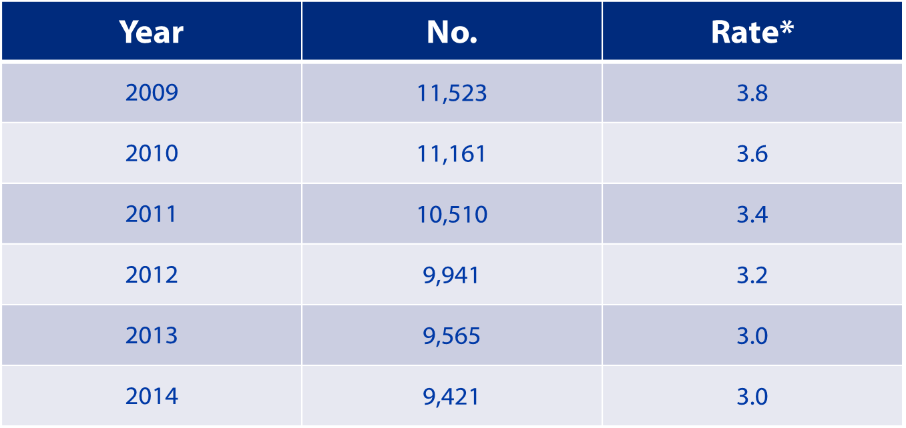
TB in the US
Notes:
What caused the increase of TB cases in the late 1980’s? HIV and decrease funding of TB programs prior to decrease
What caused the sudden decrease? Funding for HIV and TB programs, standardizing DOT for TB cases in US

Slide 10
TB Case Rates,* United States, 2014
D.C.
< 3.0 (2014 national average)
>3.0
Slide provided by CDC
*Cases per 100,000.

Slide 11
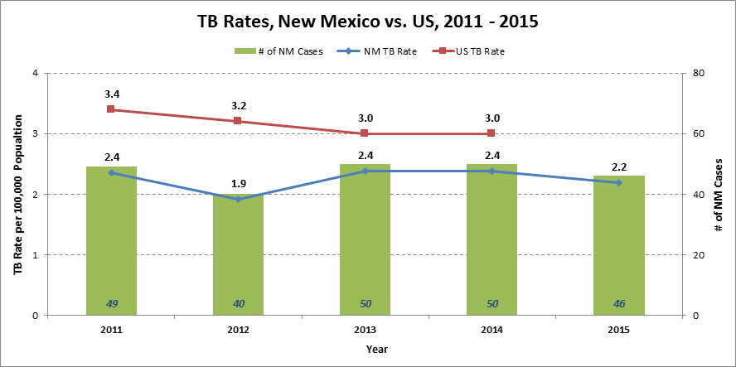
TB in New Mexico
Notes:
Could share county Data to focus on local epidemiology

Slide 12
TB in New Mexico
County Data
County Data

Slide 13
How soon may a TST be repeated?
Right away if incorrect placement.
Must wait at least a week before retesting.

Slide 14
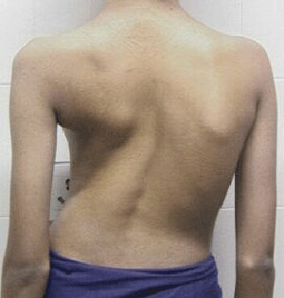
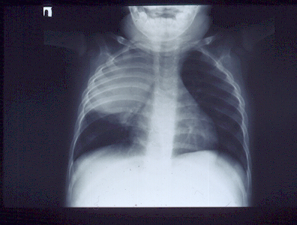
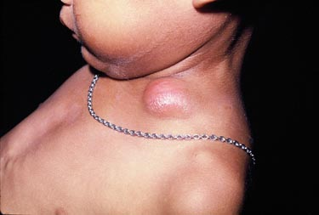
What is tuberculosis?
Tuberculosis is a disease caused by a bacterium
Mycobacterium tuberculosis.
The bacteria usually infects the lungs…..
but it can infect any part of the body such as the bone, pleura, liver, kidney, spine, and brain and other organs.
Notes:
TB Transmission and Pathogenesis (Slides 5-20) – 20 minutes

Slide 15
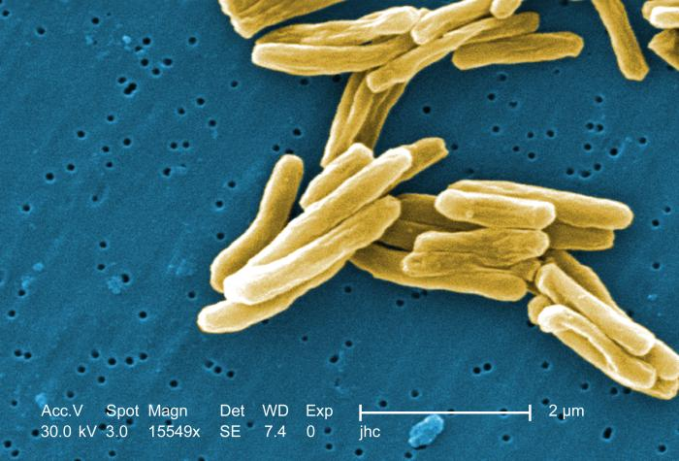
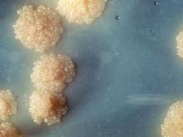
M. tuberculosis
Discovered by Robert Koch in 1882
Slightly curved, rod shaped bacilli
0.2 - 0.5 microns in diameter and 2 - 4 microns in length
Aerobic
Non-motile
Thick lipid cell wall
Acid fast
Multiplies slowly (once every 18 - 24 hours)
Can remain dormant for decades
Source: CDC/Dr. George P. Kubica, 1979
Notes:
Characteristics of the TB organism:

Slide 16
Active TB Disease
Symptomatic:
Persistent cough > than 3 weeks
Weight loss
Fever/chills
Night sweats
Fatigue
Bloody sputum
May spread TB to others
May have positive skin test/IGRA
Sputum culture positive
Occasionally cases of culture negative TB do occur

Slide 17
Can infants receive a TST?
True
False

Slide 18
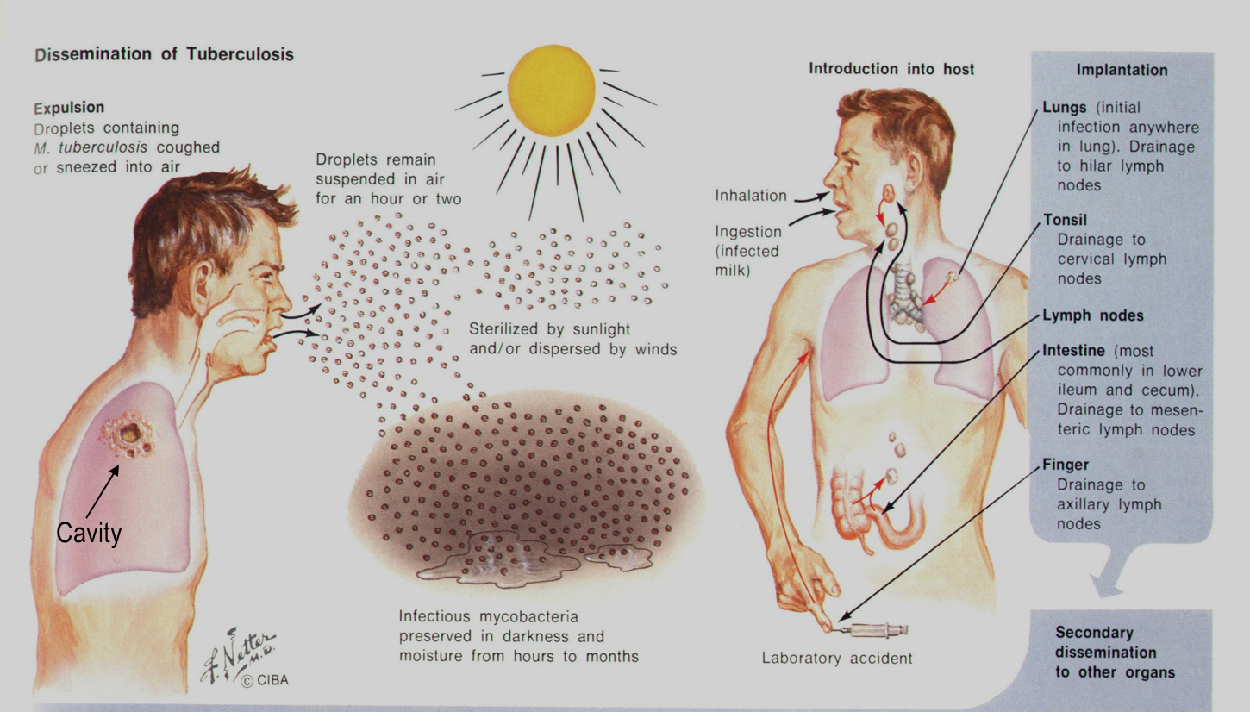
Transmission

Slide 19
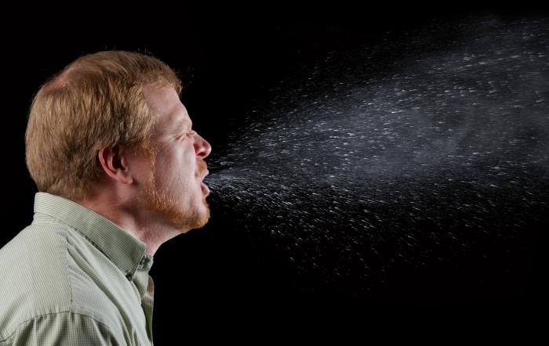
Transmission
Person to Person via through the air when a person with TB disease:
Coughs
Laughs
Talks
Sings
Notes:
TB is spread from person to person through the air. When a person with pulmonary or laryngeal TB coughs, sneezes, sings and talks, droplet nuclei contacting the bacteria are spelled into the air. Depending on the environment, these tiny particles can remain suspended in the air for several hours.
If another person inhales air containing the droplet nuclei, transmission may occur. What is the probability to be infected? Who is going to be infected?

Slide 20
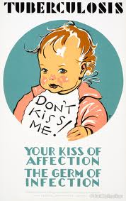
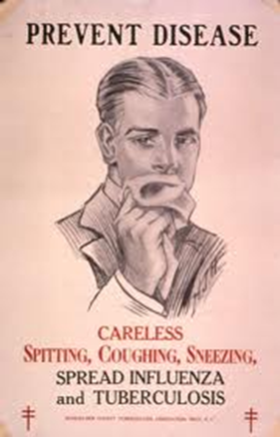
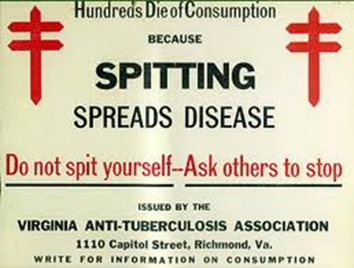
Transmission
Tuberculosis cannot be spread by:
Sharing dishes and utensils
Using towels and linens
Handling food
Brief contact

Slide 21
Can a pregnant women receive a TST?
No, there is a perceived risk to the fetus.
No, TST should not be done until 3 months post-partum
Yes, pregnancy is not a contraindication

Slide 22
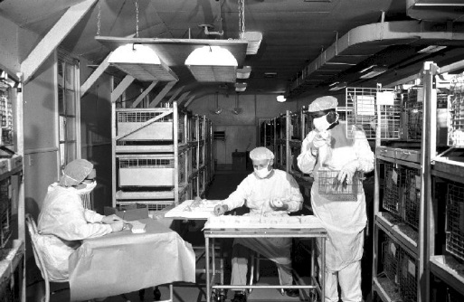
Transmission
In 1882, Robert Koch discovered the organism responsible for Tuberculosis.
68 years later….
In the 1950’s, Dr. Richard L. Riley work with guinea pigs as a Johns Hopkins Hospital researcher proved that particles the size of a mote of dust could transmit tuberculosis.¹
CDC/ Merle J. Selin
1.Aerial dissemination of pulmonary tuberculosis. A two-year study of contagion in a tuberculosis ward. 1959. <http://www.ncbi.nlm.nih.gov.offcampus.lib.washington.edu/pubmed/7785671> Riley RL, Mills CC, Nyka W, Weinstock N, Storey PB, Sultan LU, Riley MC, Wells WF.
Notes:
This slide discusses the study using guinea pigs to see the transmission of TB and also how UV lighting affects the bacteria

Slide 23
Transmission
Notes:
Air from a TB patient ward was filter up and split to flow towards two chambers. One was unfiltered and flowed directly in to cages with guinea pigs. The other was diverted through UV lights and then into cages. They found that the side with no UV light had guinea pigs dying of TB in higher rates than the other chamber.

Slide 24
Transmission: Risk of Infection
Probability TB will be transmitted:
Infectiousness of person with TB
Concentration of droplet nuclei in the air
Duration of exposure
Susceptibility of the contact
Majority of contact do not become infected
If infected, 10% lifetime risk of developing active TB
Notes:
The probability that TB will be transmitted from one person to another depends on the following factors:
The number of bacteria inhaled - The infectiousness of a person with TB disease is directly related to the number of TB bacteria that he or she expels into the air when he/she coughs, sneezes, etc. A person with TB disease who is coughing is putting more bacteria into the air than a person with TB disease who is simply breathing. Cavities contain millions to billions of TB bacilli. One cough produces about 500 droplets. An uninfected person who breathes in a lot of bacteria is more likely to become infected than someone who breathes in fewer bacteria.
The length of time of exposure - The longer an uninfected person is around someone with pulmonary TB disease the greater the chance that person will breathe in the bacteria. Therefore, people who spend a lot of time around a person with TB disease, such as family members, roommates, friends, and coworkers, are at high risk of becoming infected with the TB bacteria.
The environment in which exposure to the bacteria occurs -
Chance of infection increases when with an infectious person in areas where the bacteria can easily survive such as: Indoors, in areas with poor ventilation, in areas with no sunlight
The bacteria can survive in the air for long periods of time but it can be killed by sunlight or spread about by the wind.
The source
Cough, cough inducing procedures
Duration of symptoms
Cavitary disease
Sputum smear positive for AFB
The contact
Proximity to source
Duration of exposure
Ventilation
Air entrainment, recirculation
The length of time you spend near the person
The distance between you and the person

Slide 25
Latent TB Infection (LTBI)
Person:
Asymptomatic
Not contagious
Normal chest x-ray
Positive skin test or Quantiferon Gold
Bacteria:
Alive but inactive
Not replicating
Surrounded (walled off) by body’s defense system
Notes:
Period of time during which the person experiences no symptoms but is still infected with the bacteria
The bacteria lives inside macrophages or within a granuloma where the bacteria remains dormant
A person with latent infection cannot spread the bacteria to other people
If no preventive medicine, 10% chance of developing active TB (5% in 1st 1-2 years after infection + 5% rest of lifetime) (higher % if medical problems exists! Will cover these later in risk assessment)

Slide 26
Active TB Disease
Person:
Symptomatic
Infectious
May have positive skin test/IGRA
Bacteria:
Active and multiplying
Cause damage
Can disseminate throughout the body
Grow on culture
Damage causes abnormal x-ray or imaging
Granuloma breaks down and tubercle escape and multiply
Notes:
Latent infection can reactivate causing active TB disease
Reactivation occurs when the immune system weakens and the TB bacteria multiplies
TB bacteria and dead cells in the airway will cause a person to cough

Slide 27
Making the diagnosis
Symptom Screening
Cough
Weight loss
History of potential exposure to TB
TB skin test or IGRA results
CXR – red flags of CXR chart
Collect sputa x 3;
may collect every 8 hours
at least one specimen early AM
Medical exam
Extra-pulmonary sites
CDC/ Minnesota Department of Health, R.N. Barr Library; Librarians Melissa Rethlefsen and Marie Jones

Slide 28
Know the RED FLAGS of TB Disease
Chest X-ray Reports
Pneumonic Process - frequently in the right upper lobe.
Interstitial Infiltrates.
Possibility of cavitary lesion.
Mass, lesion, often needing a CT Scan to further define.
Pleural effusion (considered TB until proven otherwise).
Parenchymal disease.
Nodular densities consistent with old granulomatous disease.
RUL densities.
Nodular densities.
Linear parenchymal changes.
Hilar or Perhilar adenopathy.
Thickening/blunting of right costophrenic angle.
CDC/Charles Farmer
Probably Not TB Disease
Negative
no infiltrates
no active disease
no tuberculosis
Normal
clear
List created by: Mary V. Muench, RN, TB Program Coordinator and Carol Clark, RN, TB Program Nurse, Florida Department of Corrections-2003. This is not intended to be all-inclusive and as with any test must be considered with the clinical picture of the patient.

Slide 29
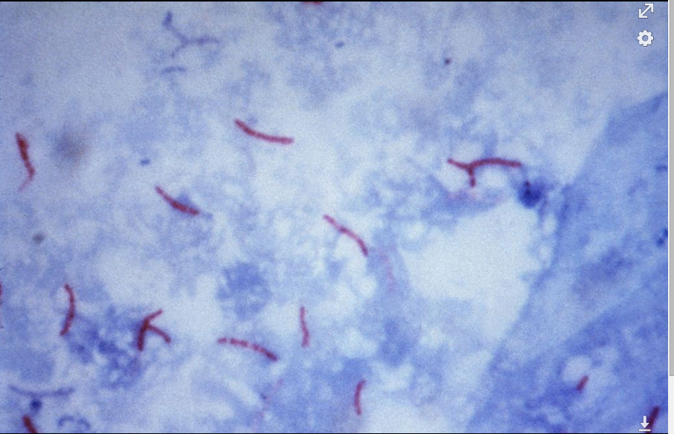
AFB SMEAR
Grading:
4+ (Numerous)
3+ (Moderate)
2+ (Few)
1+ (Rare)
(Negative smear)
Fluorescent Stain
Ziehl-Neelsen Stain

Slide 30
NAAT/PCR (Nuclei Acid Amplification Test)
Perform on ALL patients who are TB Suspects
Sputum only
Sputum Smear positive & smear negative
Takes about 2-4 hours

Slide 31
Isolation of M.TB Complex
Processed specimen inoculated to broth (MGIT) and solid media
Broth usually positive within 7-14 days
Solid media may take up to 6 weeks

Slide 32
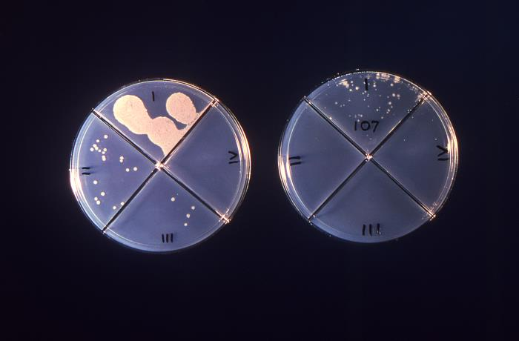
TB Susceptibilities
Performed on all initial positive MTb
If patient culture positive after 3 months of treatment
MTb drugs tested:
INH (isoniazid low level 0.1 ug)
INH (isoniazid high level 0.4 ug)
RA (Rifampin)
EMB (Ethambutol)
PZA (pyrazinamide)

Slide 33
TB Disease: Treatment Regimens
Four regimens recommended for treatment of culture-positive TB
Initial phase: standard four drug regimens (INH, RIF, PZA, EMB), for 2 months
Continuation phase: (RIF & INH) additional 4 months
(may be up to 7 months)

Slide 34
Can a HCW read their own TST?
Yes, if they work for the TB Program.
Yes, if they have received a state sponsored TST practicum.
No, Negativo, Nien!

Slide 35
HIGH risk for TB Infection
Contacts of infectious TB cases
Recently arrived immigrants from TB endemic countries
Health care workers
Persons who live/work in institutional settings
(shelters, nursing homes, correctional facilities)
Persons with compromised immune systems
(children < 4 years, other immunocompromised)
Patients in renal dialysis units
Person using TNF-Alpha Blockers
Medically undeserved/ low-income groups
Persons who live or stay in overcrowded, poorly-ventilated environments
Substance abusers, especially IVDU
Homeless
Persons with inadequate health care
Migrant workers

Slide 36
HIGH risk for progression to TB disease
Persons recently infected
Contacts and TST Convertors
Individuals with abnormal Chest X-ray
compatible with past TB
Children <5 years of age
Certain medical conditions:
Diabetes; TNF-alpha blockers; HIV+; in addition to:
Cancers , Prolonged corticosteroid or other immunosuppressed therapies, Chronic renal failure/hemodialysis, Organ transplant recipients, & Low body weight

Slide 37
Diagnosing TB Infection
Two types of TB Testing available
TB Skin Test
IGRA (Immune Gamma Release Assay)
QFT & T. Spot
Blood test
Measure immune reactivity to Mycobacterium tuberculosis
Does NOT interact with BCG!

Slide 38
Tuberculin Skin Testing (Mantoux)
Mantoux is only skin test currently used. Multiple puncture test (tine test) is inaccurate
The tuberculin used in the Mantoux skin test is also known as purified protein derivative or “PPD”
CDC/ Gabrielle Benenson
Notes:
lest turn to the tool to diagnosis TB infection. In the last guidelines they change the terminology for TST instead of PPD. For the first time in a hundred years another test is developed is the quentiferon gold standard but I will talk about it later.

Slide 39
Mantoux TST: Not a perfect test.
Sensitivity;
ability to correctly identify TB Infection
Specificity:
correctly identify those who do Not have TBI
Notes:
Reactions of the TST depends of the reaction of the immune system. It’ not 100 % specific. The TST has problem with specificity and sensitivity. I’m going to talk about the false positives or false negatives later.

Slide 40
Purified Protein Derivative (PPD)
Storage and handling
Store at 35-46 F. in refrigerator or in cooler with ice packs
Do not freeze,
do not store on refrigerator door
Keep out of light
Date and initial when vial is opened.
30-day shelf life once vial is opened
Avoid pre-filling syringes
Notes:
Storage at 35-46 Once a vial of PPD has been opened for use you should:
date and initial
Discard after 30 days of being opened
Keep out the light
Not use it beyond the expiration date

Slide 41
Administering the TST
Standard Precautions for administering
Use a tuberculin syringe
27 gauge with 1/2 inch attached need
Dose:
0.1 ml of tuberculin (5 TU PPD)
Site:
Standard site – Left forearm
Alternate site – Right forearm
Route:
Intradermally using 5-15 degree angle

Slide 42
Administering the TST

Slide 43
Incorrect placement

Slide 44
Reading the TST Reaction
Read reaction 48-72 hours after injection
Measure the diameter of induration across the forearm
Induration = hard dense raised formation
Erythema = reddening of the skin (do not measure)
Record result in millimeters (mm)
(‘0’mm = no reaction)
Notes:
Measure the INDURATION

Slide 45
Reading the TST Reaction
If client returns after 72 hours measure and record induration, then
If TST is read as negative, repeat TST
You can read a positive TST up to 7 days
Hypersensitivity reactions:
usually occur shortly after injection
subsides within 24 hours.

Slide 46
TST Interpretation Cut Points – ATS/CDC
>5 mm is considered positive in
Close contacts of infectious TB cases
(known or suspected)
HIV-infected persons
(known or suspected)
- Fibrotic changes on CXR consistent with prior TB
Patients with organ transplants and/or those receiving immunosuppressed treatments
This group should be tested by Public Health

Slide 47
TST Interpretation Cut Points – ATS/CDC
> 10 mm is considered positive in
Recent immigrants from high prevalence countries
IVDU, known to be HIV neg.
Residents and employees of high-risk congregate settings
Mycobacteriology lab personnel
Children < 4 years of age/ children and adolescents exposed to adults at high risk
Persons with medical conditions that place them at high risk of progression to TB disease

Slide 48
TST Interpretation Cut Points – ATS/CDC
> 15mm is considered positive
persons with no risk factors

Slide 49
False negative reactions
Technical factors
Incorrect method of administration;
Incorrect interpretation;
Improper storage or contamination of PPD
Host Factors
Recent TB infection
(< 3 months)
Anergic (HIV)
Very young age
< 3 months/age
Other viral, bacterial, fungal infections
Live virus vaccinations
Overwhelming TB disease

Slide 50
Live, Attenuated Vaccines
MMR, varicella, oral polio, oral typhoid, and yellow fever vaccines
may temporarily suppress response to tuberculin
What you should do:
Administer TST at same visit as vaccine
OR
Apply TST first and give vaccine when TST is read
OR
Delay TST until at least 4-6 weeks after vaccine administered

Slide 51
Two-Step TST Method
1st TST Negative
Repeat TST in 1-3 Weeks
______________________________________________
2nd TST Negative
Person likely does not have TB Infection
Positive
Boosted reaction due past infection

Slide 52
False positive reactions
Causes;
Infection with NTM (non-tuberculosis mycobacteria)
Vaccination with BCG (bacille Balmette-Guerin)
used in high prevalent countries
Size of reaction (3mm-19mm) doesn’t predict the degree of protection. (50% of vaccinated infants do not react to TST)
Reactions wane 5-10 years after inoculation
Large positive +TST reaction usually indicate a M.Tb infection
BCG history should not preclude skin testing for LTBI
Do not alter the interpretation of a TST reaction due to a past BCG vaccination

Slide 53
The TST Health History and
Consent Form

Slide 54
TST Health History/Consent Form
Demographic Information
Patient identification
Good address & contact information
Physician/PCP identification
To notify of results of TST & referral for CXR if positive TST
Refer to public health if:
+TST and CXR complete
Public Health provide tx for TBI and Nurse Case Management

Slide 55
Purposes
Targeted data collection
Minimum information required……
Should a TST be administered?
Is this a positive TST result for this patient?
Should the patient be referred for additional medical evaluation?
Client’s PCP
Informed consent for testing

Slide 56
Informed Consent
Informed consent for testing
Educational materials in patient’s preferred language
www.cdc.gov/tb
Importance of returning for TST reading
Written reminder helpful
Txt/email reminder – perhaps?

Slide 57
Allergies
True allergic reactions to PPD are rare
Do not confuse with …
Erythema
Vesiculation
Severe, necrotic reactions to TST

Slide 58
Current Medications
Prescription, OTC, herbal
Clues to other medical conditions
Risk factors for TBI and/or disease progression
False negative TST reactions
Potential drug-drug interactions, if treated

Slide 59
Referral Process
Physician/PCP or LPHO?
Refer to PCP for CXR following +TST unless
S/S of active TB disease refer to Department of Health
Prior coordination with LPHO is recommended
Fax form to physician/PCP or LPHO
F/U telephone call
See LPHO contact list in information packet
Fax form to NMDOH TB Program
(505) 827-0163
Provide copy of results to patient

Slide 60
Treatment of TBI - Adults
INH (900mg) & Rifapentine (900mg) once weekly x 12 weeks
Must be given by DOT (directly observed therapy)
Isoniazid 5 mg/kg (300mg) daily for 9 months (270 doses)
Isoniazid 15 mg/kg (900mg) twice weekly 9 months (76 doses)
Given by DOT (directly observed therapy)
Rifampin 10 mg/kg (600mg) daily for 4 months (120 doses)
INH-resistant , rifampin-susceptible source case
INH intolerant
Rifampin/PZA 2 month regimen
no longer recommended – severe hepatotoxicity & death

Slide 61
TB Program Contacts
Diana Fortune RN BSN
TB Program Manager
505.827.2473
Deborah Isaacks RN BSN
TB Nurse Consultant
505.827.2471
Benita Cook RN
TB Nurse Consultant
575.528.5108

