Slide 1
Pharmacist Prescribed Hormonal Contraception Prescriptive Authority Live Session
Offered by the New Mexico Pharmacists Association

Slide 2
Disclosure
The parties involved in creation and development of the New Mexico Pharmacists Prescriptive Authority have nothing to disclose
The parties involved in presentation and training of the New Mexico Pharmacists Prescriptive authority have nothing to disclose

Slide 3
Objectives
Provide a brief review of key facts concerning hormonal contraception
Review sample patient cases
Offer the opportunity to ask questions and clarify issues in providing hormonal contraceptive care
Identify the best resources for building clinical skills
Offer pharmacy-specific practice suggestions
Notes:
XX

Slide 4
Review
Unintended pregnancy rate is ~50% in the US.
Intention of pregnancy leads to better outcomes.
Increased access to contraceptives improves unintended pregnancy rates.
Changes in medical knowledge and practice and development of the US MEC have made pharmacist prescription of hormonal contraception possible and desirable.

Slide 5
Review (continued)
Home study considered:
barriers to contraceptive use
available contraceptives with emphasis on non-surgical hormonal methods
myths and concerns about hormonal contraception
proper use and problem management

Slide 6
Note: pharmacist prescribing protocol excludes diaphragms, as proper fitting is required prior to use.
Notes:
This chart depicts the effectiveness of contraceptive methods. The US MEC and SPR are organized according to contraceptive effectiveness, with the most effective reversible methods (IUDs and implants) listed first, followed by moderately effective methods (injection, combined hormonal methods) and less effective methods (barrier methods).

Slide 7
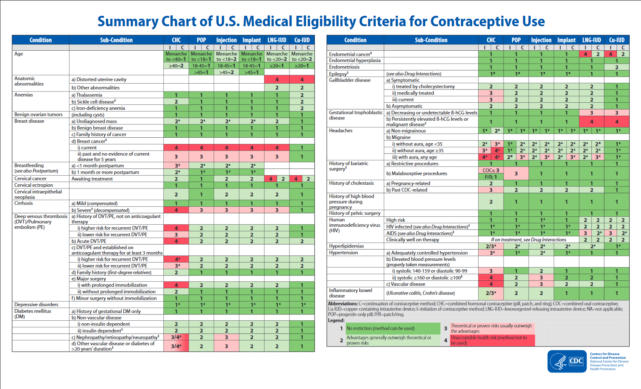
US MEC Summary Chart Page 1 https://www.cdc.gov/reproductivehealth/unintendedpregnancy/pdf/legal_summary-chart_english_final_tag508.pdf

Slide 8
Contraception Selection
Medical safety
Effectiveness
Patient goals – e.g., concerning menses, childbearing
Patient comfort and ability to use consistently, correctly
Patient’s lifestyle – predictability, control, privacy
Patient’s (family members’/friends’) experiences
Access/affordability; insurance coverage
* Clinician’s job is to give needed information and to rule out significant medical risk, not to make the contraceptive choices

Slide 9
Method Selection
Will vary depending on which of the selection factors are most important to the individual woman.
If wishes pregnancy in 6 months, then CHC or barriers, not LARC or DMPA
If needs privacy, IUD, implant, or DMPA
If needs privacy with menses, Paragard IUD
If chaotic lifestyle, then IUD or implant, not pills, possibly not barriers
If highly effective most important, IUD/IUS or implant, or sterilization if child-bearing not desired

Slide 10
Method Selection Chart
Patient Preference | CHC | DMPA | Hormonal IUD | Nonhormonal IUD | Implant | Barriers
Pregnant in 6 months | + | _ | _ | _ | _ | +
Privacy | _ | + | + | + | + | _
Privacy + menses | _ | _ | _ | + | _ | _
Chaotic life | _ | + | + | + | + | _
Highest efficacy | _ | + | + | + | + | _

Slide 11
Pill Selection
* WHO/FDA: use “lowest dose pill to decrease potential side effects”
* However, 20 mcg pills (with 7 days placebo) have higher BTB (break-through bleeding) rates
One familiar to patient and successful in past
One close to a pill previously used successfully
Monophasic 30 - 35 mcg estrogen in 28 day formulation
Limit choices

Slide 12
Common Scenario
A 22-year-old Hispanic female smoker without health problems wants to restart LoEstrin 1/20 which she has taken successfully in the past.

Slide 13
Side Effects
Up to 80% of women who stop COCs d0 so because of side effects
Double-blind, placebo-controlled studies: “no difference in the incidence of any of the major side effects in COC users compared with placebo pill users…”
Redmond G, et al. Contraception. 1999;60:81-5. as quoted in Contraceptive Technology, Hatcher et al., 20th edition, p. 311

Slide 14
Hormones and Associated Side Effects Contraceptive Technology, p. 312
Estrogen-related | Progestin-related | Androgen-related
Breast tenderness | Breast tenderness | Hirsuitism
Nausea | Nausea | Acne
Headache | Constipation, bloating
Weight gain in breasts, hips, thighs | Cyclic weight gain | Slow, steady weight gain
Increased HDL, triglycerides |  | Increased LDL

Slide 15
Management of Common Side Effects Contraceptive Technology, pp. 311-318
Symptom | Frequency | Behavior change | Rx change
Bleeding | Most common | Care with spacing of pills Patience and reassurance | Depends on timing in cycle Change method
Mastalgia | ~30% | Patience and reassurance Supportive bra | Decrease E Decrease P Drosperinone pill Ring
Nausea/vomiting | Relatively uncommon | Patience and reassurance Take with meals, at bedtime | Decrease E Try P-only method Use backup until resolved for one week

Slide 16
Abnormal Bleeding Contraceptive Technology, pp. 311-314
Symptom | Possible Actions
Absent or too light menses | Increase E Triphasic with lower P early
Unscheduled bleeding/spotting
during active pills | Increase P Triphasic with higher P at end of cycle
after menses | Increase E early in cycle Decrease P early in cycle
midcycle | Try triphasic with increased E and P in middle of cycle

Slide 17
Progestin Generations
First:
norethynodrel, norethindrone, norethindrone acetate, ethynodiol diacetate
Enovid, OrthoNovum 1/80, Micronor
increased BTB as dosages were decreased because of shorter half-life
Second:
levonorgestrel, norgestrel - more potent, longer half-life to solve bleeding problems
Seasonale, Seasonique, LoOvral
more androgenic so acne, oily skin, facial hair, adverse lipids
Contraceptive Technology, 20th edition, pp. 252-254.

Slide 18
Progestin Generations (continued)
Third:
desogestrel, norgestimate, gestodene (not in US)
Cyclessa, OrthoTricyclen
reduced androgenic effects allowed fuller estrogen impact – concern re VTE risk
Fourth:
drospirenone
Yaz
helpful for acne and premenstrual dysphoric disorder
Contraceptive Technology, 20th edition, pp. 252-254.

Slide 19
Pharmacologic Profile of Common Progestins (adapted from Contraceptive Technology, 20th Ed., p. 255)
Progestin | Progesto-genic | Anti-androgenic | Anti-mineralocorticoid | Androgenic | Half-life (hrs)
norethin-drone | + | - | - | (+) | 5-13
levonor-gestrel | + | - | - | (+) | 10
desogestrel | + | - | - | (+) | 12-24
drospire-none | + | + | + | - | 31-33
Key: + = distinct effect
(+) = negligible effect
- = no effect

Slide 20
Side Effect Resources
UNM Pager 505-380-0227
Contraceptive Technology, Hatcher et al.
Managing Contraception, Hatcher et al.
Managing Contraceptive Patients, R. Dickey
Wdxcyber.com/ncontr13.html
Wdxcyber.com/ncontr132.html
Fainamd.com/resources/Which+OCP+is+Best

Slide 21
Scenario 1
A 26 y.o. female who has been using combined oral contraceptives (COC) for one year calls you to ask whether it is safe to start taking sertraline for depression.
What should she do?
Notes:
For the last scenario, we have a 26 year old woman who is a long time user of combined oral contraceptives. She calls wanting to know whether she can start taking sertraline for depression, and whether it might make her birth control less effective.

Slide 22
Psychotropic drugs
Notes:
The 2016 MEC includes new drug interaction recommendations for selected serotonin reuptake inhibitors and St. John’s wort.
Based on currently available evidence, a systematic review found no evidence for a drug interaction between SSRIs and hormonal contraceptives. There was no evidence for reduced effect of the contraceptive, the SSRI, or for increased side effects from either drug. Therefore, all methods are category 1 with SSRIs.
A systematic review of St. John’s wort and hormonal contraception found that St John’s wort affected breakthrough bleeding, predictors of ovulation, and pharmacokinetics of estrogen and progestins. Though no studies looked directly at pregnancy outcomes, these findings suggest that St. John’s wort may have the potential to reduce the effectiveness of hormonal contraceptives. Therefore, St. John’s wort is a category 2 for oral contraceptive pills and progestin implants.
22

Slide 23
Scenario 1 Answer
26 y.o. female who has been using combined oral contraceptives for one year calls you to ask whether it is safe to start taking sertraline for depression.
What should she do?
She can start taking the sertraline and continue her COCs, if she still desires this method of contraception. There is no evidence for increased adverse events or decreased effectiveness for either drug when taken in combination.
Notes:
Returning to this patient, she can start taking the sertraline with her oral contraceptives without concern for decreased contraceptive effectiveness.

Slide 24
Scenario 2
A 30 year old female has a history of migraine headaches with light sensitivity. She does not experience any visual warning signs for a coming headache. She is interested in starting contraception. What methods are safe for her to consider?
A. Combined hormonal methods (pill, patch, ring)
B. Progestin implant
Intrauterine device
Any of the above
Notes:
Next we have a 30 year old female with a history of migraine headaches with light sensitivity. She does not experience any visual warning signs for a coming headache. She is interested in starting contraception. What methods are safe for her to consider?
24

Slide 25
Headache Evaluation Details
Vision changes – scotomata, flashing lights, loss of vision
Dizziness
Nausea and vomiting
Medications for migraine

Slide 26
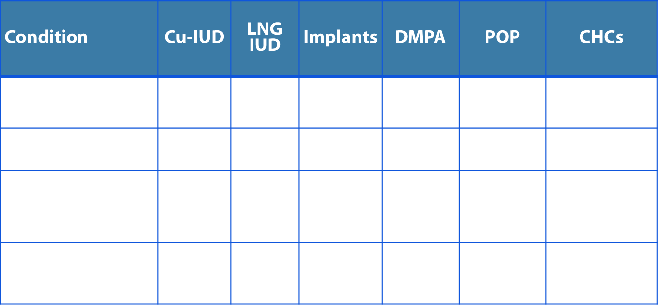
Headaches
* These recommendations rely upon accurate diagnosis of headache as migraine with or without aura. They are intended for women without other risk factors for stroke. Consult full guidance for additional clarification.
Notes:
Recommendations for headache rely on proper classification of headache, particularly with regard to auras. This is important because migraine with aura is associated with an increased risk of stroke while migraine without aura is generally not. According to the International Headache Society Classification System, menstrual associated migraines are considered migraine without aura.
These recommendations also assume women have no other risk factors for stroke (HTN, smoking)
There is theoretical concern that, among women with migraine with aura, use of CHCs would further increase the risk of stroke which is why CHCs are category 4 for those women.
Overall, women with migraine can use any method of contraception, with the exception of CHCs for women with aura.
26

Slide 27
Scenario 2 Answers
A 30 year old female has a history of migraine headaches with light sensitivity. She does not experience any visual warning signs for a coming headache. She is interested in starting contraception. What methods are safe for her to consider?
Answer:
A. Combined hormonal methods (pill, patch, ring)
B. Progestin implant
C. Intrauterine device
D. Any of the above
Any of the above, so long as she does
not have other risk factors for stroke.
(If so, progestin-only methods and IUDs are safe
or generally safe to use.)

Slide 28
Scenario 3
38 year old (GP) female with diabetes has been using condoms for contraception and is looking for a more effective method. What methods are safe for her to use?
A. IUD (copper or levonorgestrel)
B. Progestin-only methods (pill, injectable, implant)
C. Combined hormonal methods (pill, patch, ring)
D. Any of the above
Notes:
Next we have a 38 year old gravida 2 para 2 female with diabetes who has been using condoms for contraception and is looking for a more effective method. What methods are safe for her to use?
A. IUD (copper or levonorgestrel)
B. Progestin-only methods (pill, injectable, implant)
C. Combined hormonal methods (pill, patch, ring)

Slide 29
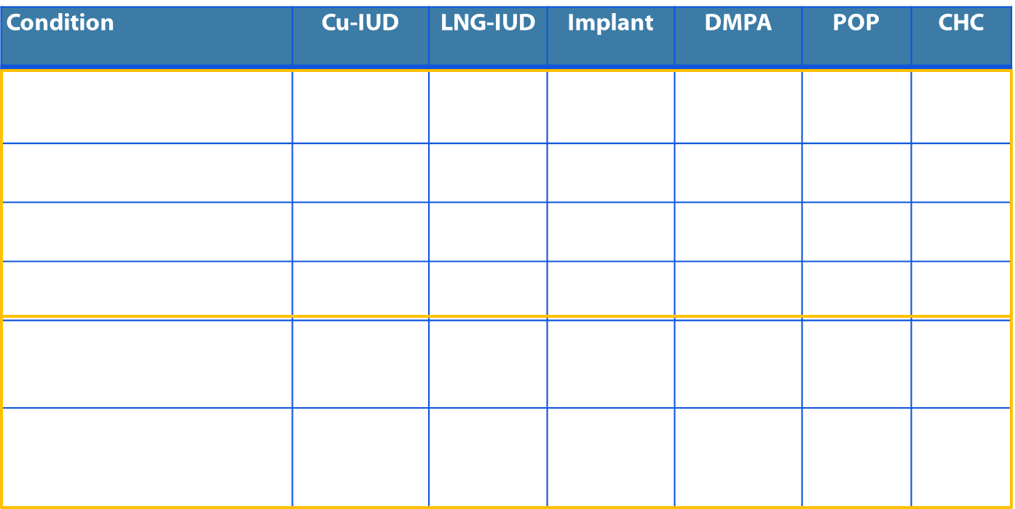
Diabetes
§ This condition is associated with increased risk for adverse health events as a result of pregnancy
† This category should be assessed according to the severity of the condition
Notes:
Recommendations for diabetes depend on the subgroup of diabetes, which have different risks.
For women with a history of gestational diabetes or with nonvascular diabetes, recommendations are based on several studies, and all methods are classified as category 1 or 2.
(click click) By contrast, in the lower portion of the screen we see recommendations for the more severe subgroups of diabetes, including diabetes with nephropathy/retinopathy/neuropathy or other vascular disease or diabetes of >20 years duration.
In review of the literature, no direct evidence was found for contraceptive safety for these more severe forms of diabetes. Most of the decisions for recommendations in these situations were based on:
Extrapolations from studies that primarily included healthy women
Theoretical considerations about risks and benefits
Expert opinion
CDC final recommendations for complicated diabetes subgroups have category 3 recommendations for DMPA and a mixed recommendation of 3/4 for combined hormonal methods according to the severity of the complicated diabetes.
Importantly, these more severe forms of diabetes are conditions that expose a woman to increased risk in pregnancy, which is noted in the MEC by a superscript notation. Effectiveness should be emphasized when discussing method options for conditions with this notation.

Slide 30
Scenario 3 Answer
38 year old (GP) female with diabetes has been using condoms for contraception and is looking for a more effective method. You now know that she is non-insulin dependent and has no vascular disease. What methods are safe for her to use?
A. IUD (copper or levonorgestrel)
B. Progestin-only methods (pill, injectable, implant)
C. Combined hormonal methods (pill, patch, ring)
D. Any of the above

Slide 31
Scenario 4
A 34 year old healthy woman whose blood pressure measurement is 140/90 comes to the pharmacy requesting HC
Choose a method for her.

Slide 32
Hypertension
CONDITION | COC/P/R | POP | DMPA | IMPLANON | IUDS
 |  |  |  |  | LNG-IUD | Cu-IUD
Adequately Controlled BP | 3 | 1 | 2 | 1 | 1 | 1
Elevated BP 1. Systolic 140–159 mm Hg or diastolic 90–99 mm Hg | 3 | 1 | 2 | 1 | 1 | 1
2. Systolic ≥160 mm Hg or diastolic ≥100 mm Hg | 4 | 2 | 3 | 2 | 2 | 1
3. History of high blood pressure during pregnancy (current BP is normal) | 2 | 1 | 1 | 1 | 1 | 1
Notes:
For all categories of hypertension, classifications are based on the assumption that no other risk factors exist for cardiovascular disease. When multiple risk factors do exist, risk for cardiovascular disease might increase substantially. A single reading of blood pressure level is not sufficient to classify a woman as hypertensive.
Evidence: Among women with hypertension, COC users were at higher risk than nonusers for stroke, acute myocardial infarction, and peripheral arterial disease. Discontinuation of COCs in women with hypertension might improve blood pressure control.
Evidence: Women with a history of high blood pressure in pregnancy, who also used COCs, had a higher risk for myocardial infarction and VTE than did COC users who did not have a history of high blood pressure during pregnancy. The absolute risks for acute myocardial infarction and VTE in this population remained small (153,172,184–186,188–193).
Evidence: Limited evidence suggests that among women with hypertension, those who used POPs or progestin-only injectables had a small increased risk for cardiovascular events than did women who did not use these methods
Theoretical risks on the use of LNG-IUD on lipids.

Slide 33
Scenario 4 Answer
First step is to repeat the BP after patient has been in the pharmacy for 5-10 minutes.
If BP remains elevated, POP and DMPA are the safest options for pharmacist prescribing; refer for implant or IUD at a later date if patient desires

Slide 34
Scenario 5
A 33-year-old 320 lb. white woman wishes more effective birth control. She has become pregnant on the diaphragm and the pill and has three children. What would you recommend she use?

Slide 35
Considerations in Overweight/Obese Patient
Inadequate data
VTE risk
Further weight gain concerns
Possible decreased effectiveness concerns

Slide 36
Overweight/Obese Patient
Method | Effectiveness | VTE Risk | Weight Gain
COC | unchanged | increased | none
Ring | unchanged | same as COC | none
Patch | probably decreased | increased (greater than COC) | none
LNG EC | decreased | n/a | n/a
DMPA | unchanged | neutral | ?????
IUD, implant | unchanged, high | neutral | none

Slide 37
Teens: Hormonal Contraception and Weight Gain
Beksinsha et al., Contraception 2010 Jan;81(1):30-4.
Method | N | Weight gain
nonusers | 144 | 2.8 kg
COC | 116 | 2.3 kg
DMPA | 115 | 6.2 kg

Slide 38
Obesity
Condition | Sub-Condition | CU-IUD | LNG-IUD | Implant | DMPA | POP | CHC
Obesity
 | a) Body mass index (BMI) ≥30 kg/m2 | 1 | 1 | 1 | 1 | 1 | 2
 | b) Menarche to <18 years and BMI ≥ 30 kg/m2 | 1 | 1 | 1 | 2 | 1 | 2
US MEC Categories For Use
Category 1
Use!
Category 3
Don’t use!
Category 2
Use!
Category 4
Don’t use!

Slide 39
Scenario 5 Answer
According to current information, she can use:
CHC
DMPA
Implant or IUD
Sterilization

Slide 40
Basic Principles
Be sure all staff are supportive and informed so will not be sabotaging the service.
Plan logistics – e.g., tech can give fact sheets to patient
Have on hand preprinted referral information
local providers and clinics
preprinted fact sheets
referrals to websites – for efficient use of pharmacy staff time
Be comfortable with setting limits, expanding skills with experience and asking for help.

Slide 41
Approach to the Patient
Be warm and open
Use simple language
Honor confidentiality
Give year’s supply if possible
Give EC, “just in case”
Acknowledge possibility of side effects; encourage call/return if problems or questions
Ask for advice
Listen to and accept each patient’s reality

Slide 42
Counseling/Education
Confidentiality expectations – assume more important than with other prescriptions
Counseling and education
Match patient needs
Choose messages, include possibility of side effects
Consent form and process
Use standardized form
Encourage questions: “What questions do you have?”
Include information concerning risks and benefits
Document education given on the consent form

Slide 43
Required Board of Pharmacy Documents
Patient informed consent form
Completed medical history/screening questionnaire
Pharmacist documentation of patient education provided
Prescription order
Provider notification documentation (if applicable)
Provider referral letter (if applicable)
US MEC guidelines

Slide 44
Legal Considerations
Sexual activity (intercourse) in a person younger than 13 must be reported to DHHS/CYFD.
file:///F:/EC/dutytoreport.pdf
Any age person can be given contraception or EC without parental consent. Pharmacists must, of course, honor confidentiality
If a patient using the insurance of parents or guardians wishes them not to know of contraceptive use, she/he may request the insurance company not to send an EOB (Explanation of Benefits). Although most companies will grant that request, there is no guarantee of confidentiality. Patients must be so informed.
An additional risk to confidentiality is on the occasions when a parent requests prescription information for filing taxes.

Slide 45
Hormonal Contraception Products for Pharmacist Prescribing
Oral contraceptive pills, including CHC, POP and EC
Transdermal patch
Xulane®
Vaginal Ring
NuvaRing®
Depomedroxyprogesterone acetate injection (DMPA)
Depo-Provera®
Other FDA approved hormonal contraception products, with the exclusion of implants, intrauterine devices, or devices requiring surgical training and implantation

Slide 46
Non-Hormonal Contraception Products for Pharmacist Prescribing
Other FDA-approved non-hormonal contraceptive methods (includes over-the-counter and prescription medications)
Barrier methods
Condoms, male and female
Spermicidal foams, films
Other barrier methods as available

Slide 47
Products Excluded for Pharmacist Prescribing
Diaphragm and cervical cap
LARC – IUDs and implant
Sterilization

Slide 48
New Mexico Board of Pharmacy Protocol Highlights
Service may be offered to all patients (non gender specific)
Prescriptions may be written with allowable refills or refills for up to one year
Must meet US MEC criteria for eligibility
Ineligible patients, based on the screening questionnaire responses, or patients seeking methods not on the pharmacy protocol formulary, must be referred to a health care provider/local clinic
Certified pharmacists for prescribing must complete 2 hours of live CE every 2 years.
Failure to complete 2 hours of live CE will require recertification prior to further prescribing.

Slide 49
Suggested CE Opportunities
The New Mexico Pharmacists Association offers at least 1 hour of live CE twice per year at their Annual Convention Meetings (January and June).
Reproductive Health ECHO offers clinics for CEs where healthcare providers can present difficult patient cases in practice (schedule/link attached)
https://echo.unm.edu/nm-teleecho-clinics/reproductive-health/

Slide 50
Required Board of Pharmacy Patient Education
The pharmacist will provide all patients interested in this service with appropriate patient education as recognized by
World Health Organization, Centers for Disease Control, Office of Population Affairs, American Academy of Family Physicians, American College of Obstetricians and Gynecologists, and the Association of Reproductive Health Professionals
Patients wishing to obtain hormonal contraception methods not available, as detailed in the formulary, must be referred to a primary provider or local clinic
Patients will also be given information regarding their health care needs and referrals to local providers, including well woman care referrals
Contraception failures or symptoms of pregnancy or contraception failure will be given a referral to a primary provider or local clinic

Slide 51
Suggested Workflow
1) Patient seeks contraception
2) Patient education/counseling, method selection, screening to determine eligibility
3) Informed consent completed
4) Prescription written, meds dispensed
5) Fees collected
6) Follow up if needed

Slide 52
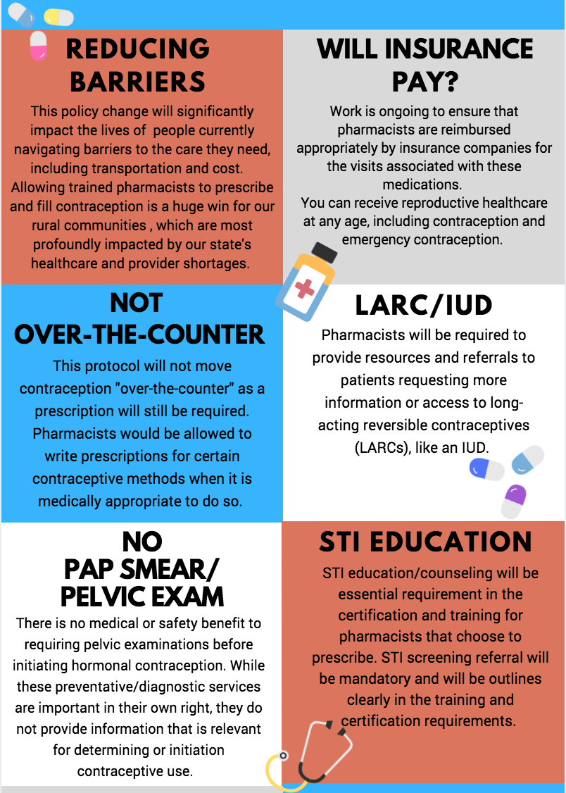
Sources of Assistance
UNM Family Planning pager (505-380-0227)
Association of Reproductive Health Professionals (ARHP) patient fact sheets
Contraceptive Technology, Hatcher et al.
Managing Contraceptive Patients, Hatcher et al.
Bedsider.org patient information
Bedsider.org reminder systems
Marketing assistance
ngermain@youngwomenunited.org

Slide 53
Summary
For the majority of women, use of some form of hormonal contraception is safer than being pregnant.
Improved access to hormonal contraception has important public health and personal benefits.
Pharmacists are more accessible than traditional health care providers and are capable of prescribing hormonal contraception to most patients using the US MEC after completion of the NMPhA training.
Access to immediate consultation with the University of New Mexico Family Planning fellows will allow pharmacists to efficiently manage patients with unusual issues and to comfortably build skills in expanding access to contraceptive products.

Slide 54
References
1. The New Mexico Pregnancy Risk Assessment Monitoring System (NM PRAMS). New Mexico Department of Health. 2012. https://nmhealth.org/about/phd/fhb/prams/. .
2. Department of Reproductive Health, WHO. United States Medical Eligibility Criteria for Contraceptive Use (US MEC), Fourth Edition. 2010. http://www.cdc.gov/reproductivehealth/unintendedpregnancy/usmec.htm.
3. Gardner SG, Miller L, Downing DF, Le S, Blough D, Shotorbani S. Pharmacist prescribing of hormonal contraceptives: Results of the Direct Access Study. JAPhA. 2008; 48(2):212-221.
4. Frost JJ, Singh S, Finer LB. U.S women’s one-year contraceptive use patterns, 2004. Perspect. Sex Reprod. Health. 2007; 39:48-55.
5. Wells ES, Hutchings J, Gardner JS, et al. Using Pharmacies in Washington State To Expand Access to Emergency Contraception. Family Plan Perspect. November/December 1998 :( 30).
6. Gilchrist, A. How Oregon Pharmacists are Prescribing Birth Control. Pharm Times. 2016.
7. Rural Health Information Hub. 2016. https://www.ruralhealthinfo.org/states/new-mexico.
8. Finer LB, Zolna MR. Declines in unintended pregnancy in the US, 2008-2011. N Engl J Med 2016;374:843-52.
American Society for Reproductive Medicine. Combined hormonal contraception and the risk of venous thromboembolism: a guideline. 2017;107:43-51

