Slide 1
Immunization Update; additions, changes, and rearranges
Amy Bachyrycz, PharmD

Slide 2
Disclosure
Amy Bachyrycz – nothing to disclose
Special thanks to Dr. Melissa Martinez and Dr. Melissa Mason for allowing use of their analog and data content

Slide 3
Analogs

Slide 4
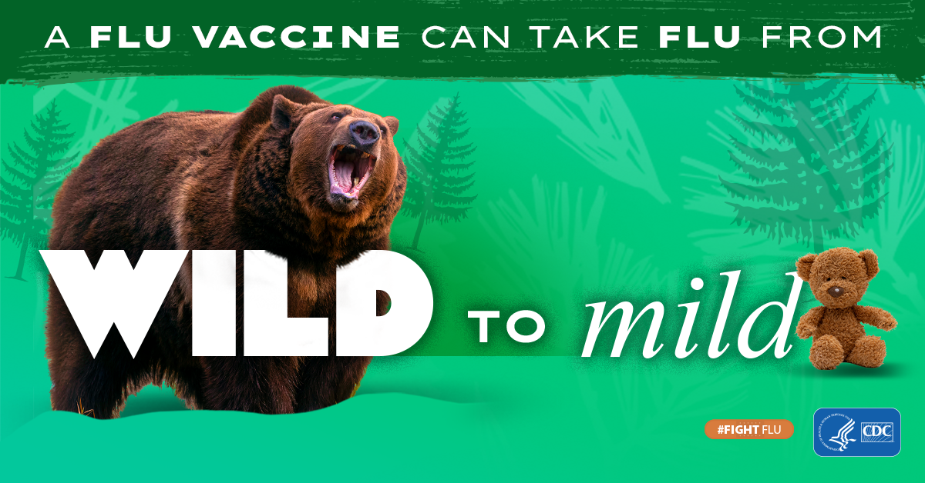

Slide 5
Vaccines are like seatbelts, there just in case

Slide 7
Do I need a COVID vaccine if I am careful in public?

Slide 8
Why do vaccines make me feel sick?
The body is training for a big match against the real virus
Just like prize fighters train and spar just to get ready for prize fight.

Slide 9
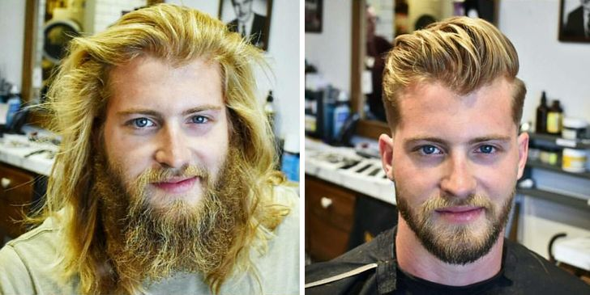
Why do we need to get vaccinated every year?
Think of it as if the virus gets a new hair style each year. The body does not recognize the virus unless it has been exposed to the current hair style.

Slide 10
Vaccines are like updating your security system

Slide 11
Natural immunity is better?
Both infections and vaccines do they same thing
They warn the body that a virus could come and cause illness, so the body builds up defenses.

Slide 12
mRNA Vaccines are like a recipe-card telling cells how to make one small piece of the virus (like just the frosting)
This small piece of virus is seen by our body make antibodies to fight the infection.
Recipe
Amino Acids
AAAA UUUU
GGGGG
Place amino acids in ribosomes and create proteins

Slide 13
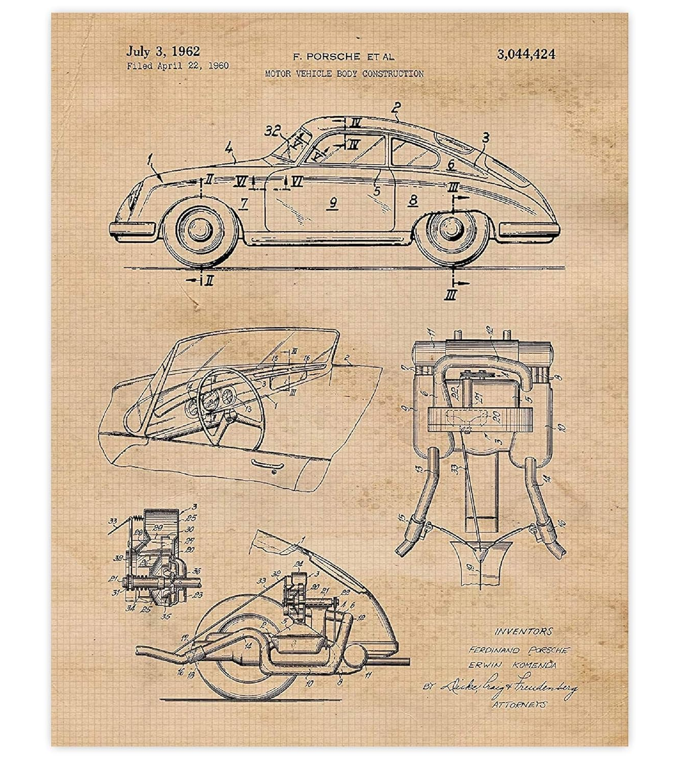
mRNA Vaccines are like blue-prints for a car part
They tell the cells to make one part of the virus(car) like a window.
When the body sees the window, it thinks the virus (car) is invading

Slide 14
Objectives
Discuss and define new ACIP recommendations for existing vaccines.
Identify interactive case-based scenarios to best utilize the ACIP schedule for the most up to date vaccine recommendations.
Identify patients that may benefit from updated ACIP vaccine recommendations.
Review any laws or legal implications that may impact vaccinations state and/or federally.

Slide 15
Jain NEJM 2015

Slide 16
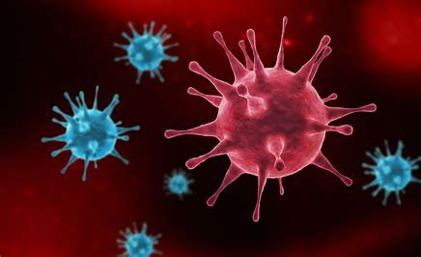
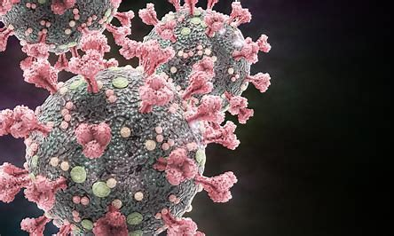
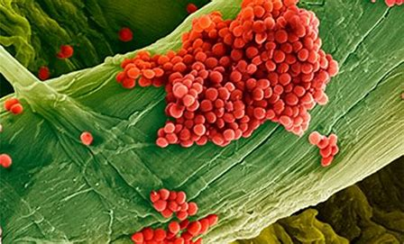
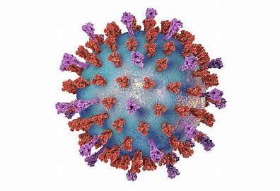
Guess the Virus?
1
2
5
3
4

Slide 17
Quick fingers challenge 1
1) CHAT THE FOLLOWING (no misspellings, correct punctuation):
Remember, if your son gets his first HPV vaccine today and before he is 15 years of age, he will only need two HPV vaccines rather than three.

Slide 18
Influenza
Vaccinate Everyone age 6 months and up

Slide 19
Annual Estimated Burden of Influenza in the US
https://www.cdc.gov/flu/about/burden/index.html

Slide 21
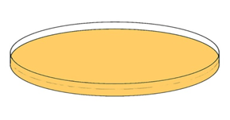
65 + CDC Recommends higher dose or adjuvanted vaccines
Standard dose
High dose
60 µ
Cell culture
45 µ
15 µ
Recombinant
RNA
Adjuvanted - Squalene
Groshskopf MMWR 2023

Slide 22
Adults aged ≥65 years preference
High-dose | Fluzone | Inactivated influenza vaccine | HD4IV
Recombinant | Flublock | Influenza vaccine | RIV4
Adjuvanted | Fluad | Inactivated Influenza vaccine | allV4
No preference for which of the three above.
If none of these three vaccines are available, then any other age-appropriate influenza vaccine should be used.
Groshskopf MMWR 2023

Slide 23
Influenza vaccine update
Persons with egg allergy should receive influenza vaccine unless a contraindication exists.
Any influenza vaccine (egg based or non-egg based) is acceptable.
Life-threatening reactions to vaccines can rarely occur with any vaccine.
All vaccines should be administered in settings in which personnel and equipment needed for rapid recognition and treatment of acute hypersensitivity reactions are available.
ACIP June 2023

Slide 24
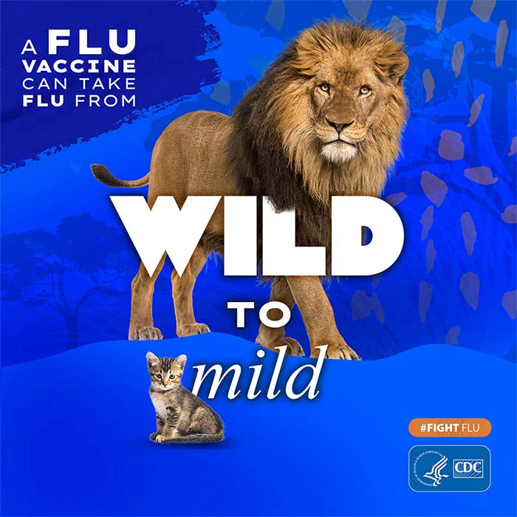
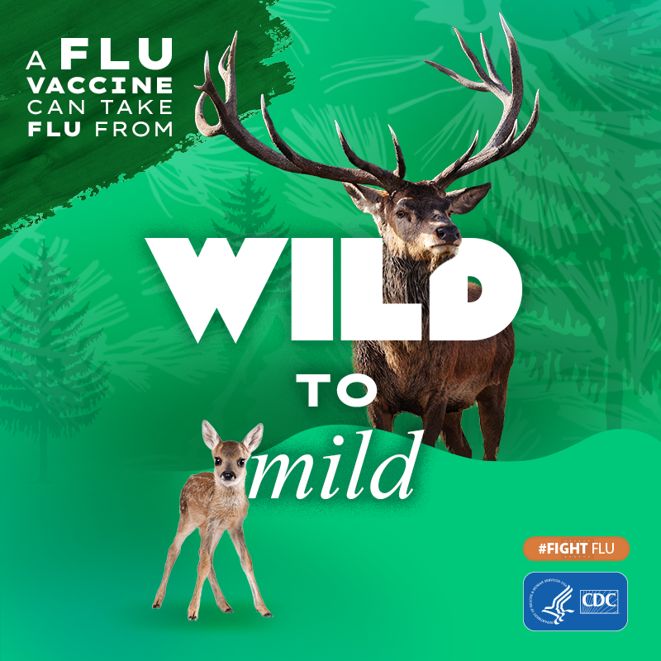
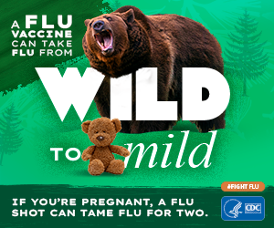
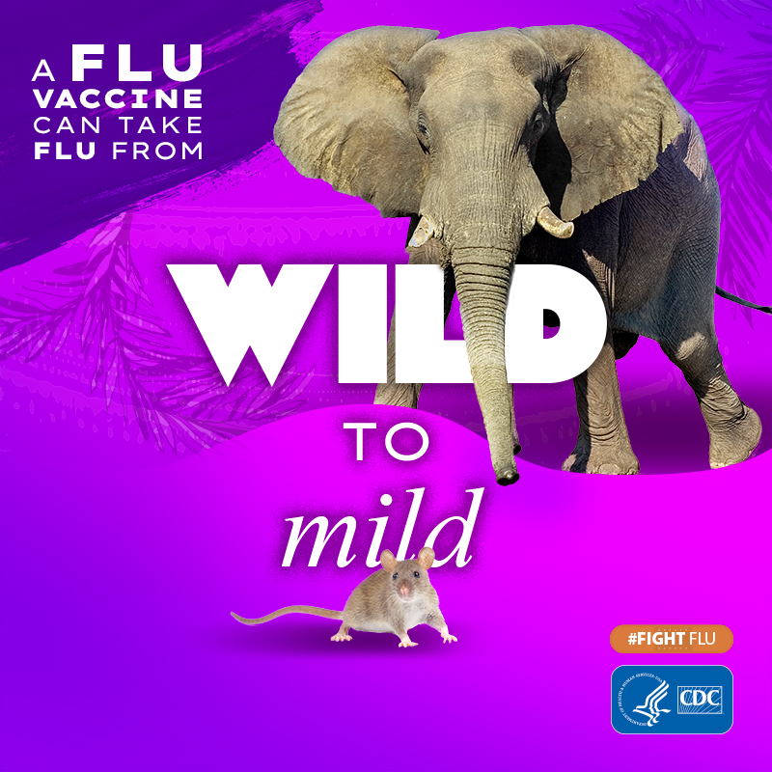
Influenza CDC 2023 Report Highlights
1) Health officials should note that in Northern Hemisphere jurisdictions prepare for a potentially earlier influenza season than normal peak of April and May and highlight the benefits of vaccination.
2) Influenza B/Yamagata lineage has not circulated globally since 2020, and ongoing monitoring will be needed to determine if B/Yamagata antigens should remain in future influenza vaccine formulations.
3) Vaccine manufacturing may return back to trivalent based on these findings, but this remains unknown.
-Please vote on your favorite slogan/poster for this years campaign!
https://www.cdc.gov/mmwr/volumes/72/wr/mm7237e1.htm#T1_down
https://www.cdc.gov/flu/resource-center/toolkit/index.htm

Slide 25
2024 ACIP childhood schedule

Slide 26
2024 ACIP adult schedule

Slide 27
Quick fingers challenge 2
1) CHAT THE FOLLOWING:
Remember, if you are 65 years of age or older, you may benefit more from the enhanced influenza vaccines that we have available which include Fluzone High Dose, Flublock, or Fluad.

Slide 28
RSV
Respiratory
Syncytial
Virus

Slide 29
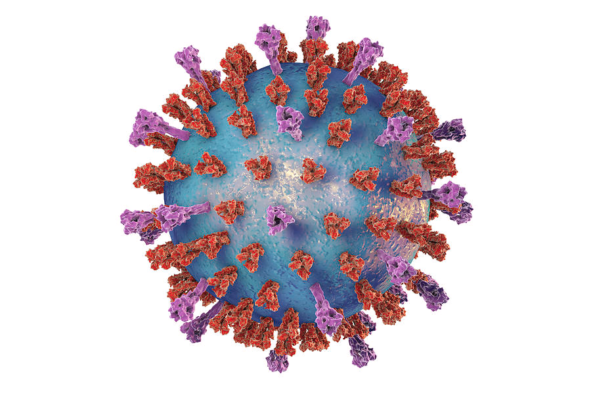
Respiratory syncytial virus
Orthornavirae
RNA virus
A and B strains
Antigens highly variable
Some natural immunity to RSV
But reinfection throughout life
Reinfection can occur in same season
Maruz Lancet ID 2023

Slide 30
RSV Burden of disease
https://www.rsvandme.com/?cc=ps_1HWG8E4SSP1479346&mcm=330002&gclid=a24ea3efeead177b203ac7a5e824424c&gclsrc=3p.ds

Slide 31
RSV Vaccine – Subunit vaccine
Pfizer RSVpreF ABRYSVO®
GSK RSVPreF3 AREXVY®

Slide 32
Efficacy of 1 dose of GSK respiratory syncytial virus RSVpreF3 vaccine against respiratory syncytial virus–associated disease among adults aged ≥60 years — multiple countries, 2021–2023
Efficacy evaluation period | Vaccine efficacy against outcome
 | RSV-associated LRTD | RSV-associated medically attended LRTD
Season 1 | 82.6 (57.9–94.1) | 87.5 (58.9–97.6)
Season 2 | 56.1 (28.2–74.4) | —
Combined seasons 1 and 2 (interim) | 74.5 (60.0–84.5) | 77.5 (57.9–89.0)
Efficacy of 1 dose of Pfizer respiratory syncytial virus RSVpreF vaccine against respiratory syncytial virus–associated disease among adults aged ≥60 years — multiple countries, 2021–2023
Efficacy evaluation period | Vaccine efficacy against outcome, % (95% CI)*
 | RSV-associated LRTD† | RSV-associated medically attended LRTD§
Season 1 | 88.9 (53.6–98.7) | 84.6 (32.0–98.3)
Season 2 (interim) | 78.6 (23.2–96.1) | —
Combined seasons 1 and 2 (interim) | 84.4 (59.6–95.2) | 81.0 (43.5–95.2)
MMWR July 2023
LRTD = lower respiratory tract disease

Slide 33
Side Effects
 | RSVpreF | RSVpreF3
Pain | 10.5% | 60%
Redness | 2.7% | 5.5%
Swelling | 2.4% | 7.5%
 | RSVPreF | RSVPreF3
Fever | 1.4%(>38.9°C <0.1%) | 2%(>39°C 0.1%)
Fatigue | 15.5% (Severe 0.3%) | 33% (Grade 3 1.7%)
Headache | 12.8% (Severe 0.1%) | 27.2%(Grade 3 1.3%)
Muscle aches | 10.1% (Severe 0.2%) | 28.9%(Grade 3 1.4%)
Joint pain | 7.5% (Severe<0.1%) | 18.1%(Grade 3 1.3%)
Nausea | 3.4% | Not reported
Vomiting | 0.9% | Not reported
Diarrhea | %.9% | Not reported

Slide 34
Serious Adverse Events
RSVpreF Pfizer | RSVpreF3 GSK
20,255 participants 3 Neurologic Events Guillain-Barré Syndrome 7 days after vaccination Miller Fisher Syndrome reported 8 days after vaccination Undifferentiated motor-sensory axonal polyneuropathy–preexisting worsening | 17,922 participants 3 Neurologic Events Guillain-Barré Syndrome 9 days after vaccination Acute disseminated encephalomyelitis X2 7 and 22 days after vaccination (both also had Flu Shots) One dx changed to hypoglycemia and dementia
Background rate Guillain-Barré Syndrome 1.5-3 per 100,000
MMWR July 2023

Slide 35
Subunit Vaccines
Pfizer RSVpreF ABRYSVO®
Prefusion F proteins from A and B strains
Approved by FDA
Recommended by CDC as of 9/22/23
IM injection at 32 through 36 weeks gestational age of pregnancy .
https://www.fda.gov/news-events/press-announcements/fda-approves-first-vaccine-pregnant-individuals-prevent-rsv-infants#:~:text=Today%2C%20the%20U.S.%20Food%20and,through%206%20months%20of%20age.

Slide 36
Respiratory Synctial Virus

Slide 37
Respiratory Synctial Virus

Slide 38
Most likely to benefit
Lung disease (such as chronic obstructive pulmonary disease and asthma)
Cardiovascular diseases (such as congestive heart failure and coronary artery disease)
Moderate or severely immune compromised
Diabetes mellitus
Neurological or neuromuscular conditions
Kidney disorders
Liver disorders
Hematologic disorders
Other underlying conditions that a health care provider determines might increase the risk for severe respiratory disease
Frailty
Advanced age
Residence in a nursing home or other long-term care facility
Other underlying factors
MMWR July 2023

Slide 39
Quick fingers challenge 3
1) CHAT THE FOLLOWING ANSWER IN:
List three different conditions where the patient may benefit from the RSV vaccination?

Slide 40
Preterm Birth Risk
FDA
Data insufficient to establish or exclude a causal relationship between preterm birth and RSVPreF.
Avoid the potential risk of preterm birth with use of Abrysvo before 32 weeks of gestation, administer Abrysvo as indicated in pregnant individuals at 32 through 36 weeks gestational age.
https://www.fda.gov/news-events/press-announcements/fda-approves-first-vaccine-pregnant-individuals-prevent-rsv-infants#:~:text=Today%2C%20the%20U.S.%20Food%20and,through%206%20months%20of%20age.

Slide 41
Concerns with RSV PreF Vaccine in Pregnancy
Vaccine protection may wane more quickly
Some infants may not get full protection from maternal vaccination if they were born too soon after immunization, born prematurely or due to maternal disease
May interfere with the effectiveness of Tdap if given together
Both vaccine and nirsevimab are not needed

Slide 42
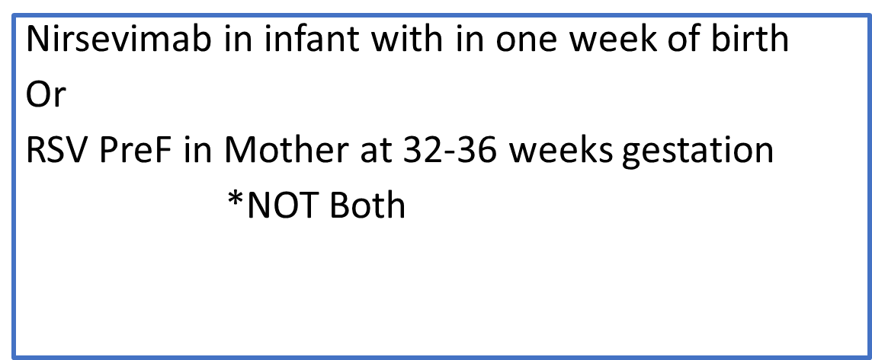
Considerations

Slide 43
Nirsevimab Efficacy
age <8 months/First RSV Season
RSV-associated LRTI
79.0% (95% CI = 68.5%–86.1%)
Nirsevimab 31/2,579 Placebo 80/1,293
RSV-associated LRTI with hospitalization
80.6% (95% CI = 62.3%–90.1%)
Nirsevimab 12/2,579 Placebo 33/1,293
RSV-associated LRTI with ICU admission
90.0% (95% CI = 16.4%–98.8%)
Nirsevimab 1/2,579 Placebo 6/1,293
No attributable deaths reported
MMWR Aug 2023

Slide 44
Nirsevimab Concerns
Can give with other vaccines
Cost
VFC coverage
How will immunization database know
Did mother get RSV vaccine
Reporting adverse events FAERS not VAERS
Excluded from Pharmacist prescribing protocol
ACIP August 2023

Slide 45
Pneumococcal
Everyone age 6 months and up

Slide 46
Annual Estimated Burden of Pneumococcal in the US
Pneumococcal pneumonia hospitalizes about 150,000 people in the US each year—killing about 5-7%, or 1 in 20 of those infected.
The death rate is even higher among adults age 65 years and older and people with certain medical conditions or other risk factors.
Pneumococcal meningitis and bacteremia killed approximately 3,250 people in the United States in 2019.
https://www.nfid.org/infectious-disease/pneumococcal/#:~:text=Pneumococcal%20pneumonia%20hospitalizes%20about%20150%2C000,conditions%20or%20other%20risk%20factors

Slide 47
Pneumococcal CDC 2023 report Highlights; Adults
ACIP recommendations specify the use of either PCV20 alone or PCV15 in series with PPSV23 for all adults aged ≥65 years and for adults aged 19–64 years with certain underlying medical conditions or other risk factors who have not received a PCV or whose vaccination history is unknown.
In addition, ACIP recommends use of either a single dose of PCV20 or ≥1 dose of PPSV23 for adults who have started their pneumococcal vaccine series with PCV13 but have not received all recommended PPSV23 doses.
Shared clinical decision-making is recommended regarding use of a supplemental PCV20 dose for adults aged ≥65 years who have completed their recommended vaccine series with both PCV13 and PPSV23.
Updated and new clinical guidance for implementation from CDC includes the recommendation for use of PCV15 or PCV20 for adults who have received PPSV23 but have not received any PCV dose.
The report also includes clinical guidance for adults who have received 7-valent PCV (PCV7) only and adults who are hematopoietic stem cell transplant recipients.

Slide 49
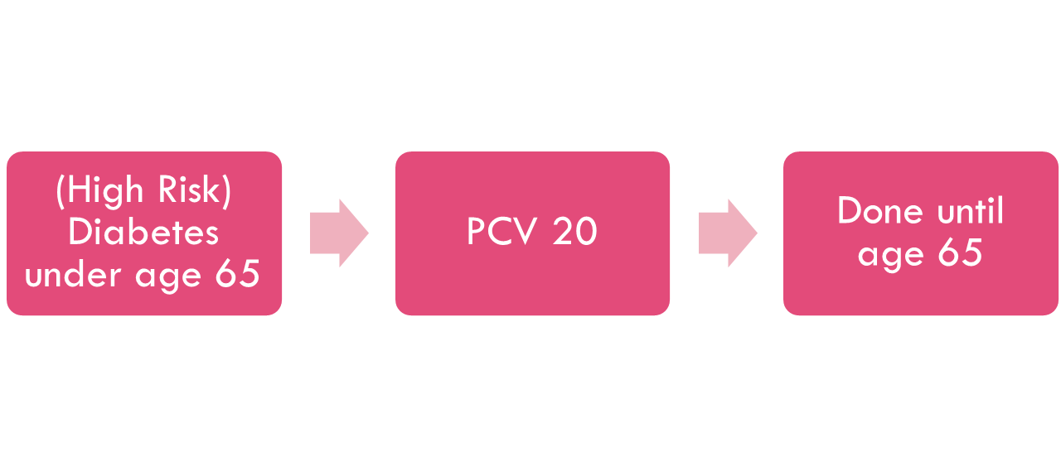
Adult-high risk
(High Risk) Chronic smoker under age 65
PCV 15 (1 yr) PPSV23
PPSV23 (5 yrs)
OR

Slide 50
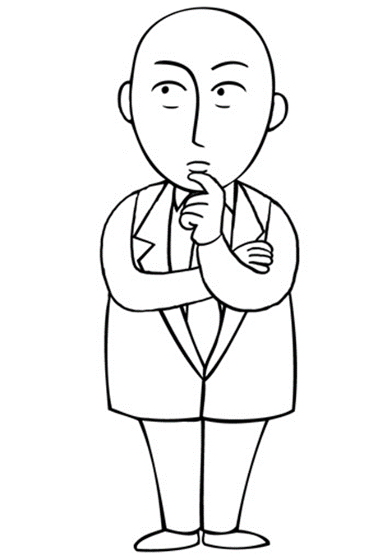
Adult case
If a 65 yr old patient comes in with PCV 13 x 10 years ago, what vaccine would you give today?
PCV20
65 yr old Pneumo vaccine naïve or vaccine hx unknown
PCV 15 (1 yr) PPSV23 OR
PCV 20
No further vaccine required Shared Decision Making Optional Later

Slide 51
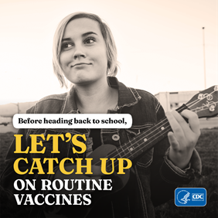
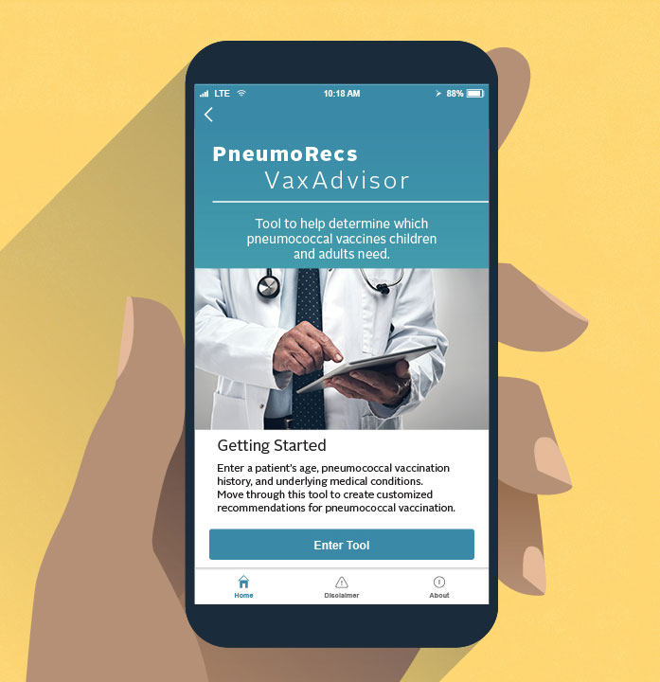
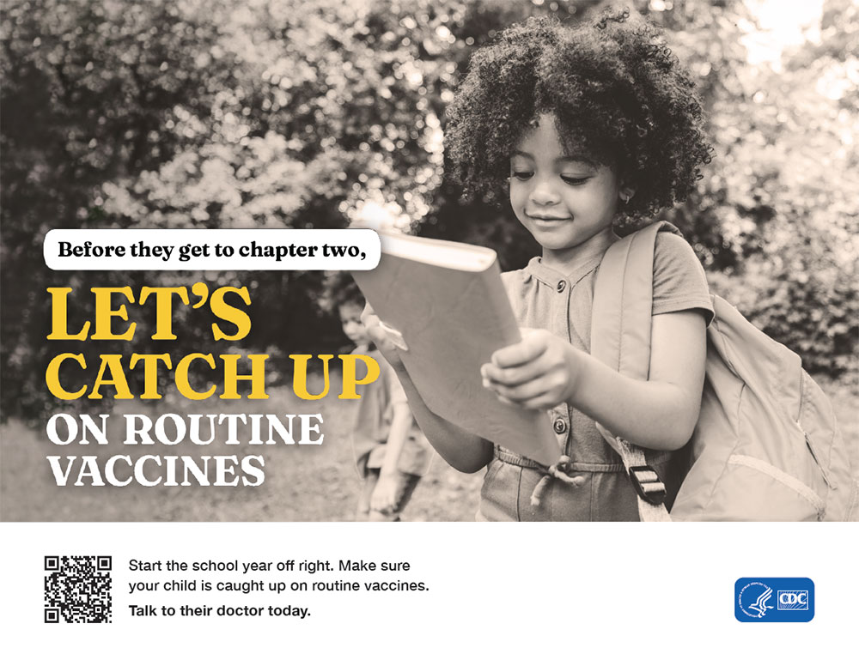
Pneumococcal campaign and cdc app
_______________________________________________________________________________
PneumoRecs App (CDC)
Pnuemo vaccines given based on:
Enter a patient’s age.
Note if the patient has specific underlying medical conditions.
Answer questions about the patient’s pneumococcal vaccination history.

Slide 52
Children 2-23 Months
PCV15 or PCV20
2 Months
4 Months
6 Months
12-18 Months
ACIP June 2023

Slide 53
Quick fingers challenge 4
1) CHAT THE FOLLOWING ANSWER IN:
TRUE OR FALSE, If you are 75 years of age or older and have already completed your pneumococcal series five years ago, you may not get a revaccination with Prevnar 20.

Slide 54
Mpox

Slide 56
Meningococcal

Slide 59
Vaccine work is never done…

Slide 60
COVID-19

Slide 61
COVID

Slide 62
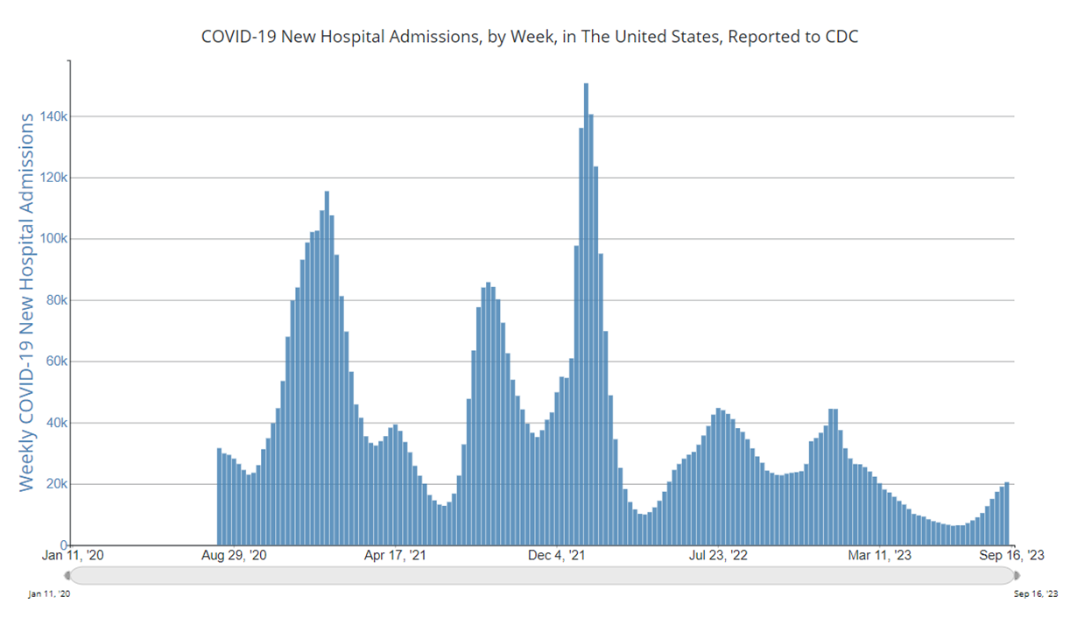
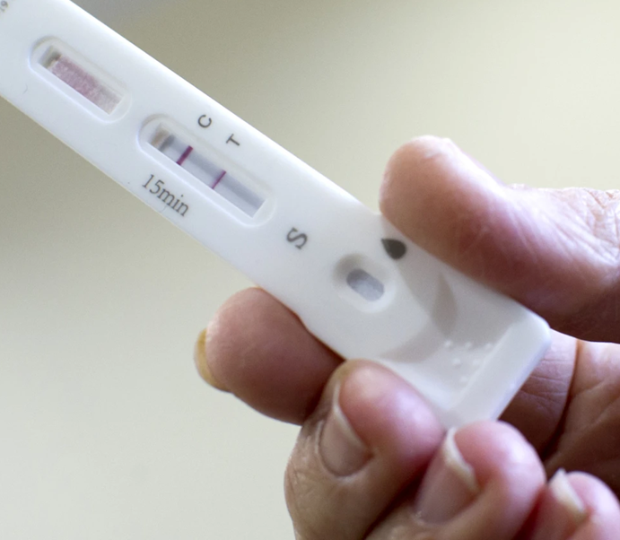
COVID-19 Still a problem

Slide 63
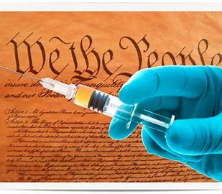
Legislation Affecting Vaccine Accessibility in the Last 30 Years
1) Vaccines For Children program (VFC) was passed in 1994. VFC ensures that children in low-income families can receive all recommended vaccines for only a small administration fee. More than 60 percent of the vaccines given to children are paid for by VFC.
2) Affordable Care Act (ACA) in 2010. The ACA required private insurance companies to make many preventive services, including vaccines, free to beneficiaries.
3) Inflation Reduction Act (IRA). The IRA received bipartisan support to address high prescription drug costs for seniors.

Slide 64
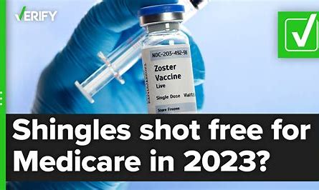
Inflation Reduction Act
The new law makes changes to Medicare Part D drug benefits, including putting a limit on out-of-pocket payments for insulin and making vital vaccines free.
Starting on Jan. 1, 2023, Medicare enrollees won’t have any out-of-pocket costs for CDC recommended vaccines for adults.
Medicare Part B, which applies to doctor visits, diagnostic tests and other outpatient services, already fully covers some vaccines, including flu shots, pneumonia vaccines, hepatitis B inoculations and now coronavirus vaccines (initial shots as well as boosters).
But other vaccines, most notably the more expensive vaccines, are covered under the Part D prescription drug plans without a co-pay. The new law eliminates co-pay or cost-sharing. (Projected to affect 4.1 million people)

Slide 65
Continuing Gaps in Vaccine Accessibility
One out of 10 adults on Medicare do not subscribe to a Part D plan, so they may still have to pay for many recommended vaccines.
Additionally, it is difficult for clinics and offices to contract with all Medicare Part D plans.
If there is no contract or they do not carry vaccines, the patient has to go to a pharmacy to be vaccinated.

Slide 66
Quick Fingers Challenge 5
It is January, A just-turned 65 year old patient comes to the pharmacy for “their shots” and with a new diagnosis of diabetes, what vaccines would you recommend for them? They have no records of previous vaccinations EVER!
Please chat the correct answer in:

Slide 67
Quick Fingers Challenge 5 answer
It is January, A just-turned 65 year old patient comes to the pharmacy for vaccines and with a new diagnosis of diabetes, what vaccines would you recommend for them? They have no records of previous vaccinations EVER!
Correct: Influenza, covid, Pneumococcal, RSV, Tdap, Shingrix
Provisionally correct: Hep a, Hep b, MMR, Meningococcal
Incorrect: Mpox, varicella, DTAP, meningococcal B, HIB

Slide 68
Summary
Keeping track of vaccine updates and updated notes are important for providers.
Expanded ACIP schedule changes have been implemented in new guidelines and schedules.
There will be many more changes and updates to vaccines in coming years.

Slide 69
References
Grohskopf LA, Blanton LH, Ferdinands JM, Chung JR, Broder KR, Talbot HK. Prevention and Control of Seasonal Influenza with Vaccines: Recommendations of the Advisory Committee on Immunization Practices — United States, 2023–24 Influenza Season. MMWR Recomm Rep 2023;72(No. RR-2):1–25. DOI: http://dx.doi.org/10.15585/mmwr.rr7202a1
Jain S, Self WH, Wunderink RG, et al. Community-Acquired Pneumonia Requiring Hospitalization among U.S. Adults. N Engl J Med. 2015;373(5):415-427. doi:10.1056/NEJMoa150024
Mazur NI, Terstappen J, Baral R, et al. Respiratory syncytial virus prevention within reach: the vaccine and monoclonal antibody landscape. Lancet Infect Dis. 2023;23(1):e2-e21. doi:10.1016/S1473-3099(22)00291-2
Papi A, Ison MG, Langley JM, et al. Respiratory Syncytial Virus Prefusion F Protein Vaccine in Older Adults. N Engl J Med. 2023;388(7):595-608. doi:10.1056/NEJMoa2209604
Melgar M, Britton A, Roper LE, et al. Use of Respiratory Syncytial Virus Vaccines in Older Adults: Recommendations of the Advisory Committee on Immunization Practices — United States, 2023. MMWR Morb Mortal Wkly Rep 2023;72:793–801. DOI: http://dx.doi.org/10.15585/mmwr.mm7229a4.
Kampmann B, Madhi SA, Munjal I, et al. Bivalent Prefusion F Vaccine in Pregnancy to Prevent RSV Illness in Infants. N Engl J Med. 2023;388(16):1451-1464. doi:10.1056/NEJMoa2216480
Walsh EE, Pérez Marc G, Zareba AM, et al. Efficacy and Safety of a Bivalent RSV Prefusion F Vaccine in Older Adults. N Engl J Med. 2023;388(16):1465-1477. doi:10.1056/NEJMoa2213836Jones JM, Fleming-Dutra KE, Prill MM, et al. Use of Nirsevimab for the Prevention of Respiratory Syncytial Virus Disease Among Infants and Young Children: Recommendations of the Advisory Committee on Immunization Practices - United States, 2023. MMWR Morb Mortal Wkly Rep. 2023;72(34):920-925. Published 2023 Aug 25. doi:10.15585/mmwr.mm7234a

