Slide 1
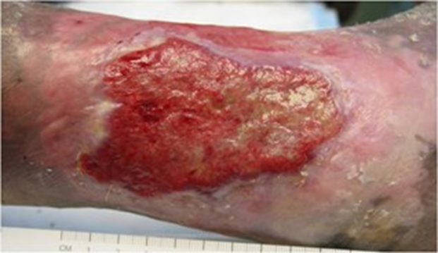
Postthrombotic Syndrome (PTS)
Michael B. Harding MD, FACC, ABVLM, ABVM, RPVI, RPhS
Notes:
PTS is a chronic complication of DVT that imposes significant morbidity, reduces quality of life, and is costly
DVT---- 20-50% PTS
5-10% SEVERE
5% Ulcer/10Y

Slide 2
Disclosures
All these slides are plagiarized
I have a tendency to cuss

Slide 3
PTS Overview
DVT Overview (quickie)
Physics
Anatomy
Pathophysiology
Risk factors
Clinical characteristics
AHA Scientific Statement
Treatment

Slide 4
VTE- It’s a big deal!
Frequently encountered with increasing incidence1
Asymptomatic-Cardiogenic Shock: Mortality elevated for decades2
Demands thoughtful evaluation in both acute and chronic setting3
Provoked vs Spontaneous
High recurrence rate
Duration of anticoagulation
Post Thrombotic syndrome
Huang W, et al. Secular trends in occurance of acute venous thromboembolism: the Worcester VTE study (1985-2009)
Am J Med 2014; 127:829-39
Sogaard KK, et al. 30-year mortality after venous thromboembolism: a population-based cohort study. Circulation 2014; 130:829-36
Kearon C, et al. Antithrombotic therapy for VTE disease: Chest guideline and expert panel report. Chest 2016; 149:315-52
Notes:
VTE diagnosed 1.5/1000 persons/year. For every 1 pt diagnosed 9 are excluded. 2/3 present with suspected DVT 1/3 PE
PE: 3rd leading cause of cardiovascular death
High Risk-SBP<90 5%pts,30%mortality at 1 mo
Intermediate-RV strain without hypotension, RV/LV CT >0.9, ECHO, +trop/BNP 1/3-1/2 pts-mortality2-15%/1yr
Low risk-majority 1% mortality @1 m
OVERALL MRR(mortality rate ratio’s are up to 40% at 30 years for combined DVT and PE

Slide 5
Diagnosis-DVT

Slide 6
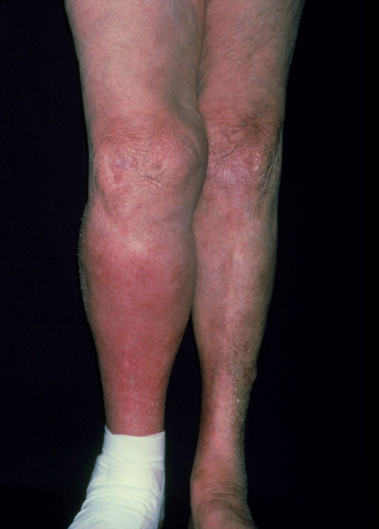
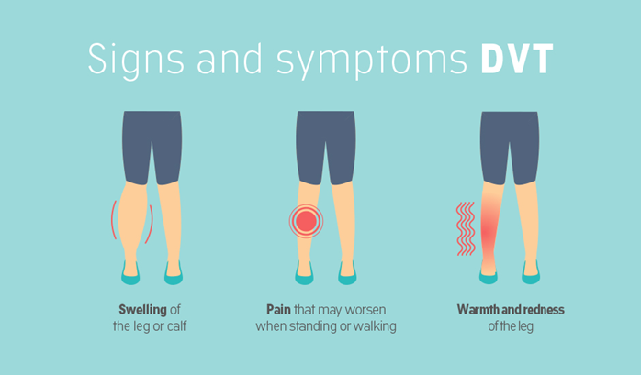
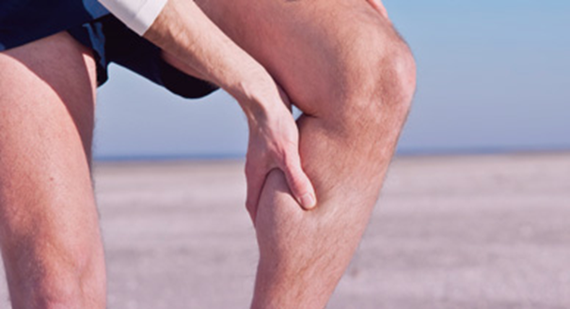
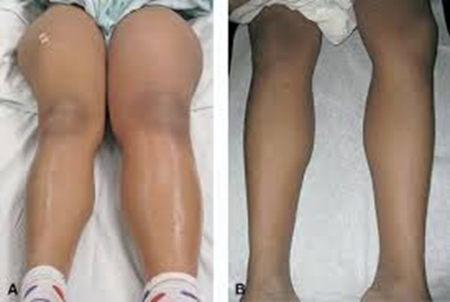
50% of DVT’s are Asymptomatic
Notes:
Phlegmasia cerulea dolens (albans)---arterial compromise---consider CDT (Catheter directed thrombolysis) or PCDT (Pharmacomechanical CDT)

Slide 7
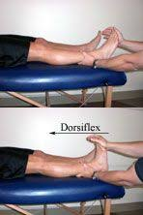
Homan’s sign is an unreliable physical finding in the diagnosis of DVT. It is both nonspecific and very insensitive.
“If they had to name a sign after me, why didn’t they pick one that was any damn good?”
John Homans, MD 1877-1954
Notes:
WHAT ABOUT THE HOMANS SIGN: Nonspecific i.e. torn calf muscle, cellulitis//Insensitive –small , non occlusive calf DVT

Slide 8
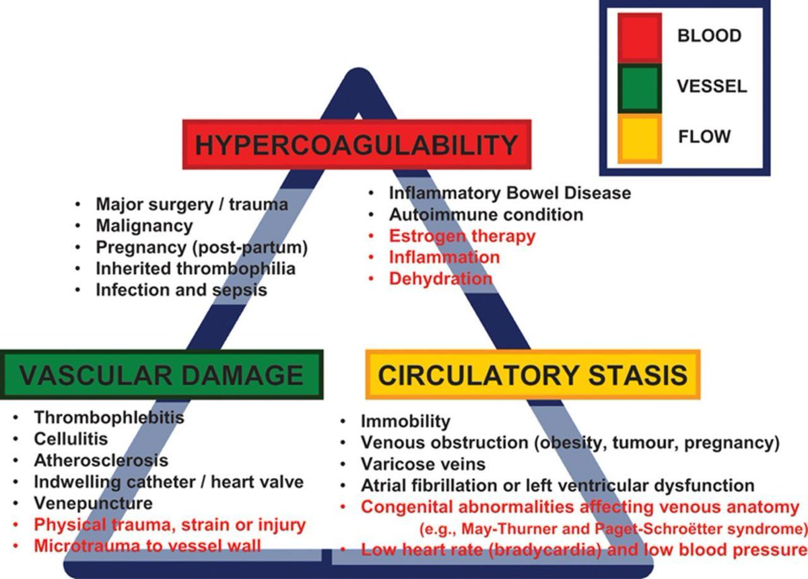
Virchow’s Triad

Slide 9
Provoking Factors for VTE
Advanced age (>60 years old)
Obesity
Recent hospitalization for medical or surgical issue (within 90 days)
Recent trauma or surgery (within 90 days)
Prior history of VTE
Malignancy
Estrogen therapy
Pregnancy/postpartum
Chronic inflammatory diseases (e.g. rheumatologic disease, inflammatory bowel disease)
Chronic medical conditions (e.g. heart failure, chronic kidney disease, chronic obstructive pulmonary disease, infection, atherosclerosis)
Venous obstructive processes (e.g. May-Thurner syndrome, thoracic outlet syndrome, tumor compression)
Indwelling central venous catheter or pacemaker
Heparin-induced thrombocytopenia

Slide 10
Thrombophilias
Thrombophilia | Initial VTE Risk | Recurrent VTE Risk
Antiphospholipid* antibody | 2-11x† | ↑↑†
Factor V Leiden heterozygote | 3-4x | -
Factor V Leiden homozygote | 11x | -
Prothrombin gene mutation heterozygote | 4x | -
Prothrombin gene mutation homozygote | 7x | -
Compound factor V Leiden + prothrombin gene mutation heterozygote | 20x | -
Antithrombin deficiency | 16x | 4x
Protein C deficiency | 8x | 3x
Protein S deficiency | 7x | ↑**
Notes:
Thrombophilia test is not indicated in pts with a clearly provoked VTE as traditional risk factors are much more common and the likely etiology. Test are difficult to interpret in acute setting and while on Rx.
Inherited thrombophilia's are associated with an increased risk of initial VTE event; however, the more prevalent thrombophilia's are not associated with risk of recurrent VTE and the remaining less common only modestly associated with recurrent events. APS: (40X)Acquired, remaining are inherited. For most part test do not influence initial anticoagulation choice. Consider APS testing in acute setting if increased suspicion ie pts with concomitant rheumatologic disorders or concomitant arterial and venous thrombosis.

Slide 11
Testing: Hypercoagulable Panel Should be Avoided
Results difficult to interpret
Acute Thrombosis
While receiving anticoagulation
Traditional risk factors much more common in patients with a clearly provoked VTE
Inherited Thrombophilia's increase risk of initial VTE, not recurrent VTE
Negative thrombophilia testing can lead to a false sense of comfort
Thrombophilia Testing and Venous Thrombosis. N Engl J Med2017;377:1177-1187.

Slide 12
Testing: Hypercoagulable Panel Should be Avoided (Never say Never)
Antiphospholipid Syndrome (APS)
Patients with concomitant rheumatologic disease
Patients with concomitant arterial and venous thrombosis
Unprovoked VTE
Factors associated with an inherited thrombophilia include VTE at a young age (<40-50 years), a strong family history of VTE, VTE in conjunction with weak provoking factors at a young age, recurrent VTE, and VTE in an unusual site (e.g., cerebral or splanchnic veins
Female child bearing age with Fm hx of first degree relative with VTE
Estrogen-based contraceptive are associated with an exponentially elevated risk of VTE in the presence of a concomitant thrombophilia
Thrombophilia Testing and Venous Thrombosis. N Engl J Med2017;377:1177-1187.

Slide 13
Testing: Malignancy
Thorough H&P
Follow the Signs and Symptoms
Age-appropriate cancer screening

Slide 14
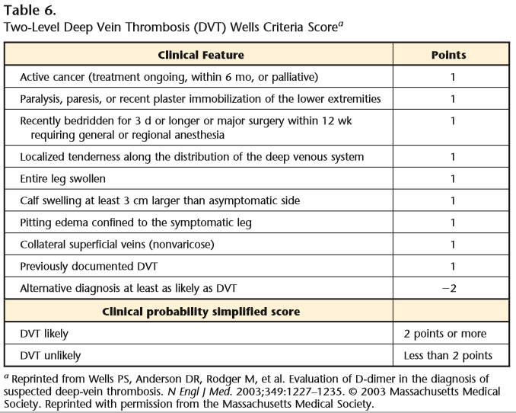
Notes:
Pre-test probability

Slide 15
Testing: D-Dimer
If it is negative you do not have a VTE
Notes:
Biomarker for thrombin formation can be measured in whole blood or plasma. Use if DVT if pretest probability unlikely. NO GOOD IF HIGH PRETEST PROBABILITY Whole blood agglutination assays or plasma D-Dimer levels (sensitivity>95%.
NEGATIVE PREDICTIVE VALUE IS EXCEPIONALLY GOOD IN LOW RISK PTS BUT IS UNACCEPTABLE IN HIGH RISK PTS
NOT SPECIFIC: advanced age, after surgery, during pregnancy, peripartum, cancer, infection, chronic inflammation ,liver dz ,renal dz, thrombolytic rx
DDIMER is of limited value in determining duration of Rx in men

Slide 16
Testing: Imaging
Notes:
U/S good but not great for proximal ie pelvic /abdominal obstruction. Hard to visualize. Rely on waveform so call phasic respiratory variation of the Doppler signal. Also many pt variables can result in incomplete studies Casts, bandages, wounds, cooperation, poisoning, sensitivity to probe
Prox DVT: 97%sensitive,94%specific-above knee.. 90% specificity and sensitivity calf. f decide not to Rx distal or high suspicion of DVT-repeat u/s10-14d. ¼ of untreated calf DVT will exten in 2 weeks
Have to have a high index of suspicion . Think north. If L eg only think May –Thurner or obstruction of the L iliac vein by the cross over of the R iliac artery. Symptom of Pelvic congestion syndrome ( ovarian vein reflux) . Nut cracker syndrome. Now go to MRV/CTV.
Gold standard—venography + IVUS

Slide 17
Treatment-DVT

Slide 18
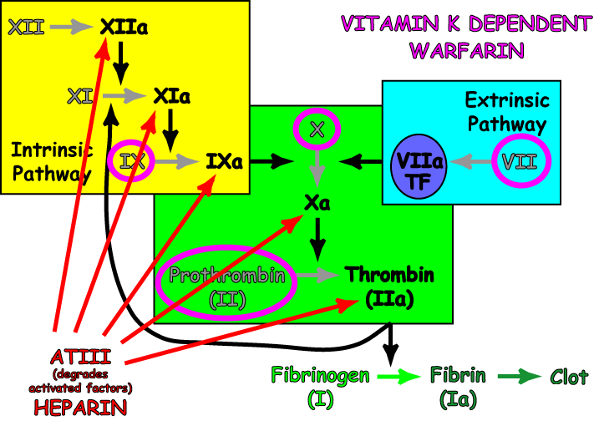
DOAC’S
Notes:
Fibrinogen is clotted by thrombin
Apixaban ELIQUIS
Rivaroxaban XERELTO
Dabigatran PRADAXA

Slide 19
Treatment-Precision Medicine: DOAC’s
Guideline first-choice medications for VTE
High efficacy
Ease of administration
Lower risk of bleeding
Antidotes available
Kearon C, et al. Antithrombotic therapy for VTE disease: Chest guideline and expert panel report. Chest 2016; 149:315-52

Slide 20
Treatment-Precision Medicine: DOAC’s
Apixiban
Rivaroxaban
Eliquis
10mg bid X 7 days
5mg bid-minimum 3 months
2.5mg bid indefinitely?
Xarelto
15mg bid X 21 days
20mg qd-minimum 3 months
10mg qd indefinitely?

Slide 21
Treatment-Vitamin K antagonists (aka-Rat Poison)
Renal dysfunction
Morbid Obesity: BMI>40
“Frail”: BMI<16, Age>80
Antiphospholipid Syndrome
Noncompliance
Insurance Issues

Slide 22
Treatment-Low Molecular Weight Heparin: Enoxaparin
Bridge for Vitamin K antagonist
Don’t stop until 2 days Therapeutic >2.0 INR
Active Cancer
Not needed with Direct Xa inhibitors (apixaban/rivaroxaban)
Needed with Dabigatran
Notes:
Anti-inflammatory add a statin?

Slide 23
Treatment: Duration of Anticoagulation
Unprovoked - recurrent VTE 30-50% over 10 years
Consider indefinite anticoagulation
After 6-12 months Rx consider ½ dose DOAC
Evaluate yearly
Reassess risk-benefit ratio of continued therapy
Personal Preference
Screen for bleeding complications
Intermittent assessment of renal function and hemoglobin
Provoked - recurrent VTE 20% over 10 years
Consider indefinite Rx

Slide 24
Compression Therapy

Slide 25
What is Compression Therapy?
Compression therapy is the application of controlled graduated external pressure to the limb to reduce and maintain the venous pressure within the limb.
Notes:
PTS prevention: “ conflicting data” 30-40mm Hg KH -2 years
SOX trial no benefit---poor compliance
JUST DO IT
BEWARE PAD and allergy

Slide 26
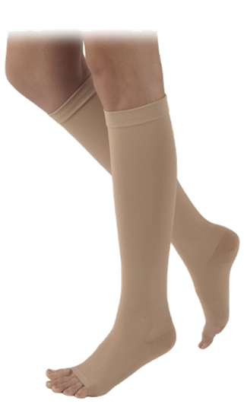
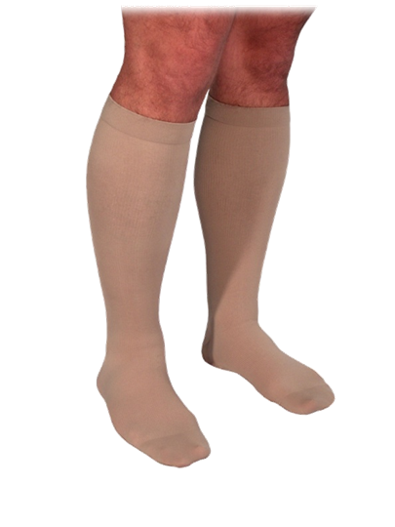
Goals of Compression Therapy
Notes:
What are the goals of Compression Therapy? (This is on the test)
To restore blood flow velocity to normal (the blue/gold chart we just reviewed)
To reduce or prevent edema.
Prevent progression of venous or lymphatic disease

Slide 27
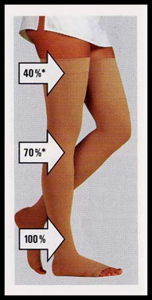
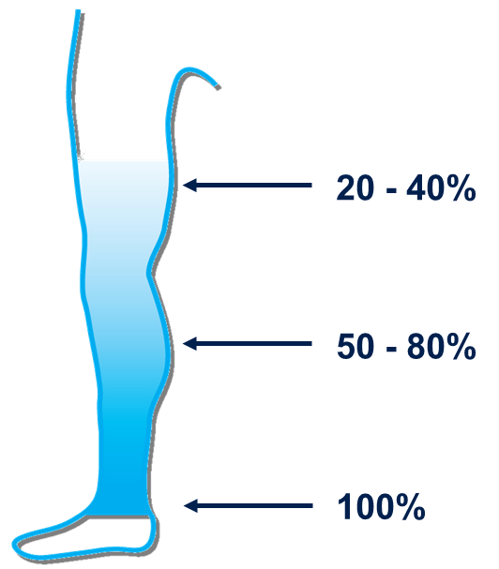
Compression Therapy
Notes:
Reducing the diameter of vein and hence improving venous valvular function
Accelerating venous back flow
Preventing and reducing leg edema

Slide 28
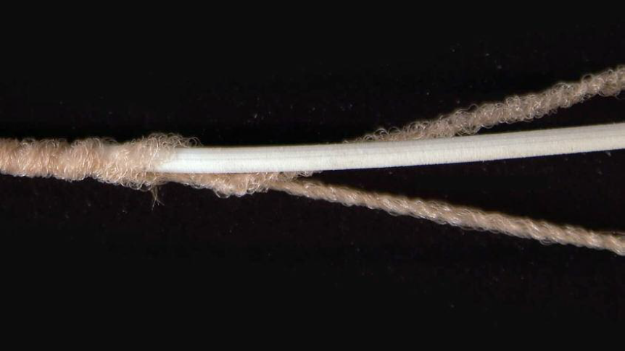
Types of Compression
Bandage/wrapping
Dependent on skill of person applying
Unna Boot
Short stretch Velcro wraps
Pneumatic pump
Compression garments
Choice of fabric/styles
Underliner with choice of overstocking
Custom
Notes:
A patient suffering from venous leg ulcers and sensitive skin issues may require a different type of compression before being put into a garment such as what we are talking about today. Also, some patients have difficulty donning/doffing. They may suffer from a disability, be obese, in pain or have weakness in their hands, etc.
Note to speaker: explain each of the types of compression, expressing the pro’s/con’s of each method. White piece is Lycra-strechy material Brown Nylon/wool/cotton/rubber-yarn-double covered High vs low quality.
Stacked rubber bands . Can be then wraped in differ materials like Merinowool.

Slide 30
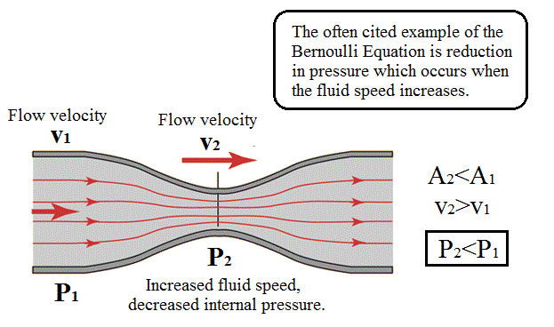
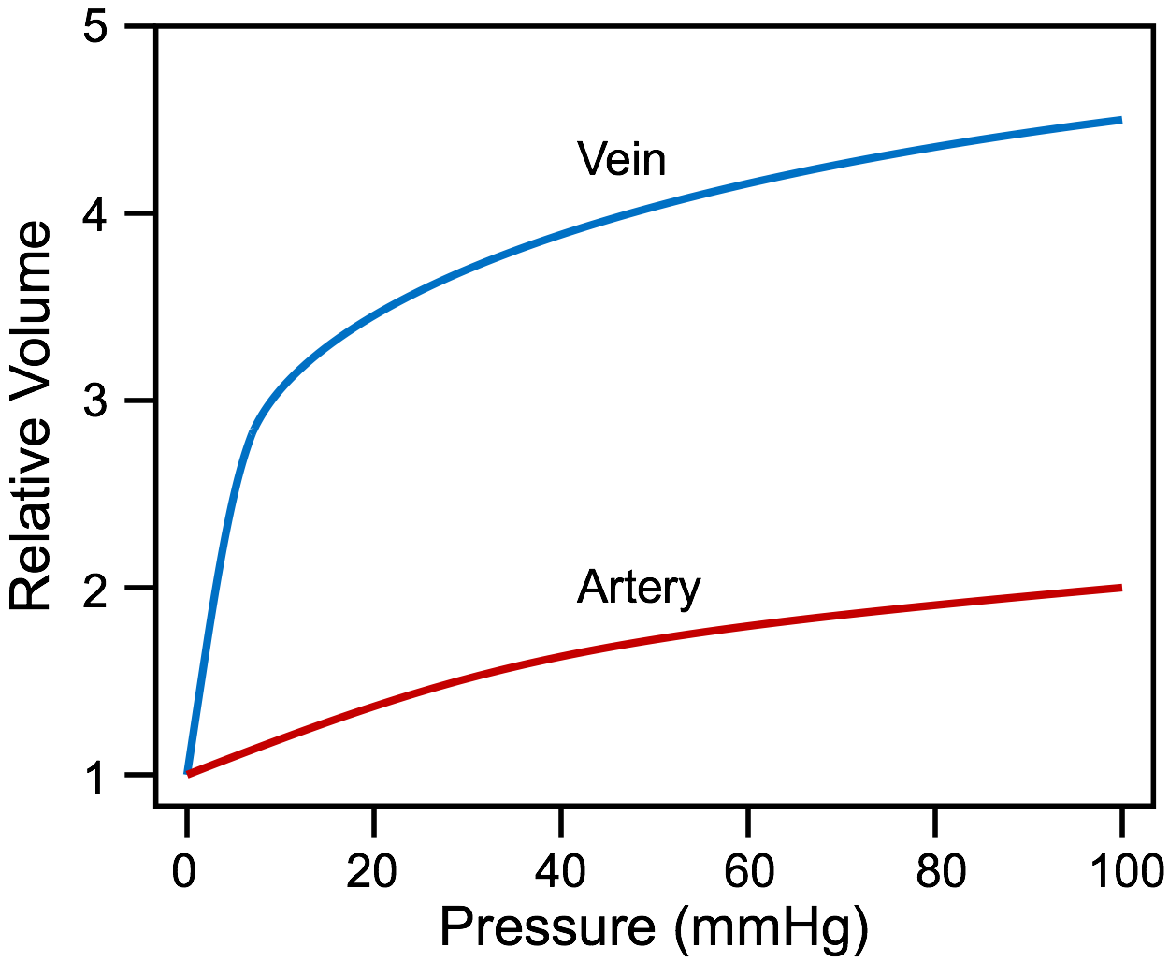
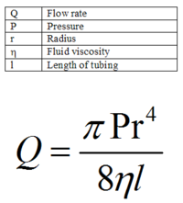
Physics
Hydrostatic Pressure = ƿgh
Residual Pressure = Arterial pressure – microcirculatory pressure
Transmural Pressure = Pressure external wall – lateral pressure
Tissue drainage
Vein caliber
Compliance (distensibility)
Flow = Pressure/ Resistance
Bernoulli's law
Poiseuilles law-Reynolds # (turbulence)
Load
Static pressure
Dynamic pressure
Cardio-Pulmonary , Thoraco-abdominal Pressures
Thermoregulation
Obstacles
Osmotic Pressure
$$F=ma$$
$$PV=nRT$$
$$SE=\frac{F}{A}$$
$KE=\frac{1}{2}$mV²
Notes:
P1-P2: Venous blood from the legs has to travel against the forces of gravity IT’S GRAVITY STUPID
RP: The push
TP= outside – inside P.
Tissue drainage-LYMPHATICS The janitor of the interstitium.
VEIN CALIBER-has a lot to do with every thing . Self fulfilling prophecy. COMPRESSION
Compliance- COMPACITANCE VESSELS
Flow Q=P/R f(radius) Ohms law I=V/R current(amps) = volts / ohms
Bernoullis: conservation of energy: simultaneous decrease in pressure with increased speed
Poiseuilles: describes pressure drop in an incompressible tube with laminar flow and increased delta P if turbulence (Reynolds #)
Load: static pressure=F/A dynamic pressure=kinetic energy= ½ densityXv2(velocity)
Cardio/pulm/thoraco/abd—PUSH & PULL
Thermo—vasodilate/constrict Ideal Gas Law n=moles
Obstacles-babies/obesity/DVT/tight clothes-socks-TORNOQUIT
Osmotic: Starling Forces

Slide 31
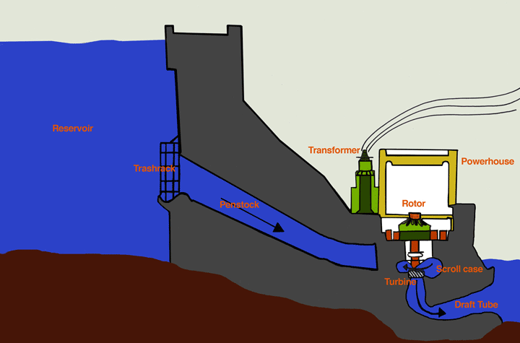
Hydrostatic Pressure = $P$1-$P$2 = $pgh$
P1
P2
Notes:
Potential Energy---Kinetic energy
Venous blood has to travel upward against the forces of gravity. If standing and no valves-f(height) >100mmHg

Slide 32
Notes:
Same forces but no height thus no VV. Think about it. When was the last time you saw a lizard with VV.

Slide 33
Notes:
So why don’t Giraffes have VV?

Slide 34
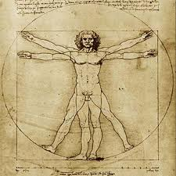
ANATOMY

Slide 35
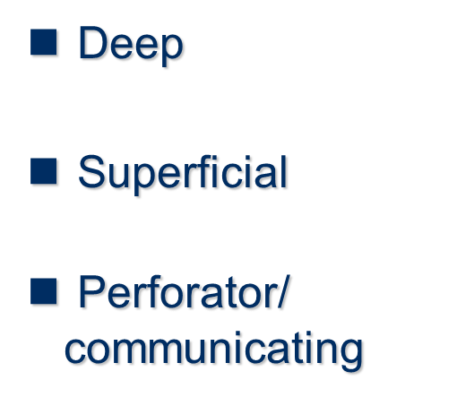
Three Systems of Veins
Think of a Roadmap!
Notes:
To summarize…think of the three systems of veins as you would a road map…
The interstate handles a larger volume of traffic, just like the deep vein system handles more blood volume. It is also a more direct route (point “a” to point “b”) at a higher rate of speed. Think of volume as pressure.
The side roads, like the superficial roads, feed into the interstate. They are smaller roads and move at a lower rate of speed or lower volume.
The perforating veins are the on-ramps which take blood from one system to the other.
What happens to the traffic flow when there is an accident (1) on the exit ramp and/or (2) on the interstate?
Discuss the flow and reversing of flow, increasing pressure. And discuss how to get around an obstruction, you might have to drive on the shoulder which redefines the normal wall.
Introduce the concept of DVT in the deep vein (interstate) , but don’t go there yet as there is are slides later in this module discussing DVT, PE and PTS.

Slide 36
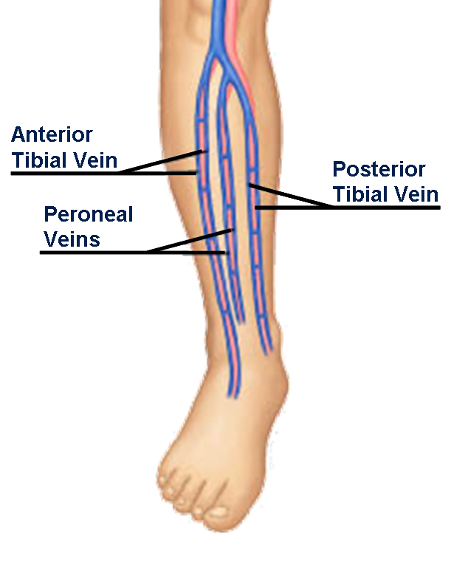
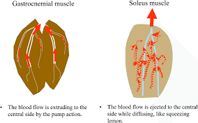
Deep Venous System
This is no longer called the
Superficial Femoral Vein!
Above the knee!
Notes:
As the name implies, the deep venous system lies deep inside the leg. The deep system handles up to 90% of the venous blood volume and has a slightly higher pressure within the venous circulation of the legs.
The deep system veins are surrounded strong facia and muscle. The muscle contractions helps move the blood flow.
The deep veins move blood more direct from “point A” (lower leg) to “point B” (lungs/heart)
The major veins of the deep system are: (use pointer)
The Anterior and Posterior Tibial Veins
The Peroneal Veins, located below the knee,
The Popliteal Vein, found behind the bend of the knee, is the most common site for a blood clot to develop It is “ABOVE THE KNEE”
NOT shown-Gastroc and soleal.
In the thigh you, will find the Superficial Femoral Vein,( FEMORAL VEIN) which is the main vein in this system, and the Common Femoral Vein at the groin crease.

Slide 37
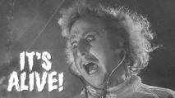
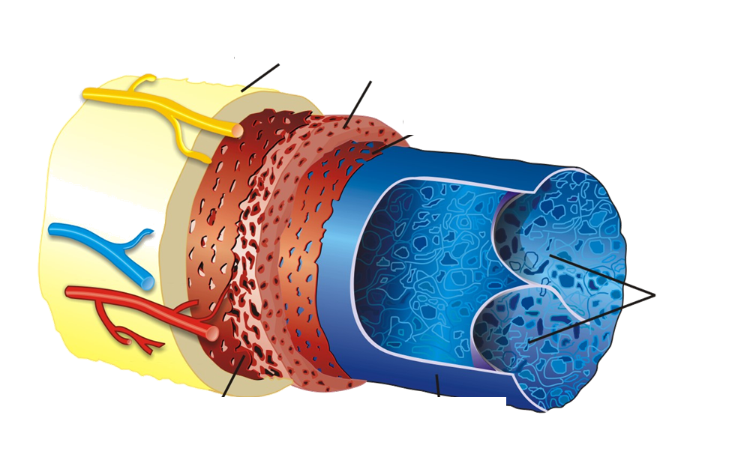
The Vein – Internal Structure
Adventitia Layer
Media Layer
Intima Layer
Venous Valves
Notes:
1. The Adventita layer is the outer supporting layer of the vein has an elastic tissue which expands and relaxes allowing the vessel to return to it's original size and shape. It also is “sticky” to help adhere the vessel to the cavity and other vessels.
2. Again ,The walls of the vein are thin as there is little muscle in the media. But still is vasoactive and responds physiologic stimuli. Dilating and contracting. ALIVE-not just a pipe.
3. The Intima or endothelium is a lining which reduces friction of the flow of blood allowing it to flow without collecting against the wall forming a clot. Think TEFLON.
4. Valves are unique to the vein (not found in an artery) and very useful as it keeps blood flowing towards the heart and prevents backflow known as reflux.

Slide 38
Normal Valve Function
Vein Anatomy
Valve Open
Blood flows toward heart
Valve Closed
Prevents blood from reverse flow
Notes:
Venous valves are tissue paper thin structures (cusps) that resemble upside down parachutes and are found every 2 to 7 cm. depending on the size of the vein. These valves provide a one-way flow of venous blood back to the heart and lungs.
Valves are uni-directional; they allow blood to flow in only one direction, bicuspid, work against gravity and prevent reverse flow or pooling.

Slide 39
Calf Pump — The Second Heart
Notes:
The calf pump. The second heart. The vein are embedded with in the calf muscle so that with every step you take up to 200mmHg of pressure is generated milking the venous blood upwards against the forces of gravity.

Slide 40
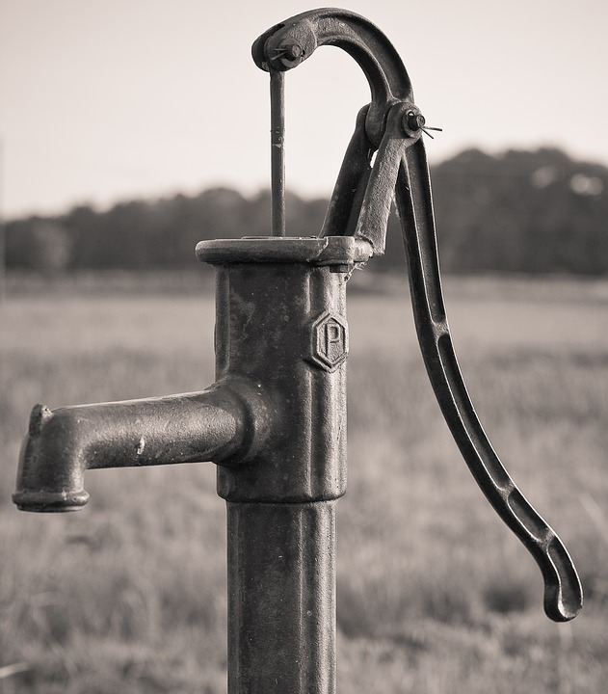
Sources of Venous Return
External Foot Pumping
Notes:
The calf muscle is not the only source of venous return. Other ‘pumps’ help push the blood toward the heart. Ankle and foot pumps contract to force blood upwards. Think of this ankle calf pump as a machine analogous to an old time hand pump on the farm.

Slide 41
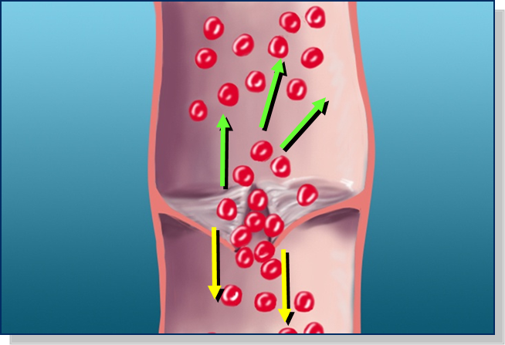
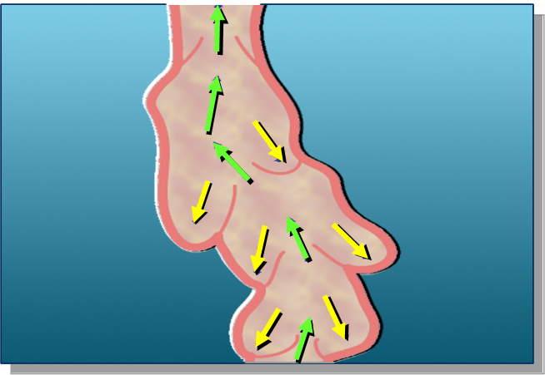
Abnormal Valve Function
When valves don’t close….
They become INCOMPETENT…. and reverse blood flow causes “pooling”
and weakening of the vein wall.
Notes:
When venous valves are competent (working properly), the blood flows upwards to the heart. When valves are incompetent (do not work properly) blood flow is sluggish and may leak through the opening in the valve causing blood “pooling”.
Valves in the veins can become incompetent due to pressure which weakens the walls. Combining the elements of “life” discussed previously which causes pressure in the vein and the pull of gravity is how damage is done within the vein starting venous insufficiency and then leading into chronic (long-lasting/progressive) conditions

Slide 42
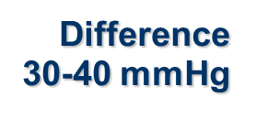
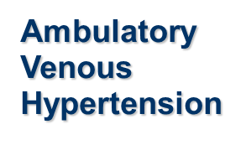
Venous Pressure at the Ankle Normal vs. Incompetent
Notes:
BLUE CHART: When you are laying down, your heart elevation is equal to the level of your feet and the pressure on the vein walls is low because the force of gravity is very low. It is not difficult to push the blood back towards the heart because your heart is not at a higher elevation than your feet. This is also true for people who are bed ridden. Remember this when we discuss anti-embolism vs graduated compression later in the day. TED=BED 8-18mmHg NOT GRADUATED
Waking up in morning, you are flat on your back, and the pressure at the ankle is 10mmHg.
Then your alarm goes off and you swing your legs out of bed and stand up. Very quickly, the blood rushes to your feet because of the force of gravity. So, when the blood rushes down your legs, the vein walls expand and create 90 mmHg in the veins at the bottom of your legs. This is a high pressure.
Now the magic of the calf muscle pump kicks in. As you start to walk, the muscles in the calf start to compress the vein walls and the valves and veins start to push the blood toward the heart.
After seven steps, the venous pressure drops to around a more normal range of 25-35mmHg.
Think about the jobs that require standing or sitting for long periods of time and where the calf muscle isn’t engaged on a regular basis.
Do your legs ache at the end of the day?
Do your legs swell at the end of the day?
Sound like your day?
Who else in your community has jobs that require sitting or standing for prolong periods of time. These are the people you should be targeting to GROW your compression business.
(click) As you can see from gold graph, the patient with defective valves has the same recumbent venous pressure of 10mmHg, but the standing pressure – here 100 mm Hg – can go much higher, perhaps greater than the systolic pressure of the heart ( 120mmHg). However, when this person starts to walk, the venous pressure is reduced at most to 70 mm Hg due to malfunctioning valves resulting in venous reflux.
The person with defective valves has ambulatory venous hypertension (high pressure) when walking, of approximately 70mmHg. The normal walking pressure is 25-35 mmHg. In order to bridge this gap with the use of an external counter pressure (stockings), we must provide the compression of at least 30 mmHg for CVI.

Slide 43
May-Thurner Syndrome
Notes:
Congenital abnormality affecting venous anatomy
Obstructive process affecting venous return

Slide 44
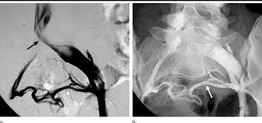
May-Thurner Syndrome

Slide 45
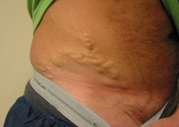
May-Thurner Syndrome

Slide 46
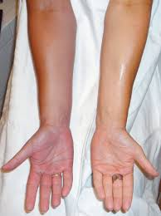
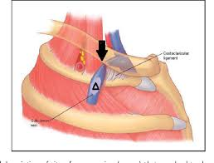
Paget-Schroetter Syndrome (Thoracic Outlet Syndrome-Venous)

Slide 47
PTS
Notes:
No objective diagnostic test . Diagnosed on clinical grounds in pt with manifestations of CVI and a previous DVT at least 3 months previously.

Slide 48
PTS
Chronic complication of DVT
Imposes significant morbidity
Reduces quality of life
Costly
20-50% pts develop PTS
5%-10% severe symptoms
5% ulcers/10years

Slide 49
Secondary Varicose Veins PTS
DEEP VEINS OCCLUDED BY THROMBUS
DESTRUCTION OF VENOUS VALVES
BLOOD POOLING IN DEEP VEINS
HIGH PRESSURE IN DEEP SYSTEM
PRESSURE TRANSMITTED TO SUPERFICIAL SYSTEM
THROUGH PERFORATORS
VARICOSE DILATION OF SUPERFICIAL VEINS
Notes:
DVT leads to chronic venous HTN via 2 major principles: valvular reflux and residual venous obstruction. DVT also triggers inflammation -induced valvular damage.
JUST READ SLIDE. Secondary varicosities are a direct result of an occlusion in the deep vein. If an occlusion occurs increased pressure develops within the deep vein system. Once the deep veins have been occluded by a thrombus, the resulting ambulatory venous hypertension continues to dilate the veins rendering more and more of the venous valves incompetent. The larger and longer the clot the greater the potential for multiple valve damage.
The venous reflux results in higher venous pressure in the deep system which is transmitted to the superficial veins via the perforating veins and this can result in varicose dilatation of the superficial veins.

Slide 50
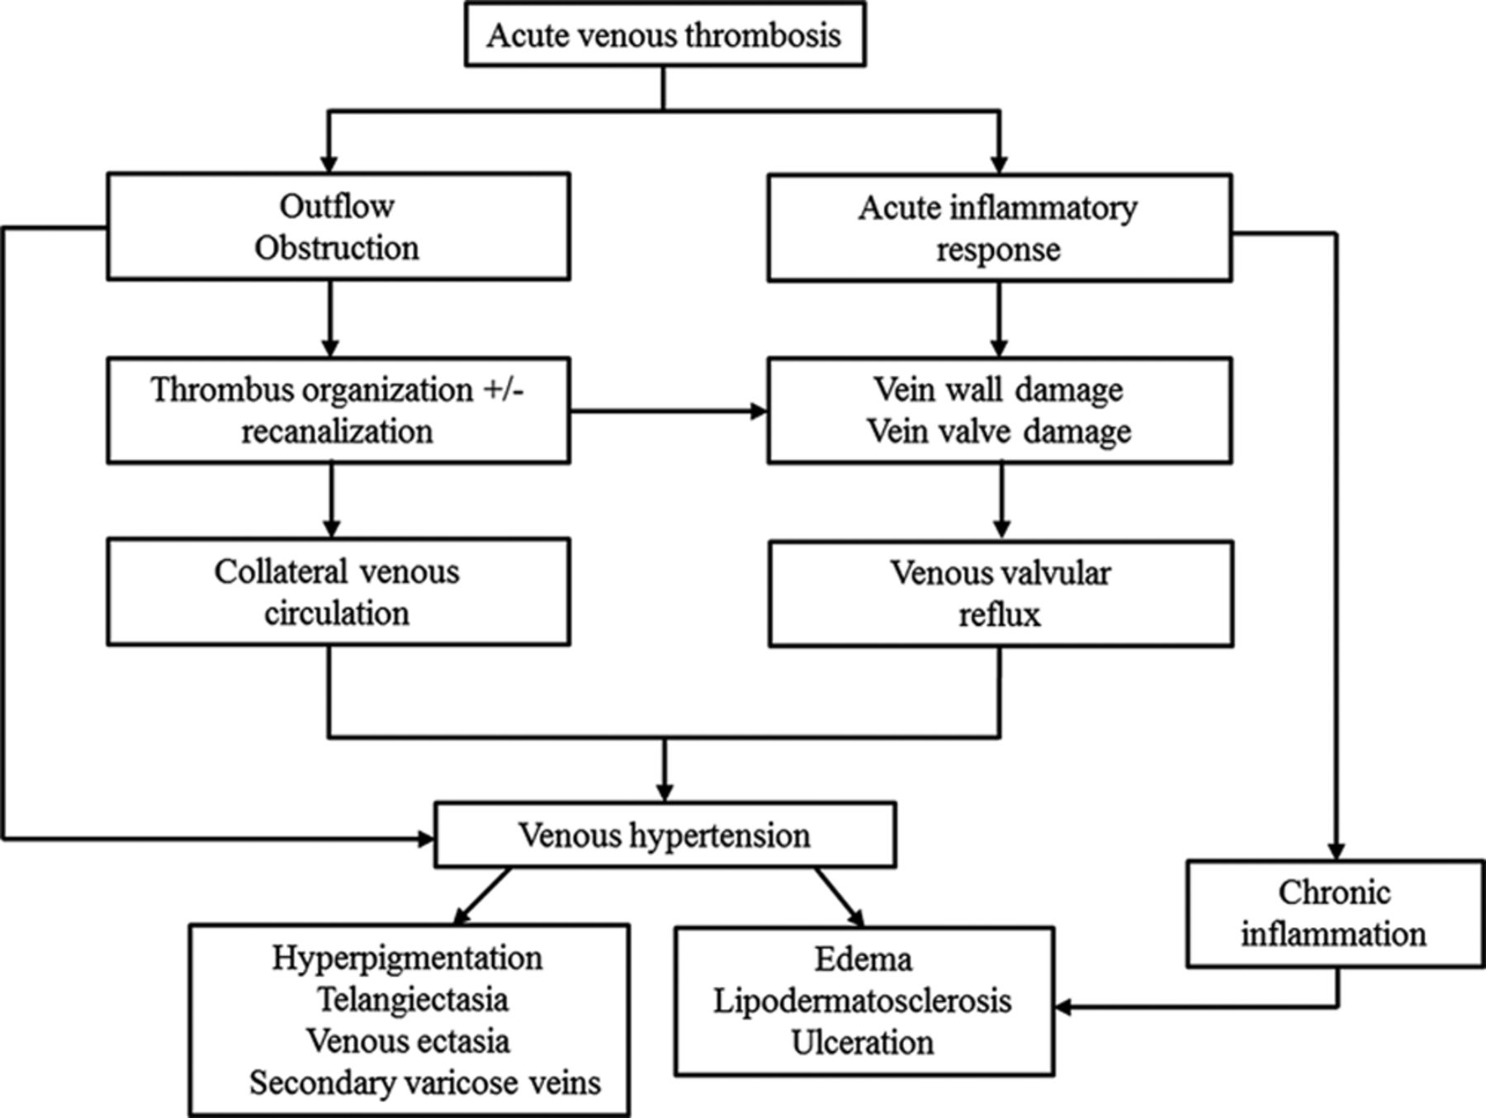
Proposed pathophysiology of postthrombotic syndrome.
Susan R. Kahn et al. Circulation. 2014;130:1636-1661
Copyright © American Heart Association, Inc. All rights reserved.
Notes:
Proposed pathophysiology of post thrombotic syndrome. 20-50% of pts develop PTS Sequelae. 5% ulcerate in 10 years. Venous HTN plays a central role f(outflow obstruction or valvular incompetence, more important )

Slide 51
Risk Factors PTS
Apparent at the Time of DVT
Apparent During DVT Treatment and Follow-Up
Body mass 2X
Older age 3X
Extensive thrombosis: 2-3X
Common Femoral vein
Iliac vein
Subtherapeutic anticoagulation 3X
Recurrent ipsilateral DVT 4-6X
Residual Vein Thrombosis 2X
Greater symptom severity at 1month
Susan R. Kahn et al. Circulation. 2014; 130: 1636-1661
Notes:
Risk factors for PTS are incompletely understood and difficult to predict. Subtherapeutic 1st 3 months-2X Lovenox better? DOAC better Dealers choice BUT IF VKA-REGOROUS MONITORING
BMI>30 2X Recurrent: 4-6X!!!!!
Older age 3X Residual U/S-3-6 months 2X ( reflux independent risk factor)
Proximal 2-3X
No effect: sex, provoked vs unprovoked, thrombophilia IN STUDIES 60% SUBTHERAPUTIC

Slide 52
Clinical Characteristics PTS
Table 2.
Clinical Characteristics of PTS
PTS indicates postthrombotic syndrome.
Symptoms | Clinical Signs
Pain | Edema
Sensation of swelling | Telangiectasia
Cramps | Venous dilatation/ectasia
Heaviness | Varicose veins
Fatigue | Redness
Itching | Cyanosis
Pruritis | Hyperpigmentation
Paresthesia | Eczema
Bursting pain | Pain during calf compression
Venous claudication | Lipodermatosclerosis
 | Atrophie blanche
 | Open or healed ulcers
Susan R. Kahn et al. Circulation. 2014; 130: 1636-1661
Notes:
PTS diagnosed on clinical grounds. I.e. no precise definition. Again: PTS develops after DVT because of the onset of ambulatory venous HTN that lead to reduced calf muscle perfusion, and increased tissue permeability, causing chronic edema, tissue hypoxemia, progressive calf pump dysfunction, subcutaneous fibrosis and ultimately ulceration
TIME? No specific recommended time limit. It can take a few months for initial pain and swelling of acute DVT to resolve. Thus dx of PTS should be reserved 3-6 months.
SYMPTOMS: Large range of symptoms: intermittent or persistent, worsens by end of day or with prolonged standing or sitting. Improved with leg elevation.. Venous claudication : bursting leg pain with exercise resembling arterial claudication caused by persistent venous obstruction of large vein.
SIGNS: similar to CVD

Slide 53
Chronic Venous Disease: Clinical Presentation
Superficial
Deep

Slide 54
Inflammation Hypoxemia Death(Ulcers)

Slide 55
Venous Stasis Ulcer
Notes:
5-10% DVT SEVERE SYMPTOMS 5% Ulcers
Multidisciplinary : internist, dermatologist, vascular surgeon, wound care nurse
Rx: compression, leg elevation, topical dressings, pentoxifylline, surgical intervention
IT TAKES A VILLAGE

Slide 56
Varicose Veins: Impact venous Ulcers
Many take >9 months to heal
Up to 60% last >5 years
Affect 1% general population/annual healthcare cost of $1 billion (US)
Whiddon,LL.Proc(Bayl Univ Med Cent).2007 October:20(4):263-366
Notes:
$10,000/year

Slide 57
AHA SCIENTIFIC STATEMENT
The Postthrombotic Syndrome: Evidence-Based Prevention, Diagnosis, and Treatment Strategies
A Scientific Statement From the American Heart Association
Susan R. Kahn, Anthony J. Comerota, Mary Cushman, Natalie S. Evans, Jeffrey S. Ginsberg, Neil A. Goldenberg, Deepak K. Gupta, Paolo Prandoni, Suresh Vedantham, M. Eileen Walsh, Jeffrey I. Weitz
and on behalf of the American Heart Association Council on Peripheral Vascular Disease, Council on Clinical Cardiology, and Council on Cardiovascular and Stroke Nursing
Download PDF
https://doi.org/10.1161/CIR.0000000000000130Circulation. 2014;130:1636-1661
Originally published September 22, 2014
Susan R. Kahn et al. Circulation. 2014; 130: 1636-1661
Notes:
The 1st evidenced based guidelines focused solely on PTS

Slide 58
Prevent PTS: Prevent the 1st and 2nd DVT
Recommendations for Primary and Secondary Prevention of DVT to Prevent PTS
Use of thromboprophylaxis in patients at significant risk for DVT is recommended as a means of preventing PTS (Class I; Level of Evidence C).
Providing anticoagulation of appropriate intensity and duration for treatment of the initial DVT is recommended as a means of reducing the risk of recurrent ipsilateral DVT and consequent PTS (Class I; Level of Evidence B).
Susan R. Kahn et al. Circulation. 2014; 130: 1636-1661
Notes:
Pharmacological and mechanical thromboprophylaxis is are effective but only reduce VTE by ½ to 2/3 . Furthermore 50% VTE occurs unpredictably. HENCE secondary prevention very important!

Slide 59
Prevent PTS: Optimize Anticoagulation
Recommendations for Optimizing Anticoagulation Delivery to Prevent PTS
In patients whose DVT is treated with a vitamin K antagonist, frequent, regular INR monitoring to avoid subtherapeutic INRs, especially in the first few months of treatment, is recommended to reduce the risk of PTS (Class I; Level of Evidence B).
Compared with LMWH followed by a vitamin K antagonist, the effectiveness of LMWH used alone to treat DVT as a means to reduce the risk of PTS is uncertain (Class IIb; Level of Evidence B).
Compared with a vitamin K antagonist, the effectiveness of the new oral anticoagulants (ie, oral thrombin or factor Xa inhibitors) to treat DVT as a means to reduce the risk of PTS is unknown (Class IIb; Level of Evidence C).
Susan R. Kahn et al. Circulation. 2014; 130: 1636-1661
Notes:
3X risk PTS if INR<2.0 for >50% of time (LMWH anti-inflammatory properties
CHEST 2016---DOAC
THERE IS NO CONCENSUS ON EXTENDING ANTICOAGULATION I PTS WITH PTS BEYOND THE DURATIONS RECOMMENDED FOR THE TREATMENT OF THE DVT

Slide 60
Prevent PTS: Compression Socks
Recommendations for Compression to Prevent PTS
The effectiveness of ECS for PTS prevention is uncertain, but application of ECS is reasonable to reduce symptomatic swelling in patients with a diagnosis of proximal DVT (Class IIb; Level of Evidence A).
Susan R. Kahn et al. Circulation. 2014; 130: 1636-1661
Notes:
DVT---- 20-50% PTS
5-10% SEVERE
5% Ulcer/10Y
LOW RISK OF HARM

Slide 61
Prevent PTS: Thrombolysis/Mechanical
Recommendations for Thrombolysis and Endovascular Approaches to Acute DVT for the Prevention of PTS
CDT and PCDT, in experienced centers, may be considered in select patients with acute (≤14 days) symptomatic, extensive proximal DVT who have good functional capacity, ≥1-year life expectancy, and low expected bleeding risk (Class IIb; Level of Evidence B).
Systemic anticoagulation should be provided before, during, and after CDT and PCDT (Class I, Level of Evidence C).
Balloon angioplasty with or without stenting of underlying anatomic venous lesions may be considered after CDT and PCDT as a means to prevent rethrombosis and subsequent PTS (Class IIb; Level of Evidence B).
When a patient is not a candidate for percutaneous CDT or PCDT, surgical thrombectomy, in experienced centers, might be considered in select patients with acute (≤14 days) symptomatic, extensive proximal DVT who have good functional capacity and ≥1-year life expectancy (Class IIb; Level of Evidence B).
Systemic thrombolysis is not recommended for the treatment of DVT (Class III; Level of Evidence A).
Susan R. Kahn et al. Circulation. 2014; 130: 1636-1661
Notes:
CTD= Catheter Directed Thrombolysis PCDT= Pharmacomechanical CDT-----BLEEDING RISKS OUT WEIGH BENEFITS BE SELECTIVE
CTD is not effective to prevent PTS overall but may prevent more severe forms of PTS and should be reserved for selective patients with extensive thrombus, recent symptom onset, and low bleeding risk.
ATTRACT TRIAL 2016 Compared std anticoagulation to intervention. Primary endpoint PTS at 24 mo. 692 Prox DVT;FV/CFV/and/or Illiac (most iliofemoral) excluded >75y/o Secondary endpoint- greater relief of pain/swelling at 10- 30 d subgroup analysis in pts with severe symptoms-@24 mo reduction in mod-severe PTS 18 vs 24% major bleeding1.7vs 0.3%.. CONSIDER: most favorable risk /benefit : younger<65/iliofemoral/mod-severe symptoms.
Negative study---both 40% PTS
PHLEGMASIA CERULEA DOLENS---arterial compromise

Slide 62
Treat PTS: Compression
Recommendations for the Use of Graduated ECS and Intermittent Compression to Treat PTS
A trial of ECS may be considered in patients with PTS who have no contraindications (eg, arterial insufficiency) (Class IIb; Level of Evidence C).
For patients with moderate or severe PTS and significant edema, a trial of an intermittent compression device is reasonable (Class IIb; Level of Evidence C
Susan R. Kahn et al. Circulation. 2014; 130: 1636-1661
Notes:
So once you got PTS now they recommend compression

Slide 63
Treat PTS: Horse Chestnut
Recommendations for Pharmacotherapy to Treat PTS
The effectiveness and safety of rutosides, hidrosmin, and defibrotide to treat PTS are uncertain (Class IIb; Level of Evidence B).
Susan R. Kahn et al. Circulation. 2014; 130: 1636-1661
Notes:
INTRIGUING: anti-inflammatory Lovenox + statin
Pentoxifylline (Trental) 400 tid—400qd renal—for ulcers

Slide 64
Treat PTS: Exercise
Recommendations for Exercise Training to Treat PTS
In patients with PTS, a supervised exercise training program consisting of leg strength training and aerobic activity for at least 6 months is reasonable for patients who are able to tolerate it (Class IIa; Level of Evidence B).
Susan R. Kahn et al. Circulation. 2014; 130: 1636-1661
Notes:
Other lifestyle: leg strength and flexibility, avoid sedentary lifestyle, elevate legs, loose weight, avoid prolonged exposure to heat, moisturizing cream

Slide 65
What you did(or didn’t) do did not work
Recommendations for Venous Ulcer Management
Compression should be used to treat venous ulcers in preference to primary dressing alone, noncompression bandage, or no compression (Class I; Level of Evidence A).
Multicomponent compression systems are more effective than single-component systems (Class I; Level of Evidence B).
Pentoxifylline can be useful for treating venous ulcers on its own or with compression (Class IIa; Level of Evidence A).
Neovalve reconstruction may be considered in patients with refractory postthrombotic venous ulcers (Class IIb; Level of Evidence C).
Susan R. Kahn et al. Circulation. 2014; 130: 1636-1661
Notes:
The mainstream of treating ulcers is compression

Slide 66
Call in the Calvary
Recommendations for Endovascular and Surgical Treatment of PTS
For the severely symptomatic patient with iliac vein or vena cava occlusion, surgery (eg, femoro-femoral or femoro-caval bypass) (Class IIb; Level of Evidence C) or percutaneous endovenous recanalization (eg, stent, balloon angioplasty) (Class IIb; Level of Evidence B) may be considered.
For severely symptomatic patients with postthrombotic occlusion of their common femoral vein, iliac vein, and vena cava, combined operative and endovenous disobliteration may be considered (Class IIb; Level of Evidence C).
For severely symptomatic patients with PTS, segmental vein valve transfer or venous transposition may be considered (Class IIb; Level of Evidence C).
Susan R. Kahn et al. Circulation. 2014; 130: 1636-1661

Slide 67
EVRA(Early Venous Reflux Ablation)Ulcer Trial
20 centers
450 patients
Compression alone vs. Early intervention
Conclusion: “Early endovenous ablation of superficial reflux resulted in faster healing of venous leg ulcers and more time free from ulcers than deferred endovenous ablation”
N Engl J Med 2018: 2105-2114

Slide 68
EVRA(Early Venous Reflux Ablation)Ulcer Trial
N Engl J Med 2018: 2105-2114

Slide 69
Testing: Imaging
Notes:
U/S good but not great for proximal ie pelvic /abdominal obstruction. Hard to visualize. Rely on waveform so call phasic respiratory variation of the Doppler signal.
Have to have a high index of suspicion . Think north. If L eg only think May –Thurner or obstruction of the L iliac vein by the cross over of the R iliac artery. Symptom of Pelvic congestion syndrome ( ovarian vein reflux) . Nut cracker syndrome. Now go to MRV/CTV.
Gold standard—venography + IVUS

Slide 70
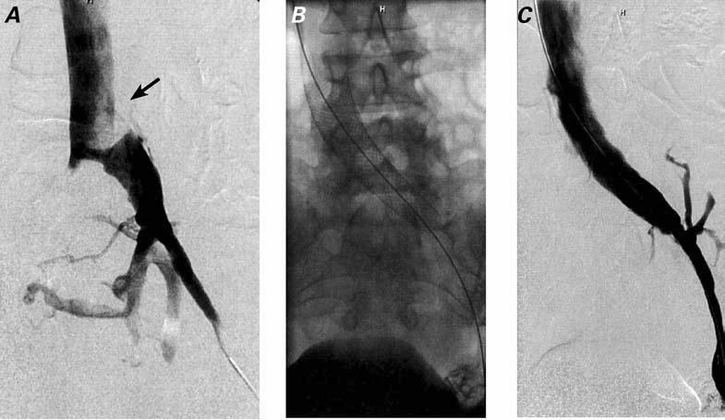
Treatment: May-Thurner

Slide 71
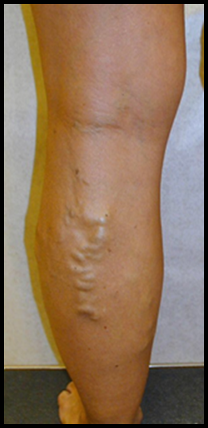
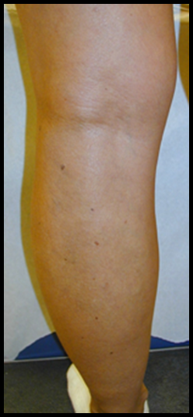
Varicose Vein Treatments
Conservative therapy
Walking
Leg elevation
Compression
Medication: Horse Chestnut/Diosmin
Endovenous thermal ablations
Radio-frequency, RFA
Lasers, EVLA
Steam
Ambulatory Phlebectomy
Injection Sclerotherapy, UGFS
Nonthermal ablation
MOCA
Cyanoacylic glue
Stripping and ligation
Notes:
MOCA=Mechanical Occlusive Chemical Abaltion

Slide 72
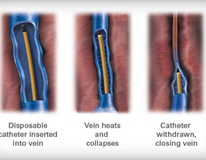
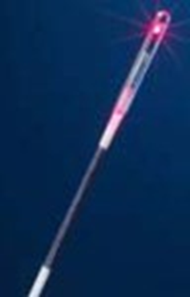
Varicose Vein Treatments Catheter-Based Endovenous Thermal Ablation
1.Gloviczki P,et al. J Vasc Surg.2011;532s-48S.
2. Van den Bos RR,et al.J Vasc Surg.2011:53:181-6.
3. Almeida JL. Endovasc Today, 2001.

Slide 73
Ambulatory “stab” Phlebectomy

Slide 74
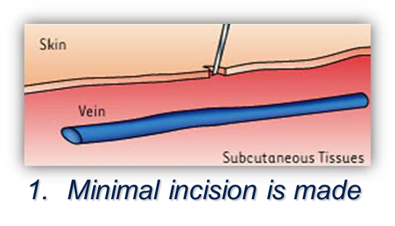
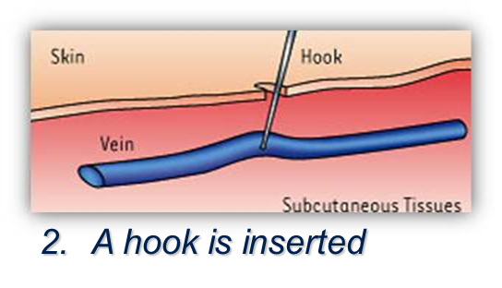
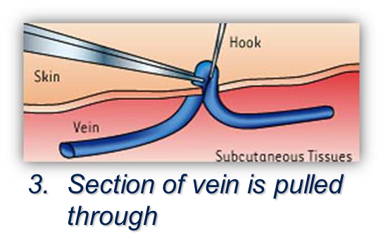
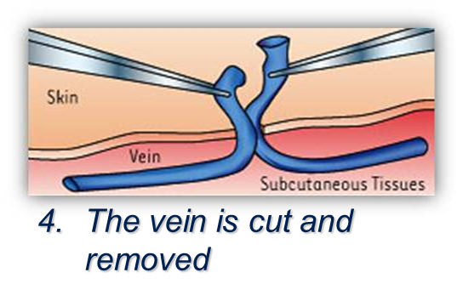
Phlebectomy
Notes:
The previous procedures, as well as this one—phlebectomy—are in office procedures. Sometimes these procedures may be used on the same patient depending on how the disorder was caused, the condition of the vessel and surrounding vessels. During the phlebectomy, the patient receives a topical suppresent for numbing and then a small incision is made on the surface of the skin above the vessel. A hook is inserted (similar to a crochet hook), the vessel is pulled up and then cut/removed and catheterized

Slide 75
Varicose Vein Treatments Injection Sclerotherapy: Foam
Generally very safe, with notable side effects: hyperpigmentation, STP, DVT, and PE
Transient visual disturbances, stroke, headache, cough being notable for foam
Rathbun S,et al.Phlebology.2014 Mar;29(2):76-82
Gloviczki P,et al. J Vasc Surg. 2011:53:2s-48S
Notes:
4:1 ratio gas ( air or CO2) to STS/polydocinol (detergents) : Like dissolves like; lipophilic cell walls Tessari method-microbubbles increases surface area thus potency

Slide 76
UGFS (Ultrasound Guided Foam Sclerotherapy)

Slide 77
Conclusion – Postthrombotic Syndrome
Up Front
After the Fact
Prevent DVT
H&P: Virchow’s Triad
Dx: Wells Criteria, D-Dimer, U/S
Rx: Fast & Effective – DOAC’s
Walk
Compression: Just Do It
H&P: Symptoms, Skin Changes
Think May-Thurner
Walk
Compression
Referral

Slide 78
Anticoagulation
Stewardship

