Slide 1
Doxycycline for Post-Exposure Prophylaxis (Doxy-PEP)
Devin Horinek, PharmD, RPh
PGY1 Pharmacy Resident
Southwest Care Center

Slide 2
Disclosures
I have NO financial disclosures or conflicts of interest with the following presented material.

Slide 3
Definitions
PEP – Post-Exposure Prophylaxis
PrEP – Pre-Exposure Prophylaxis
DOH – Department of Health
Doxy – Doxycycline
MRSA – Methicillin Resistant Staphylococcus Aureus
MSM – Men who have Sex with Men
PLWH (PWH) – Persons Living with HIV (People with HIV)
HIV – Human Immunodeficiency Virus
STI – Sexually Transmitted Infection
IPERGAY – Intervention Préventive de l’Exposition aux Risques avec et pour les Gays
Gonorrhea, GC – Neisseria gonorrhea
Chlamydia, CT – Chlamydia trachomatis
FDA – Unites States Food and Drug Administration
CDC – United States Centers for Disease Control
RCT – Randomized Clinical Trial

Slide 4
Pharmacist Learning Objectives
Identify patients indicated for doxy-PEP.
Utilize available data to effectively counsel patients how to take doxy-PEP and what adverse effects they may experience.
Know the risks of potential acquired antimicrobial resistance when prescribing doxy-PEP.
Differentiate between doxy-PEP and doxy-PrEP.

Slide 5
Pharmacy Technician Learning Objectives
Describe the purpose of doxy-PEP.
Recognize which patients could benefit from doxy-PEP.
Know which resources are available for patients regarding STI treatment and prophylaxis.
Differentiate between doxy-PEP and doxy-PrEP.

Slide 6
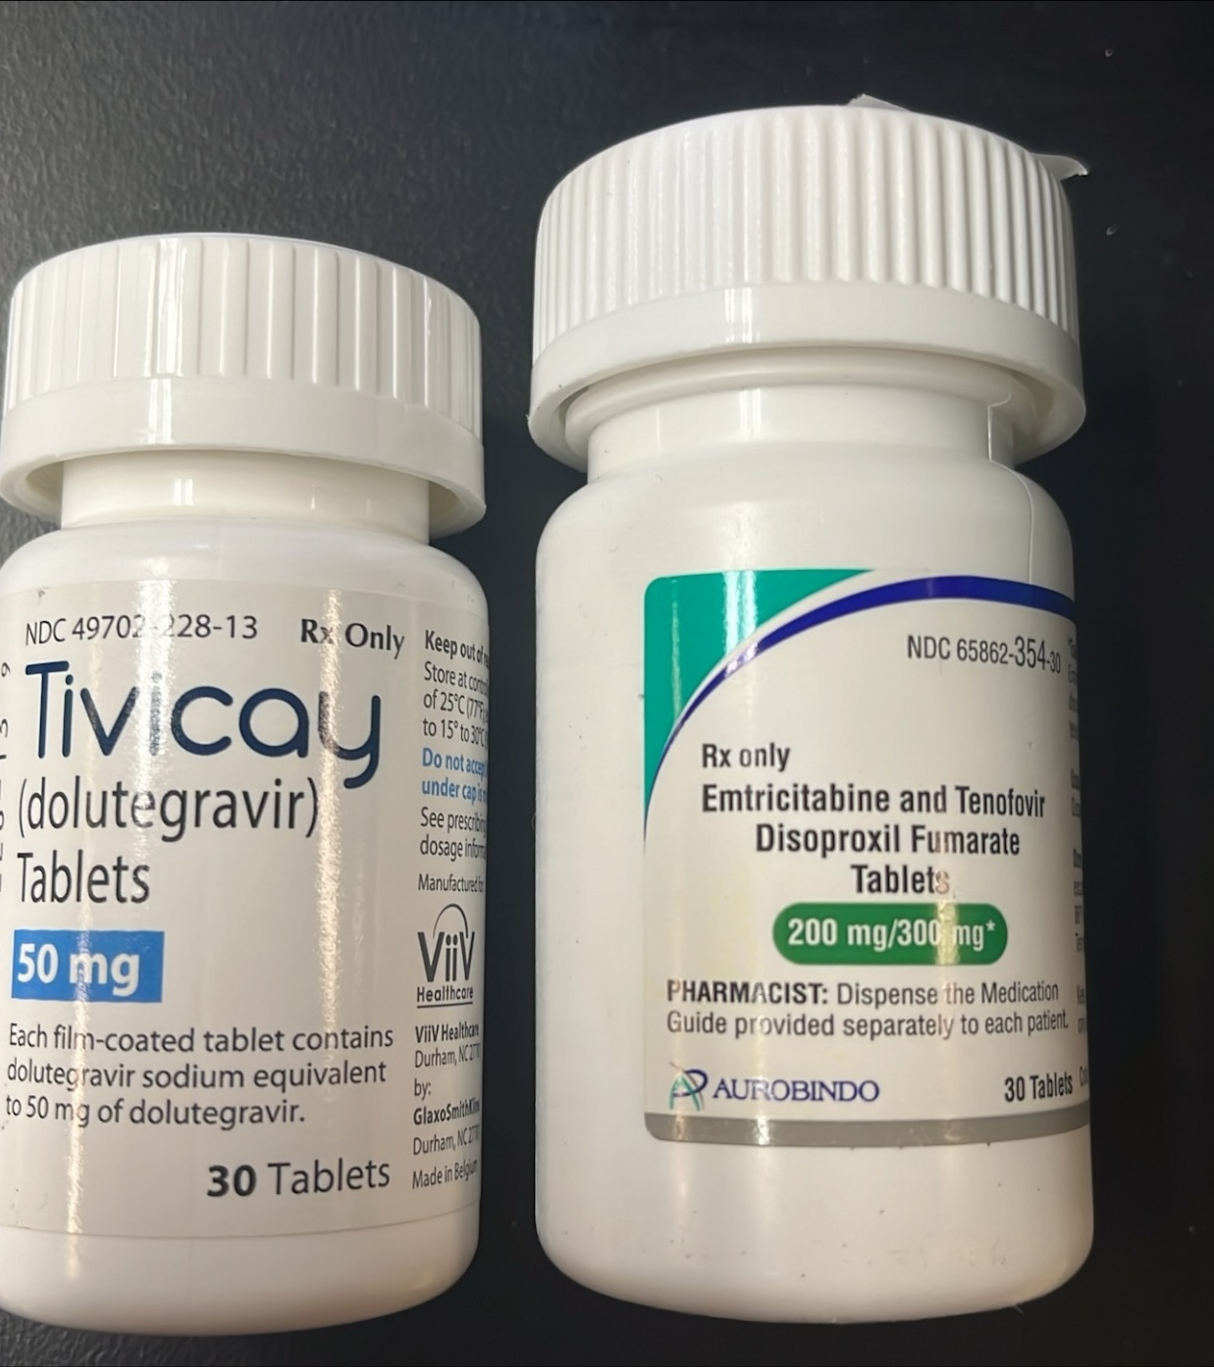
Post-Exposure Prophylaxis (PEP) is a short course of medication taken after exposure to potential infection.
HIV PEP
Should be started within 72 hours of exposure and is a 28 day course
Three drug regimen consisting of Truvada (2 drugs) or its generic equivalent + Isentress (1 drug) or Tivicay (1 drug).
Pharmacists Can prescribe HIV PEP with proper certification in New Mexico
Notes:
Also, Hepatitis B PEP that involves immune globulin and vaccination

Slide 7
Doxycycline was chosen for several reasons, including its safety profile.
Effective treatment for chlamydia and syphilis
Safety profile
Low-cost formulations
Limited drug-drug interactions
Reference: DoxyPEP 2023, Lexicomp 2023
Notes:
These are reasons given in the DoxyPEP article we will talk about later. I validated them with Lexicomp

Slide 8
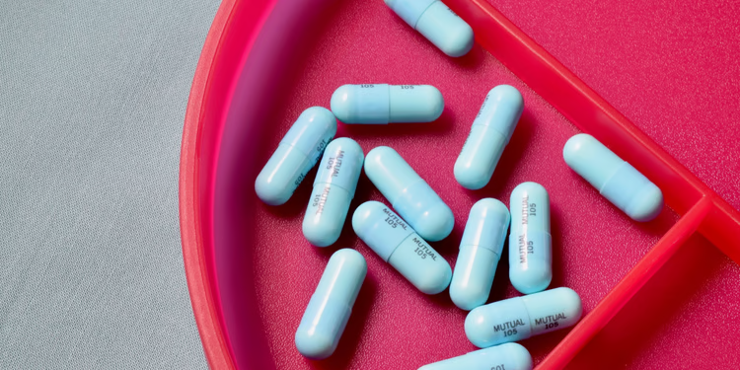
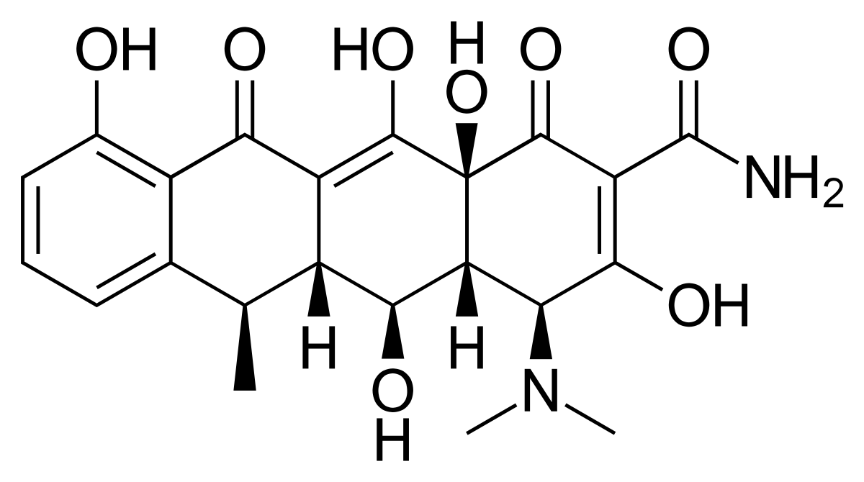
Doxycycline
Tetracycline antibiotic
Protein synthesis inhibitor
Time-dependent
Bacteriostatic
Almost completely absorbed from the GI tract
Shutterstock, 2023
Common Dosage Forms
Doxycycline Hyclate 50mg, 100mg | Doxycycline Monohydrate 50mg, 100mg
Tablets and Capsules | Tablets and Capsules
Adobe, 2017
Reference: Lexicomp, 2023

Slide 9
Which of the following is NOT a use for doxycycline?
A.) Rosacea
B.) Plague due to Yersenia pestis
C.) Varicella virus infection
D.) MRSA Skin and Soft Tissue Infections
E.) Rocky Mountain Spotted Fever

Slide 10
Many organisms are susceptible to doxycycline, including common STI pathogens.
N. gonorrhea
Shutterstock, 2023
T. pallidum
Medline Plus, 2023
C. trachomatis
Shutterstock, 2023

Slide 11
IPERGAY and Sub-study showed Doxy-PEP was effective in reducing both chlamydia and syphilis infections
IPERGAY – On-Demand Preexposure Prophylaxis in Men at High Risk for HIV-1 Infection
PrEP 2-1-1 method
Post-exposure prophylaxis with doxycycline to prevent sexually transmitted infections in men who have sex with men: an open-label randomised substudy of the ARNS IPERGAY trial (iPrEx Trial)
Doxy-PEP
Primary Endpoint – First Occurrence of STI within 10 months of follow-up
232 Patients randomized 1:1
Reference: IPERGAY Sub-study, 2018
Notes:
N=232, MSM and TGW on Truvada
First STI infection during a 10-month follow up period
Chlamydia risk reduced 70% and Syphilis risk reduced 73%
Limitation – open label and short follow up

Slide 12
The Doxy-PEP study showed reduced risk of chlamydia, gonorrhea, and syphilis infections per study quarter.
Incidence of at least one STI per follow-up quarter
 | Doxycycline Group | Standard of Care | Relative Risk | Number Needed to Treat
PrEP | 10.7% | 31.9% | 0.34 | 5
PLWH | 11.8% | 30.5% | 0.38 | 6
MSM and Transgender Women
Taking PrEP or PLWH
At least 1 chlamydia, gonorrhea, or syphilis infection in past year
317 Patients included in primary efficacy analysis from PrEP cohort and 156 from PLWH cohort
Notes:
Doxycycline Hyclate ER 200mg tablets
217 in PrEP cohort got doxy and 100 standard of care
109 in PLWH cohort got doxy and 47 standard of care
Median age was 38
30% of participants were Hispanic or LatinX
96% identified as male gender with 87% of participants assigned male at birth
Persons in standard of care group were recommend to switch to doxy after 8 months because they study had crossed the stopping boundary for effectiveness
RR= risk is lowered by about 66% in the PrEP cohort and 62% in the PLWH cohort
NNT= need to treat 5 patients in the PrEP cohort to prevent one STI and 6 patients in the PLWH cohort to prevent one STI
More pharyngeal gonorrhea
More rectal chlamydia
Terminated early due to significant efficacy

Slide 13
Figure 2: Primary, Secondary, and Subgroup Analyses of Effectiveness against Incident Sexually Transmitted Infections (STIs).
Not statistically significant.
Reference: DoxyPEP, 2023
Notes:
Reduced syphilis by 87%, CT by 88%, and GC by 55%
Limitations – short follow up and open label

Slide 14
Figure 2: Primary, Secondary, and Subgroup Analyses of Effectiveness against Incident Sexually Transmitted Infections (STIs).
Not statistically significant
Reference: DoxyPEP, 2023
Notes:
Reduced syphilis by 77%, GC 74%, and CT57%

Slide 15
A Doxy-PEP study among cisgender women in Kenya showed no statistically significant differences in incidences of chlamydia, gonorrhea, or syphilis infections.
STI | All STIs | Chlamydia | Gonorrhea
Relative Risk | 0.88 | 0.73 | 1.64
95% Confidence Interval | 0.6-1.29 | 0.47-1.13 | 0.78-3.47
Reference: dPEP, 2023
Notes:
Any incident of STI
There were only two syphilis infections during the study

Slide 16
Waiting for guidelines from the CDC after opening the document for public comment, but current recommendations are given the Grade A1.
Doxy as STI PEP when offered should be implemented in the context of a comprehensive sexual health approach.
Current efficacy data only applies to gay and bisexual MSM and transgender women.
Doxycycline 200mg administered within 24-72 hours of condomless sex was the regimen evaluated. Other antibiotics should not be considered.
In addition to informing patients about the potential STI prevention benefits of doxy as PEP, providers should also counsel patients about potential adverse effects.
Providers should continue to screen, test, and treat for bacterial STIs in accordance with CDC’s STI Treatment Guidelines, even among people using Doxycycline as PEP or PrEP.
Reference: CDC, 2023

Slide 17
New Mexico DOH has current recommendations for clinicians
Recommend doxy-PEP to MSM and TGW who have had one or more bacterial STIs in the past 12 months.
Offer doxy-PEP using shared clinical decision-making to all non-pregnant individuals at increased risk for bacterial STIs and to those requesting doxy-PEP, even if these individuals have not been previously diagnosed with an STI or have not disclosed their risk status.
For all sexually active individuals, provide comprehensive sexual health counseling and education, including HIV/STI screening, HIV PrEP and PEP, immunizations, condoms, and contraception as appropriate.
Reference: New Mexico DOH, 2023

Slide 18
New Mexico DOH endorses use of the California Department of Public Health’s guidelines to providers
Prescribe 200mg of doxycycline to be taken within 72 hours (ideally within 24 hours) after condomless oral, anal, or vaginal sex. It can be taken daily depending on sexual activity, but no more than 200mg in 24 hours.
Clinicians can prescribe an amount of doxycycline to meet a patient’s anticipated use for 1-3 months.
Either immediate release or delayed release doxycycline may be prescribed. Immediate release may be less expensive and should be equivalently bioavailable. The delayed release formulation has an enteric coating which delays release until further down the GI tract which prevents nausea but doesn’t change the pharmacokinetics.
Screen for GC and CT at all anatomic sites of exposure (urogenital, pharyngeal, and/or rectal), syphilis and HIV (if not a known PLWH) at initiation of doxy-PEP and every three months. If diagnosed with an STI, treat according to CDC STI Treatment Guidelines (cdc.gov).
Counsel persons who can become pregnant that doxycycline should not be taken during pregnancy. Rule out pregnancy prior to prescribing doxy-PEP.
Counsel patients on standard precautions and warnings while taking doxy-PEP, (e.g., sun sensitivity, pill esophagitis, and rarely intracranial hypertension).
Reference: New Mexico DOH, 2023

Slide 19
NM DOH Prescription
Reference: Southwest Care Center, 2023

Slide 20
Which of the following are correct counseling points for Doxycycline-PEP?
A.) Take with a full glass of milk
B.) Can cause increased sun sensitivity
C.) Can cause upset stomach
D.) Take until all medication is gone
E.) Taking with proton pump inhibitors can help increase absorption

Slide 21
Doxy-PEP Patient Counseling
May take daily, but do not take more than 200mg (1 dose) in a 24-hour period
May cause upset stomach or diarrhea
May cause increased sensitivity to the sun
Avoid taking with multivitamins or supplements containing certain metals – separate by at least 2 hours before or 4 hours after, if necessary
Ca2+, Mg 2+, Fe2+, etc…
Acid suppressing therapy may decrease absorption
Reference: Lexicomp, 2023
Notes:
Must be within 72 hours of unprotected sex

Slide 22
Doxycycline Postexposure Prophylaxis Could Induce Cross-Resistance to Other Classes of Antimicrobials in Neisseria gonorrhoeae: An In Silico Analysis
Analyzed 2375 gonococcal isolates from the 2018 Euro-GASP survey.
Tested 2 major determinates of reduced susceptibility to tetracyclines to assess resistance to other antimicrobials acquired indirectly.
tetM
rpsJV57M
Found strong evidence of clonal spread of tetM and rpsJV57M by genogroup.
Recommend monitoring for the emergence of resistance to other antimicrobials in N. gonorrhea and other bacterial species.
Reference: Resistance, 2023

Slide 23
Considerations for Resistance
Bacterial resistance to antimicrobials should always be considered when prescribing antibiotics.
Local resistance patterns should be examined when prescribing long-term antibiotics.
Doxy-PEP is still effective for GC infection prevention even with baseline resistance and high-level resistance to tetracyclines.
S. aureus showed some increased resistance in the Doxy-PEP arm, but there were no significant changes when studying MRSA.
There is a possibility that resistance to tetracyclines will confer resistance to other antimicrobials with similar mechanisms of action.
Resistance patterns for Neisseria gonorrhea vary by geographical region, the previous study was conducted in Europe, where resistant N. gonorrhea is more prevalent than in the United States.

Slide 24
Doxycycline Prophylaxis for Bacterial Sexually Transmitted Infections (Doxy-PrEP) has not been studied to the same scale as Doxy-PEP
To prevent syphilis, gonorrhea, or chlamydia infections
Multiple RCTs with positive results
Doxycycline 200mg 24-72 hours after unprotected sex
To prevent syphilis, gonorrhea, or chlamydia infections
Several small-scale studies with positive results
Doxycycline 100mg daily
VS
Reference: CDC, 2023

Slide 25
Resources for Pharmacies
CDC.gov
NM DOH – NMHealth.org
NMHIVguide.org

Slide 26
This is a great resource for clinics in New Mexico and allows you to easily search for testing sites.
Reference: NMHIVGuide.org

Slide 27
Conclusion
Doxycycline for PEP is an effective way to help prevent STIs in the MSM and Transgender Women populations who are taking PrEP or who are living with HIV.
Risks of antimicrobial resistance should be weighed against the benefits of doxy-PEP when prescribing long-term use of doxycycline.
Doxy-PEP and doxy-PrEP are both used off-label in practice, but studies for doxy-PEP have more data and compelling evidence.

Slide 28
References
Chlamydia infections | chlamydia | chlamydia symptoms. MedlinePlus. Accessed August 22, 2023. https://medlineplus.gov/chlamydiainfections.html.
Grant JS, Stafylis C, Celum C, et al. Doxycycline Prophylaxis for Bacterial Sexually Transmitted Infections. Clin Infect Dis. 2020;70(6):1247-1253. doi:10.1093/cid/ciz866
Grossman TH. Tetracycline Antibiotics and Resistance. Cold Spring Harb Perspect Med. 2016;6(4):a025387. Published 2016 Apr 1. doi:10.1101/cshperspect.a025387
Jacobson K. Doxycycline Post-Exposure Prophylaxis (doxy-PEP) for the Prevention of Bacterial Sexually Transmitted Infections. April 28, 2023. Accessed August 22, 2023. chrome-extension://efaidnbmnnnibpcajpcglclefindmkaj/https://www.cdph.ca.gov/Programs/CID/DCDC/CDPH%20Document%20Library/CDPH-Doxy-PEP-Recommendations-for-Prevention-of-STIs.pdf.
Luetkemeyer AF, Donnell D, Dombrowski JC, et al. Postexposure Doxycycline to Prevent Bacterial Sexually Transmitted Infections. N Engl J Med. 2023;388(14):1296-1306. doi:10.1056/NEJMoa2211934
Molina JM, Capitant C, Spire B, et al. On-Demand Preexposure Prophylaxis in Men at High Risk for HIV-1 Infection. N Engl J Med. 2015;373(23):2237-2246. doi:10.1056/NEJMoa1506273
Molina JM, Charreau I, Chidiac C, et al. Post-exposure prophylaxis with doxycycline to prevent sexually transmitted infections in men who have sex with men: an open-label randomised substudy of the ANRS IPERGAY trial. Lancet Infect Dis. 2018;18(3):308-317. doi:10.1016/S1473-3099(17)30725-9

Slide 29
References
National Center for Biotechnology Information. PubChem Compound Summary for CID 54671203, Doxycycline. https://pubchem.ncbi.nlm.nih.gov/compound/Doxycycline. Accessed Aug. 22, 2023.
Neisseria gonorrhoeae: Symptoms: Transmission: L&amp;R prevent and protect |. L&amp;R Prevent and Protect. August 13, 2021. Accessed August 22, 2023. https://prevent-and-protect.com/pathogen/neisseria-gonorrhoeae/.
Patel RS, Parmar M. Doxycycline Hyclate. [Updated 2023 May 22]. In: StatPearls [Internet]. Treasure Island (FL): StatPearls Publishing; 2023 Jan-. Available from: https://www.ncbi.nlm.nih.gov/books/NBK555888/
Primary prevention methods. Centers for Disease Control and Prevention. April 3, 2023. Accessed August 22, 2023. https://www.cdc.gov/std/treatment-guidelines/clinical-primary.htm#CautionsForDoxyPEP.
Reducing STI risk with doxycycline: Is it a good idea? - healthnews. Accessed August 22, 2023. https://healthnews.com/health-conditions/immunity-infections/reducing-sti-risk-with-doxycycline-is-it-a-good-idea/.
Treponema pallidum (syphilis): Symptoms: Transferability: Treatment |. L&amp;R Prevent and Protect. August 13, 2021. Accessed August 22, 2023. https://prevent-and-protect.com/pathogen/treponema-pallidum-syphilis/.
Vanbaelen T, Manoharan-Basil SS, Kenyon C. Doxycycline Postexposure Prophylaxis Could Induce Cross-Resistance to Other Classes of Antimicrobials in Neisseria gonorrhoeae : An In Silico Analysis. Sex Transm Dis. 2023;50(8):490-493. doi:10.1097/OLQ.0000000000001810

Slide 30
Questions?
Tenor, 2023
dhorinek@southwestcare.org

