Slide 1
Pharmacist Technician Immunization Training Course
Home Study

Slide 2
Who’s Excited?
After you get your certification, you will be able to administer Immunizations (IZ)…
Please Ensure you submit all of the following…
technician certification
Supervising Pharmacist letter of reference
CPR certification
Home study assessment exam (70% required)
Home study NMPHA evaluation form

Slide 3
Introduction
NMPhA presents the “NEW MEXICO PHARMACY TECHNICIAN IMMUNIZATION HOME STUDY TRAINING COURSE.”
This course was created in collaboration with the University of New Mexico College of Pharmacy, the Department of Health New Mexico Immunization Coalition, the New Mexico Board of Pharmacy, and the New Mexico Pharmacists Association.
This course is accredited by the Accreditation Council for Pharmacy Education (ACPE).
ACPE #0104-0000-20-044-H06-T 3 contact hrs. / 0.3 CEUs / Initial Release Date: 12/2/20 / Expiration Date: 12/2/2023
Presenters:
Amy Bachyrycz, PharmD, Walgreen’s Patient Care Center Clinical Pharmacy Specialist; Clinical Assistant Professor, UNM College of Pharmacy, Albuquerque, NM
Alexandra Herman, PharmD, Assistant Professor - Clinical Educator, University of New Mexico College of Pharmacy Department of Pharmacy Practice & Administrative Sciences, Albuquerque, NM

Slide 4
Disclosures
Amy Bachyrycz, PharmD, has nothing to disclose and is not a paid speaker for any vaccine manufacturer or drug company. I am an NMPhA Immunization Trainer for Pharmacists, and NMPhA trainer for pharmacy students at the University of New Mexico College of Pharmacy, and an APhA Trainer for Pharmacists & Technicians.
Alexandra Herman, PharmD, has nothing to disclose and is not a paid speaker for any vaccine manufacturer or drug company. She is an NMPhA Immunization Trainer for pharmacy students at the University of New Mexico College of Pharmacy.

Slide 5
Objectives
Pharmacy Technicians, at the completion of this course, will be able to:
Describe proper technique when drawing up and administering immunizations.
Recognize vaccines, preparations, and their appropriate routes of administration.
Identify proper supplies, needle size & length based on vaccine, and patient age/size.
Identify proper documentation, reporting, and vaccine storage requirements.
Describe safety measures to avoid accidental needle stick injuries.
Describe appropriate procedures for emergency situations.

Slide 6
History of the pharmacy technician
In the1960s and early 1970s, pharmacists saw an important role for pharmacy technicians. By taking over a variety of administrative duties, pharmacy technicians would allow licensed pharmacists to focus on the decision-making process of pharmacy.
In the first part of the 20th century, there was no real recognition of pharmacy technicians by the pharmacy profession. However, since the 1970s, several steps have been taken to recognize pharmacy technicians.
In 1975, the American Society of Health-System Pharmacists (ASHP) created training guidelines for hospital pharmacy support personnel.
In 1982, the ASHP created standards for the accreditation of pharmacy technician training programs.
In 1995, the ASHP and other groups created the Pharmacy Technicians Certification Board (PTCB).
In 2002, the Institute for the Certification of Pharmacy Technicians (ICPT) established the Exam for the Certification of Pharmacy Technicians (ExCPT).

Slide 7
History of immunizations in new Mexico
In 1993, New Mexico Pharmacy Clinicians (PhC) were granted authority to prescribe and administer immunizations.
In 2001, New Mexico pharmacists were granted authority to prescribe and administer immunizations.
In 2015, New Mexico pharmacists were granted authority to prescribe and dispense certain travel medications.
In 2020, New Mexico pharmacy technicians were allowed to administer immunizations during the emergency COVID order only.
Future, New Mexico pharmacy technicians were granted authority…yet to come.
New Mexico Protocol for Pharmacists Prescribing of Vaccines: https://www.nmpharmacy.org/resources/Documents/IZprot2015%20-%20June%20BOP-Aug%20MB-Aug%20BON%201.pdf

Slide 8
The pharmacy technician’s role in immunizations in new Mexico (actions technicians may perform)
As a New Mexico pharmacy technician, certified in immunizations, you will be able to:
Identify eligible patients for immunizations.
Perform clinic set-up or 2nd dose appointment scheduling.
Perform inventory management, immunization ordering, and temperature log recording.
Prepare and administer immunizations.
Complete billing and claim adjudication.
Complete documentation of immunizations.
NM Board of Pharmacy Qualified Pharmacy Technician Childhood and COVID-19 Vaccine Administration and COVID-19 Testing Document: http://www.rld.state.nm.us/uploads/FileLinks/ad6770c244f74bdaaeaa53842023b4c7/technician_vaccine_administration_and_covid_testing_ii.pdf

Slide 9
the pharmacist’s role in immunizations in new Mexico (actions technicians may not perform)
Verifying the screening questions, consent form, and immunization prescription.
Educating patients on vaccines and clinical information (vaccine education).
Counseling patients on other vaccine needs (vaccine assessment).
Decision making for and with patients on vaccine needs (clinical decision making).
Answering patient questions pre & post vaccine administration (vaccine counseling).
Administration of Emergency Response prescription medication(s) (emergency situations).

Slide 10
Pharmacy technicians success with immunizations thus far & yet To come…
In Idaho on March 2017, a new law allowed a pharmacist to “delegate the technical task of administering an immunization to a student pharmacist or a certified technician…” (Idaho Rule 330.03)
A study completed in Idaho, looked at dates between December 2016 to May 2017, where immunized trained certified pharmacy technicians administered 953 vaccinations to patients with no adverse events.
The U.S. Department of Health and Human Services (HHS) has released federal guidance that now expands the immunization authorities of “qualified” pharmacy technicians during the public health emergency.
McKeirnan KC, Frazier KR, Nguyen M, et al. Training pharmacy technicians to administer immunizations. JAPHA. 2018; 58(2):174-178. http://www.japha.org/article/S1544-3191(18)30004-9/pdf.

Slide 11
HHS Federal guidance
Please reference the following HHS document at https://www.hhs.gov/sites/default/files/prep-act-guidance.pdf
Interns and technicians who meet conditions set forth by HHS will not only be allowed to administer ACIP-recommended childhood vaccines (ages 3 to 18) and FDA-authorized or licensed COVID-19 vaccines and tests (ages 3 and older)—including serology tests—but they will also be granted liability coverage for these duties during the public health emergency.
According to the guidance, to be deemed a “qualified person” under federal law—that is, authorized and granted liability coverage to administer FDA-authorized or FDA-licensed COVID-19 vaccines to patients ages 3 or older or ACIP-recommended childhood vaccinations to patients ages 3 through 18—qualified pharmacy technicians and state-authorized pharmacy interns must satisfy and practice under certain requirements.
Requirement summary: https://www.pharmacist.com/article/pharmacy-interns-and-techs-who-meet-hhs-requirements-can-administer-childhood-covid-19

Slide 12
New Mexico Board of Pharmacy state Guidance
Please reference the following New Mexico Board of Pharmacy (NM BOP) document at http://www.rld.state.nm.us/uploads/FileLinks/ad6770c244f74bdaaeaa53842023b4c7/technician_vaccine_administration_and_covid_testing_ii.pdf
Interns and technicians who meet conditions set forth by the NM BOP will not only be allowed to administer ACIP-recommended childhood vaccines (ages 3 to 18) and FDA-authorized or licensed COVID-19 vaccines and tests (ages 3 and older)—including serology tests—but they will also be granted liability coverage for these duties during the public health emergency.
NM BOP Additional Allowances and Requirements:
A qualified pharmacy technician may administer influenza vaccine to persons ages three or older.
According to the guidance, to be deemed a “qualified person” under federal law—that is, authorized and granted liability coverage to administer FDA-authorized or FDA-licensed COVID-19 vaccines to patients ages 3 or older or ACIP-recommended childhood vaccinations to patients ages 3 through 18—qualified pharmacy technicians and state-authorized pharmacy interns must satisfy and practice under certain requirements.
Requirement summary: http://www.rld.state.nm.us/uploads/FileLinks/ad6770c244f74bdaaeaa53842023b4c7/technician_vaccine_administration_and_covid_testing_ii.pdf

Slide 13
So who can you, Pharmacy Technician, immunize/vaccinate in new Mexico?
Ages 3 to 18, All Advisory Committee on Immunization practices (ACIP) routine vaccines
Ages 3 and above, all FDA-Approved influenza vaccines
Ages 3 and above, all FDA-Authorized or FDA-licensed covid-19 vaccines

Slide 14
Requirements & suggestions
Required:
NM BOP Guidance Letter
NM BOP Pharmacy Technician License
Pharmacy Technician Certification
Immunization Certification
CPR Certification
Optional, but strongly encouraged:
Blood Bourne Pathogen OSHA Training
Hepatitis B Vaccination Series
Professional Liability Insurance
Needle Stick Policies and Procedures

Slide 15
Immunization definitions
In accordance with the NM BOP Pharmacist Prescribing Immunization Regulations (16.19.26 NMAC) http://www.rld.state.nm.us/uploads/files/16_19_26%20Immunization.pdf:
A. "Antigen" means a substance recognized by the body as being foreign; it results in the production of specific antibodies directed against it.
B. "Antibody" means a protein in the blood that is produced in response to stimulation by a specific antigen.
C. "Immunization" means the act of inducing antibody formation, thus leading to immunity.
D. "Vaccine" means a specially prepared antigen, which upon administration to a person, will result in immunity.
E. "Vaccination" means the administration of any antigen in order to induce immunity; is not synonymous with immunization since vaccination does not imply success.
F. “Macrophages” are white blood cells that swallow up and digest germs, plus dead or dying cells. The macrophages leave behind parts of the invading germs called antigens. The body identifies antigens as dangerous and stimulates antibodies to attack them.
G. “B-lymphocytes” are defensive white blood cells. They produce antibodies that attack the antigens left behind by the macrophages.
H. “T-lymphocytes” are another type of defensive white blood cell. They attack cells in the body that have already been infected.

Slide 16
How vaccinations work
To fully understand how vaccinations work, please review https://www.cdc.gov/vaccines/hcp/conversations/downloads/vacsafe-understand-color-office.pdf
Vaccines help develop immunity by imitating an infection. This type of infection, however, almost never causes illness, but it does cause the immune system to produce T-lymphocytes and antibodies to fight against the illness.
Sometimes, after getting a vaccine, the imitation infection can cause minor symptoms, such as fever (systemic reaction) or red arm (local reaction), which are normal and should be expected but do not always occur.
Once the imitation infection goes away, the body is left with a supply of T-lymphocytes, as well as B-lymphocytes that will remember how to fight that disease in the future. However, it typically takes a few weeks for the body to produce T-lymphocytes and B-lymphocytes after vaccination.
Therefore, it is possible that a person infected with a disease just before or just after vaccination still get the disease, because the vaccine has not had enough time to provide protection.

Slide 17
How vaccines work
The British Society for Immunology: https://www.immunology.org/celebrate-vaccines/public-engagement/guide-childhood-vaccinations/how-vaccines-work

Slide 18
Two Common types of vaccines
Live, attenuated vaccines fight viruses and bacteria.
These vaccines contain a version of the living virus or bacteria that has been weakened so that it does not cause serious disease in people with healthy immune systems.
Because live, attenuated vaccines are the closest thing to a natural infection, they are considered teachers for the immune system.
Even though these vaccines are very effective, not everyone can receive these vaccines. People with a weakened immune systems (i.e. those undergoing chemotherapy) or people who are pregnant, cannot get live, attenuated vaccines.
Inactivated vaccines also fight viruses and bacteria.
These vaccines are activated by killing the virus or bacteria during the process of developing and making the vaccine.
Inactivated vaccines produce immune responses in different ways than live attenuated vaccines.
Often times multiple doses may be necessary to build up or maintain immunity against the virus or bacteria.
Inactivated vaccines can be received by people even if they have a weakened immune system or are pregnant.
https://www.cdc.gov/vaccines/hcp/conversations/downloads/vacsafe-understand-color-office.pdf

Slide 19
recognizing vaccines
Influenza vaccine
Approved for 6 months and above.
Not every manufacturer has this age approval.
All need one vaccine every season.
Pneumococcal vaccine
Two different types of vaccines exist.
There are other strains of pneumococcal disease that the vaccines do not protect against.
Medical condition & age predict which vaccine is needed and when.
Tetanus, Diphtheria, Pertussis vaccine
Whooping cough is caused by the pertussis virus.
Pregnant women need a vaccine with every pregnancy.
Others need one vaccine every ten years.
Shingles vaccine
When adults get chickenpox, it’s called herpes zoster or shingles.
Healthy lifestyle can also help to prevent shingles.
Medical condition & age predict if this vaccine is appropriate.

Slide 20
Types of covid-19 vaccines
Currently, there are three main types of COVID-19 vaccines that have, are, or soon will be undergoing large-scale clinical trials.
mRNA vaccines contain material from the virus that causes COVID-19 that gives our cells instructions for how to make a harmless protein that is unique to the virus. After our cells make copies of the protein, they destroy the genetic material from the vaccine. Our bodies recognize that the protein should not be there and build T-lymphocytes and B-lymphocytes that will remember how to fight the virus that causes COVID-19 if we are infected in the future.
Protein subunit vaccines include harmless pieces (proteins) of the virus that cause COVID-19 instead of the entire germ. Once vaccinated, our immune system recognizes that the proteins don’t belong in the body and begins making T-lymphocytes and antibodies. If we are ever infected in the future, memory cells will recognize and fight the virus.
Vector vaccines contain a weakened version of a live virus, a different virus than the one that causes COVID-19, that has genetic material from the virus that causes COVID-19 inserted in it (this is called a viral vector). Once the viral vector is inside our cells, the genetic material gives cells instructions to make a protein that is unique to the virus that causes COVID-19. Using these instructions, our cells make copies of the protein. This prompts our bodies to build T-lymphocytes and B-lymphocytes that will remember how to fight that virus if we are infected in the future.
CDC COVID-19 Vaccine Resource:
https://www.cdc.gov/coronavirus/2019-ncov/vaccines/different-vaccines/how-they-work.html

Slide 21
Immunity types
To fully understand how immunity works please review https://www.cdc.gov/vaccines/vac-gen/immunity-types.htm
Immunity to a disease is achieved through the presence of antibodies to that disease in a person’s system. Antibodies are proteins produced by the body to neutralize or destroy toxins or disease-carrying organisms. Antibodies are disease-specific. For example, measles antibody will protect a person who is exposed to measles disease, but will have no effect if he or she is exposed to mumps.
There are two types of immunity:
Active immunity results when exposure to a disease organism triggers the immune system to produce antibodies to that disease (like vaccines). Exposure to the disease or organism can occur through infection with the actual disease (resulting in natural immunity), or introduction of a killed or weakened form of the disease organism through vaccination (vaccine-induced immunity). Either way, if an immune person comes into contact with that disease in the future, their immune system will recognize it and immediately produce the antibodies needed to fight it. Active immunity is long-lasting, and sometimes life-long.
Passive immunity is provided when a person is given antibodies to a disease rather than producing them through his or her own immune system. A newborn baby acquires passive immunity from its mother through the placenta. A person can also get passive immunity through antibody-containing blood products such as immune globulin, which may be given when immediate protection from a specific disease is needed. Passive immunity; protection is immediate, whereas active immunity takes time (several weeks) to develop.

Slide 22
Resources for understanding how immunizations work
New Mexico Immunization Coalition https://hsc.unm.edu/about/administrative-departments/community-health/programs/nmic/
New Mexico Department of Health https://www.kob.com/new-mexico-news/fact-vs-fiction-what-you-need-to-know-about-the-covid-19-vaccine/5941661/
KOB 4: fact or fiction https://www.kob.com/new-mexico-news/fact-vs-fiction-what-you-need-to-know-about-the-covid-19-vaccine/5941661/
PublicHealth.org https://www.publichealth.org/public-awareness/understanding-vaccines/vaccines-work/

Slide 23
The Why to immunize
U.S. Preventable Disease Outbreaks
As of November 27, 2020, 35 states have reported Hepatitis A outbreaks for a total of 36,697 cases, with 22,450 (61%) hospitalizations, and 345 deaths.
As of April 24, 2019, the CDC was reporting 695 cases of Measles from 22 states. This is the greatest number of cases reported in the U.S. since Measles was eliminated from this country in 2000.
New Mexico Preventable Disease Outbreaks
As of September 5, 2019, The New Mexico Department of Health said it was investigating six Mumps cases in Bernalillo County with patients ranging in age from 7 to 41.
As of October 31, 2018, New Mexico State Health Officials reported 103 confirmed Hepatitis A infections in Bernalillo County with 2 associated deaths, in adults ranging in age from 19-64.
CDC: https://www.cdc.gov/media/releases/2019/s0424-highest-measles-cases-since-elimination.html

Slide 24
So let’s do it new Mexico pharmacy technicians!
You have been selected by your Supervising Pharmacist because you have the following qualities:
Communication skills
Perform at a high level
Dedication to patients
Dedication to pharmacy
Motivation to protect patients
Motivation to save lives
And other skills…

Slide 25
vaccine preparation
Proper vaccine preparation is essential when you are maintaining the integrity of the vaccine from vial to syringe and from syringe to a patient.
Aseptic technique and following infection prevention guidelines are also essential when preparing vaccines to be administered to a patient.
Aseptic technique = this is the way you handle, prepare, and store vaccines and supplies to prevent bacterial contamination.
Hands should be cleansed with an alcohol-based waterless antiseptic hand rub or washed with soap and water before preparing vaccines and between each patient interaction.
Current federal guidelines do not require gloves to be worn when administering vaccinations, unless persons administering vaccinations have open lesions on their hands or are likely to come into contact with a patient’s body fluids. However, use of gloves is strongly encouraged by the New Mexico Pharmacist Association.
If gloves are worn, they should be changed between each patient. If unable to do so, gloves must be sanitized between each patient and not be used for more than 5 patients.
Vaccines should be drawn up in a designated clean area (not directly in front of the patient). The area should not be where possible contaminated items are or may be placed.
To prevent contamination of the vial, ensure all areas that the vial may be exposed to are clean and free of potential contamination.
ACIP Vaccine Administration: https://www.cdc.gov/vaccines/hcp/acip-recs/general-recs/administration.html

Slide 26
Vaccine preparation
Ensure you have all the proper equipment needed (use a separate needle and syringe for each injection and each patient).
Different single-components of combination vaccines should never be mixed in the same syringe unless specifically approved for you to do so.
Single-dose vials and manufacturer pre-filled syringes are designed for one time administration and should be discarded if vaccine has been withdrawn or reconstituted and subsequently not used within the time frame specified by the manufacturer. Always specify this time frame clearly, where the prepared vaccine is kept, to ensure it is not used after the recommended timeframe.
Single-dose vials or multi-dose vials that have been prepared in a needle/syringe, should be discarded after 6 hours in accordance with the NM BOP recommendations.
Manufacturer pre-filled syringes that have been prepared with a needle, but unused, should be discarded at the end of the clinic day.
If questions arise regarding stability, please refer to your supervising pharmacist immediately.
Always check the expiration dates on all supplies, vaccine, and diluent, before you prepare the vaccine.
The CDC best practices recommendation is to only administer vaccines you have prepared, however, if another person prepares the vaccine you must administer, please make sure it is clearly marked/labelled, so you can be sure what vaccine is in the syringe.
CDC: https://www.cdc.gov/vaccines/hcp/admin/prepare-vaccines.html

Slide 27
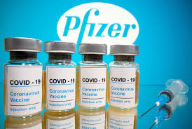
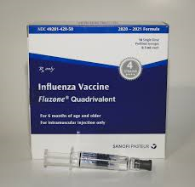
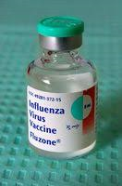

Slide 28
vaccine preparation
Single dose vial preparation: https://www.youtube.com/watch?v=aYpKmjFMZcg
Multi-dose vial preparation: https://www.youtube.com/watch?v=TDcFievcUVs
Manufacturer Pre-filled syringe preparation: https://www.youtube.com/watch?v=b22fcpRtMiE&feature=youtu.be
Reconstitution preparation: https://www.youtube.com/watch?v=oZAOqlk3TBA

Slide 29
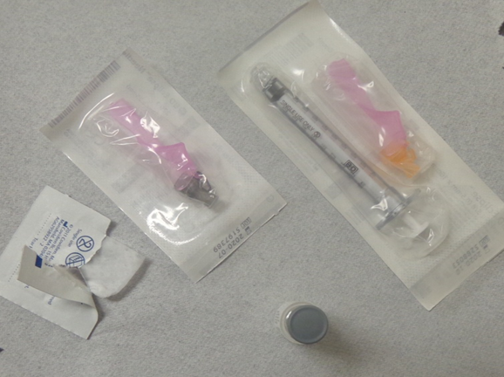
Summary; drawing up vaccine
Assemble your supplies and equipment
Wash hands
Wear gloves
Alcohol swab stopper for vials and let dry
Hold the vial upside-down & push the needle through the rubber stopper
Air to liquid exchange for vials only (draw up the amount of air in the syringe = to the amount you will pull out of the vial) push air in and draw back slowly
Secure needle for manufacturer-prefilled syringes (click ensures needle is secure)
Remove air bubbles
Safely recap needle (new needle is the only time recapping is allowed)
Check and double check vaccine, dose, and patient label

Slide 30
Equipment and supplies
Needle gauge size indicates thinness or thickness of the needle.
The first number in front of the letter G indicates the gauge size of the needle. The higher this number is, the thinner the needle.
Needle length size is based on type of immunization or type of route of administration.
The second number after the letter G indicates the length of the needle in inches.
The needle length depends on a patient’s size (i.e. a small child may need a shorter needle than an adult) as well as where the needle will be administered.
Syringe size is based on volume capacity in milliliters (mL) or cubic centimeters (cc).
The syringe size should be as close as possible to the final volume of the vaccine.

Slide 31
vaccines site of administration
Subcutaneous injections go into the fatty tissue just below the skin. Since these are relatively shallow shots, the needle required is small and short (5/8 inch long with a gauge of 25 to 30).
Intramuscular injections go directly into the muscle. Muscle is deeper than the SQ layer of skin, so the needle used for IM injections must be thicker and longer than SQ injections (1 inch long with a gauge of 22 to 25).
For these injections, you must consider the amount of body fat the needle has to go through. While a thin person might be able to use an inch-long needle, someone heavier might need a needle that is an inch-and-a-half-long.

Slide 32
Needle size selection
Selecting the proper needle length when vaccinating your patients is critical – vaccine must reach the desired tissue site for optimal immune response to occur. To determine the proper needle length to use in each situation, you must consider the following factors:
Route of Administration (Intramuscular or Subcutaneous)
Site of Injection (deltoid or anterolateral thigh area)
Infants and children age and size
Adults weight

Slide 33
Sites of administration; chart review
Immunization Action Coalition: https://www.immunize.org/catg.d/p3085.pdf

Slide 34
Needle size selection
Infants and Children: Intramuscular (IM) injections
For newborns (0–28 days): Use anterolateral thigh muscle, ⅝" needle, 22–25 gauge Note: For neonates (first 28 days of life) and preterm infants, a ⅝" needle is recommended if the skin is stretched flat between the thumb and forefinger and the needle is inserted at a 90° angle to the skin.
For infants (1–12 months): Use anterolateral thigh muscle, 1" needle, 22–25 gauge
For toddlers (1–2 years): There are two options for injection site and needle length:
Anterolateral thigh muscle – use 1"–1¼" needle, 22–25 gauge
Deltoid muscle – if muscle mass adequate, use ⅝"–1" needle, 22–25 gauge
For children (3–10 years): There are two options for injection site and needle length:
Deltoid muscle – use ⅝"–1" needle, 22–25 gauge
Anterolateral thigh muscle – use 1"–1¼" needle, 22–25 gauge
For preteens and teens (11–18 years): There are two options for injection site and needle length:
Deltoid muscle – use ⅝"–1" needle, 22–25 gauge
Anterolateral thigh muscle – use 1"–1½" needle, 22–25 gauge

Slide 35
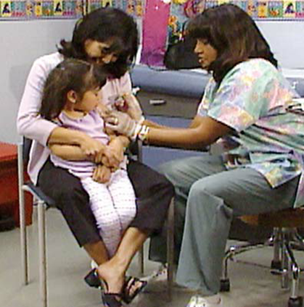
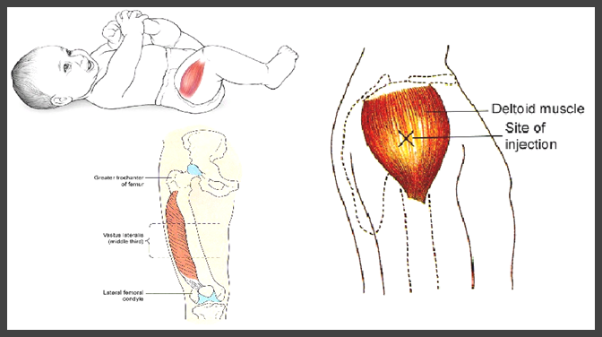
Intramuscular (IM) injection
Note: Place 3 fingers below the top of the shoulder to avoid injecting into the joint space and form a V with outstretched finger. Have parents secure patient’s limbs securely.

Slide 36
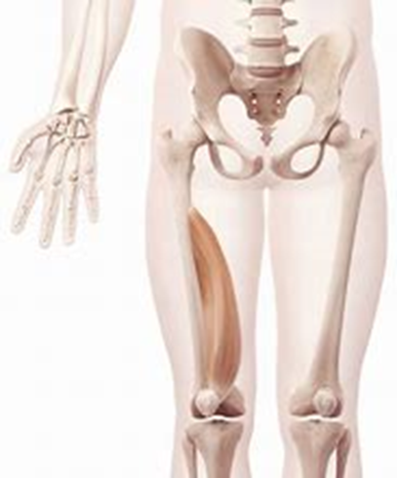
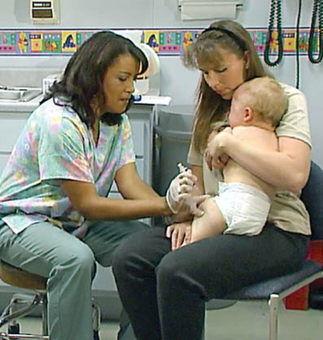
Anterolateral (thigh) injection
Note: Have parents hold patient’s limbs securely.

Slide 37
Needle size selection
Adults: Intramuscular (IM) injections
Needle length is usually 1"–1½", 22–25 gauge, but a longer or shorter needle may be needed depending on the patient's weight.
Note: An alternate site for IM injection in adults is the anterolateral thigh muscle. The needle length and gauge are the same as when the deltoid muscle is used, i.e., 1"–1½" length, 22–25 gauge.
You should choose needle length based on the weight of your adult patients, as follows:
Adults weighing less than 130 lbs (60 kg): Use of a 1" needle is recommended. However, a ⅝" needle may be used for IM injection in the deltoid muscle if the fatty tissue overlying the deltoid muscle is flattened (i.e., not bunched between thumb and fingers during the injection) and the needle is inserted at a 90° angle to the skin.
Adults weighing 130–152 lbs (60–70 kg): Use of a 1" needle is recommended.
Women weighing 152–200 lbs (70–90 kg): and men weighing 152–260 lbs (70–118 kg): Use of a 1"–1½" needle is recommended.
Women weighing more than 200 lbs (90 kg) or men weighing more than 260 lbs (118 kg): Use of a 1½" needle is recommended.
Immunization Action Coalition: https://www.immunize.org/technically-speaking/20200721.asp

Slide 38
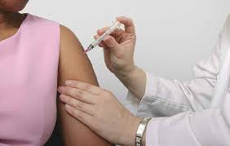
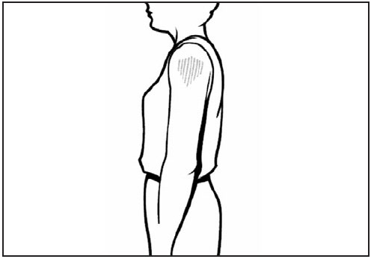
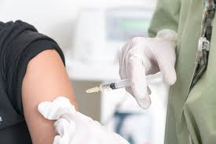
Intramuscular (im) injection

Slide 39
Needle size selection
Infants and Children: Subcutaneous (SQ) injections
For infants (11–12 months): Inject at a 45° angle into fatty tissue overlying the anterolateral thigh muscle – use ⅝" needle, 23–25 gauge
For children and teens (1–18 years): Inject at a 45° angle into fatty tissue overlying the triceps or anterolateral thigh muscle – use ⅝" needle, 23–25 gauge
Immunization Action Coalition: https://www.immunize.org/technically-speaking/20200721.asp

Slide 40
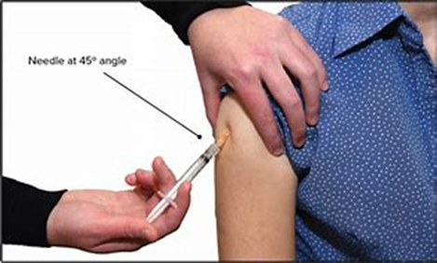
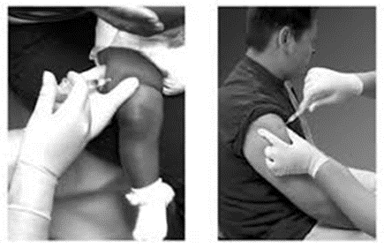
Subcutaneous (SQ) injection

Slide 41
Needle size selection
Adults: Subcutaneous (SQ) injections
All adults regardless of weight: Inject at a 45° angle into fatty tissue overlying the triceps muscle – a ⅝" needle, 23–25 gauge is recommended.
Immunization Action Coalition: https://www.immunize.org/technically-speaking/20200721.asp

Slide 42
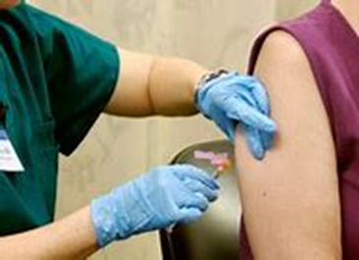
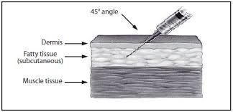
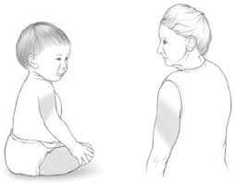
Subcutaneous (sq) injection

Slide 43
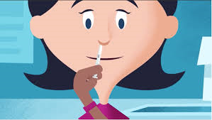
Intranasal administration
Check the expiration date before administering the vaccine
Recommend putting gloves on
Remove rubber tip protector, do not remove dose divider
When the patient is upright, place the vaccine tip just inside the nostril
With a single motion, depress plunger as rapidly as possible until dose divider clips stops you
Pinch and remove the dose divider from the plunger
Place the vaccine tip inside the other nostril and with a single motion, depress plunger as rapidly as possible
Note: Patient does not need to sniff in while you are depressing plunger, and if some vaccine drips out, there is no need to re-vaccinate.
FluMist Resource: https://www.flumistquadrivalenthcp.com/dosing-and-administration/administration.html

Slide 44
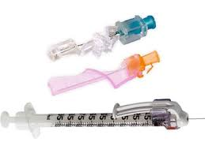
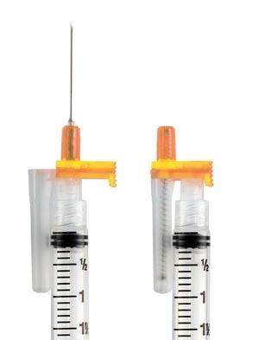
Equipment and supplies
BD
Retractable Technologies

Slide 45
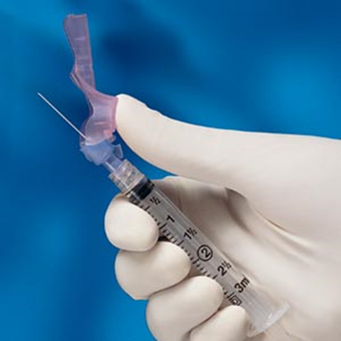
Safety needle devices Resources
CardioMed Supplies INC. easypoint safety needle: https://cardiomed.com/catalog/safety-devices/easypoint/
BD Eclipse safety needle: https://www.youtube.com/watch?v=qQRgqK_ONKk
Braun SolCare safety needle: https://www.youtube.com/watch?v=yKpQkuTR968

Slide 46
Additional supplies needed
Vaccines, needles, syringes, proper storage containers/temperature logs
Screening questions/consent form, vaccine information statement form
Alcohol pads
Cotton or gauze
Band-Aids
Gloves
Face or eye covering
Emergency kit(s)
Sanitizer and disinfection products
Additional items suggested can be found at immunize.org: https://www.immunize.org/catg.d/p3046.pdf

Slide 47
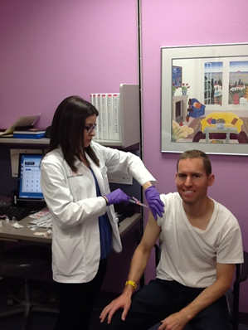
7 Rights of Vaccine administration
Right patient
Right time
Right vaccine
Right dose
Right route, needle, & technique
Right injection site
Right documentation
Immunization Action Coalition 7 Rights Link: https://www.immunize.org/technically-speaking/20141101.asp

Slide 48
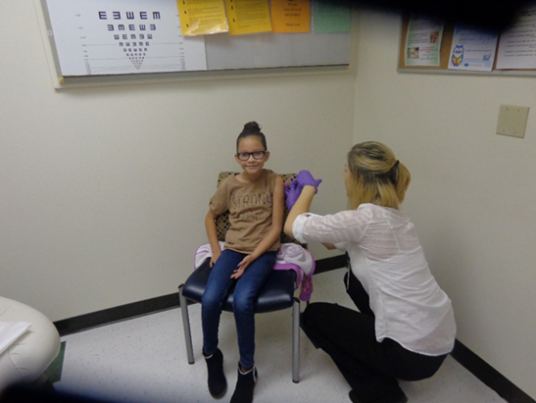
Giving vaccines, saving lives!

Slide 49
vaccine administration demonstrations
California DOPH, 2014: https://www.youtube.com/watch?v=WsZ6NEijlfI
APHA, 2018: https://www.youtube.com/watch?v=1H7LnK0CpOY
APhA, 2014: https://www.youtube.com/watch?v=-STH2nfCIk8

Slide 50
Vaccine Administration Technique overview
Review VAR and if you have any questions or concerns, ask the Supervising Pharmacist.
Confirm the vaccine name with the patient and if the patient has any questions or concerns, ask the Supervising Pharmacist.
Adjust patient clothing to view the needed site of vaccine administration.
Talk to the patient, be open, be friendly, be kind.
Put on clean, new gloves.
Have cotton & band-aid opened and ready.
Give vaccine, schedule follow-up appointment, & thank the patient for coming in.
Refer any follow-up questions or other concerns to the Supervising Pharmacist.
Notes:
Okay now you have the patients consent form which looks good. You have drawn up the vaccine into the syringe with a 1 inch needle for most adults and a 1 and ½ inch needle for adults with larger arms. You are now ready to inject.

Slide 51
What is sirva?
Shoulder Injury Related to Vaccine Administration (SIRVA) is a preventable occurrence caused by the injection of a vaccine into the shoulder capsule rather than the deltoid muscle.
This results in inflammation of the shoulder, causes patients to experience pain, decreased range of motion, and poor quality of life.
Immunizers can mitigate SIRVA and other injection site events by using proper injection technique, using land marking on the injection site (avoid tattoos, moles, and scars if possible), and sitting (not standing) directly adjacent to the patient.
SIRVA Resource:
https://www.ncbi.nlm.nih.gov/pmc/articles/PMC6347325/

Slide 52
Screening Questions/Responses or vaccine administration record (VAR)
Are you sick today?
Do you have allergies to medications, food, a vaccine component, or latex?
Have you ever had a serious reaction after receiving a vaccination?
Do you have a long-term health problem with heart, lung, kidney, or metabolic disease ?
Full list of adult screening questions: http://www.immunize.org/catg.d/p4065.pdf
Is the child sick today?
Does the child have allergies to medications, food, a vaccine component, or latex?
Has the child had a serious reaction to a vaccine in the past?
Does the child have a long-term health problem with lung, heart, kidney or metabolic disease?
Full list of children and teen screening questions: https://www.immunize.org/catg.d/p4060.pdf
Note: anytime a screening response is yes, ASK your Supervising Pharmacist and DOCUMENT why it was still safe to administer the vaccine to the patient.

Slide 53
Sample var
The patient fills out this section and you look at it, before immunziation. Ask the Supervising Pharmacists if questions arise.
You fill this out after immunization is given. Refer to your Supervising Pharmacist for any post-cousenling or questions that arise.
Notes:
One of the most important parts of any medical procedure is to make sure that there is good documentation. The consent form is the document we use for flu shots. The patient, or if the patient is a child the parent/legal guardian, completes and gives consent but this form also gives us information that we need to review. The person giving the shots documents information that needs to be kept on record. The patient competes the top portion and you will complete the bottom portion after the injection.
Additionally, there will be two identical copies of this document when the patient/you fill it out. The top copy belongs to us, and the bottom copy is given to the patient.

Slide 54
Vaccine Information Sheet (VIS)
A VIS or Vaccine Information Statement is a document, produced by the CDC, that informs vaccine patients–or their parents–about the benefits and risks of a vaccine they are receiving. The appropriate VIS must be given prior to the vaccination, and must be given prior to each dose of a multi-dose series. It must be given regardless of the age of the patient.
https://www.cdc.gov/vaccines/hcp/vis/vis-statements/flu.pdf
Notes:
Every patient should have an opportunity to read the Vaccine Information Sheet before the vaccine is given. Clinics may hand out a copy or offer patients an opportunity to read the information on a laminated copy. This form is available in several languages on the CDC web site.

Slide 55
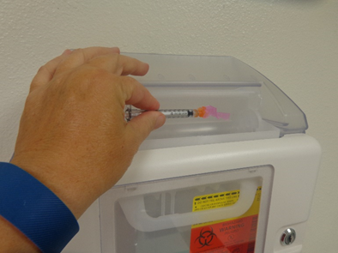
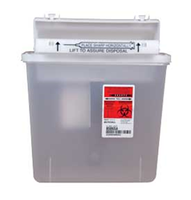
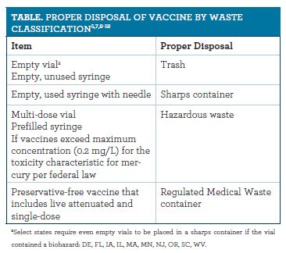
Needle disposal
Table taken from Pharmacy Times: https://www.pharmacytimes.com/publications/supplementals/2017/ImmunizationSupplementNovember2017/vaccine-vial-disposal-guidelines

Slide 56
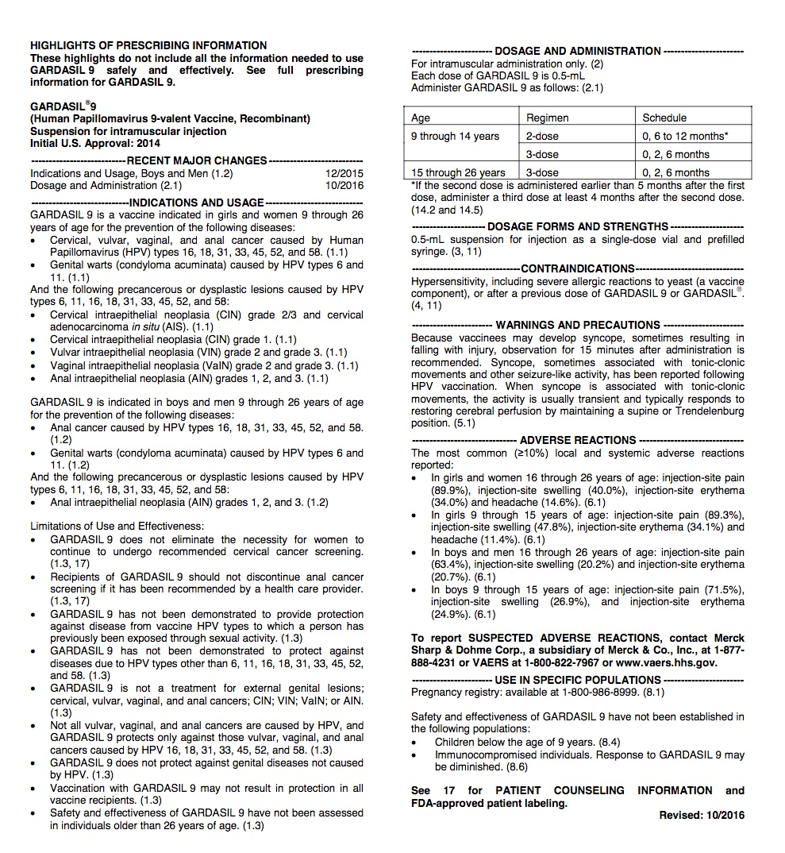
Resource; vaccine package insert
Although the Supervising Pharmacist must counsel patients on clinical and/or medical questions, the vaccine package insert has a lot of information available for your own education and reference.
Areas included in the vaccine package insert (but not limited to) are:
Contraindications
Warnings and precautions
Potential adverse reactions
Administration and storage instructions
Immunization Action Coalition, Vaccine Package Insert Links: https://www.immunize.org/fda/

Slide 57
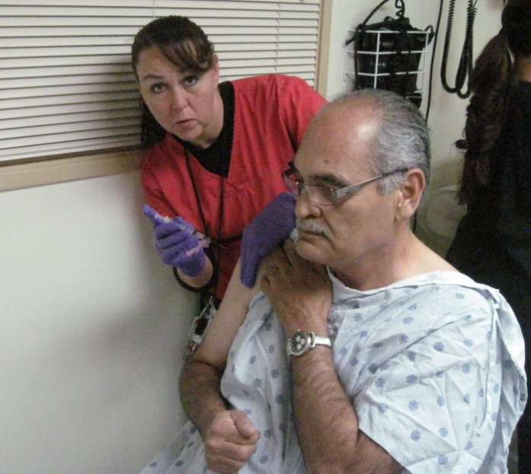
Professionalism
The people you give immunizations to are your patients, treat them well!
Honor your commitments-if you sign up for an immunziation clinic or event, please show up and be on time.
Dress appropriate.
Treat your patients/co-workers with respect.
Use good technique.
Address questions/problems with the Supervising Pharmacist.
Always Ask if seems strange, weird, unclear, unusual, or unsettling...
Notes:
Most of you know this already but just to be sure we are all on the same page…patients and clinics are counting you to show up to the clinics you have signed up for, be on time, treat every one with respect, use the good technique we will teach you, and work to prevent problems.

Slide 58
Professionalism
- Dress code best practices (adopted from the University of New Mexico Health Sciences Center):
Keep jewelry to a minimum.
Avoid highly fragranced lotion, perfume, cologne and/or smoke odor.
Hair must be worn in a way that prevents contamination and does not present a safety hazard.
Mustaches and beards must be well groomed.
Visible body piercing should be limited.
Tattoos and/ body should be covered if possible.
Avoid shorts, tank tops or tube tops, halter tops, tops with spaghetti straps, or strapless tops or dresses.
Avoid tight, low cut, or sheer clothing, or any attire that exposes skin between the top and bottom layer of clothing.
Avoid skirts or dresses short in length.
Avoid headwear, unless outside, required for safety, required for medical reasons, or associated with religious beliefs.
Footwear should be safe, supportive, clean, and non-noise producing; no open-toe shoes.
Hose, stockings, or socks must be worn.
Artificial nails are discouraged; natural nails should be kept short (no longer than ¼ inch beyond the fingertip) and clean.
Notes:
This dress code comes from the UNM Hospital. It gives you some idea of standards of appearance. If your house or school is going to work together at a Flu Shot Clinic as a team, you can all wear the some tee shirt that identifies you as part of the that group. Otherwise avoid tee shirts and wear more formal clothing. We do ask that you are dressed according to these guidelines, but comfortable, closed toe-shoes, are required.

Slide 59
Professional; Do and Do NOTs
Do treat the patient like a family member or friend, even when busy or tired!
Do smile, be friendly, and engaging!
Do question ambiguity, always ask, ask, ask!
Do enjoy this, this is an opporunity to perform high level tasks!
Do NOT be mad or complain to the patient about others, co-workers, or your employer!
Do NOT curse or swear in front of the patient!
Do NOT make inappropriate jokes/laughs in front of the patient!

Slide 60
Example of a positive tech-patient interaction
Tech: Hi Ms. Smith (confirm DOB), I am Sue, your pharmacy technician that will be giving you the high-dose flu shot today.
Patient: Great, thanks.
Tech: What questions or concerns do you have?
Patient: No questions, I get it every year.
Tech: Which arm would you like your vaccine on today?
Patient: Which arm do you think would be best?
Tech: The dominate arm is preferable because you are more likely to move it and prevent excess soreness.
Patient: Great, right arm it is….continued during the live course…

Slide 61
Proper documentation sample
Check box to reflect what you gave
Use sticker or
complete manually
Indicate which arm/leg (i.e. RD = right deltoid)
Sign with your name and credentials (i.e. CPhT) and date
Notes:
After completing the injection you must fill out the parts marked in yellow. Make sure you write your name legibly. You can add MSI for first year medical Students and PAS for PA students.

Slide 62
Proper immunization/vaccination reporting
Federal requirements mandate that you document five things when you administer a vaccine, other documentation may be required by your company:
The name of the vaccine and the manufacturer.
The lot number and expiration date of the vaccine.
The date of administration that you gave the vaccine.
The name, address, title and signature (electronic is acceptable) of the person administering the vaccine.
The publication date of the Vaccine Information Statement (VIS) and date the patient or parent receives the VIS.
American Academy of Family Physicians: https://www.aafp.org/fpm/2007/0300/p48.html
VIS Current Publication Dates Resource as of July 28, 2020: https://www.immunize.org/catg.d/p2029.pdf

Slide 63
NMSIIS reporting
New Mexico utilizes the New Mexico Statewide Immunization information System (NMSIIS). Reporting to this system became a state law for all vaccine providers as of 2013. NMSIIS is used as a statewide registry that tracks and records immunizations received, generates immunization histories, and creates recommendations for needed immunizations.
NMSIIS is a confidential and secure computer database designed to collect and maintain the vaccination records of all children and adults in New Mexico.
NMSIIS Resource: https://www.nmhealth.org/about/phd/idb/imp/siis/

Slide 64
Vaccine storage
Vaccines must be kept at their proper storage temperature at all times to maintain their efficacy.
Some vaccines require refrigeration, while others must be frozen. Promptly transfer the vaccines to their proper storage place immediately after receiving them, and follow these tips:
Store all vaccines in the middle of the refrigerator rather than the upper/lower racks or on the door for best temperature consistency.
Designate a refrigerator with a separate freezer compartment with its own outer door for vaccine storage.
Do not keep any food in this refrigerator, but may keep filled water bottles for temperature control.
Avoid small, dormitory-style refrigerators with freezer compartments. They are not reliable for storing vaccines that need to be frozen. Must be separate refrigerator and freezer unit.
If you have to transport vaccines, use an insulated container with a cold source and a thermometer/temperature log. Never let the vaccine directly touch ice packs or frozen packs.
Monitor the temperatures in the freezer and refrigerator, and record these twice daily in a temperature log (see an example at http://www.immunize.org/catg.d/p3039.pdf).
In the event of a power failure or a faulty refrigerator or freezer, mark the affected vaccines, record their current temperature, and work with your Supervising Pharmacist to troubleshoot.
American Academy of Family Physicians: https://www.aafp.org/fpm/2007/0300/p48.html

Slide 65
Emergency situations
Needle Stick Injury (poked yourself with a used needle)
Syncope (fainting after vaccine is given)
Allergic Reactions (skin becomes red with hives, anaphylaxis, throat tightness)
Other Errors (expired vaccine given, adult dose given to a pediatric patient, etc.)
Note: The best practice to prevent emergency situations is to identify patient’s risk by addressing screening question responses and clarifying with your Supervising Pharmacist before administering the immunization.
Notes:
We do not want to scare you but we need to make you aware of potential problems. With awareness we may be able to avoid problems.

Slide 66
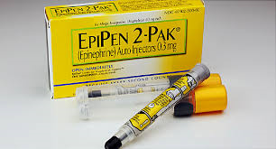
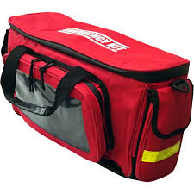
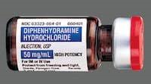
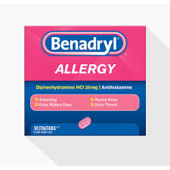
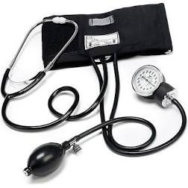
Emergency Kits in New Mexico immunizing pharmacies - required
Optional but strongly encouraged

Slide 67
Trivia
Question: Name three things you do with the needle immediately after you immunize the patient?
Answer:
Retract the needle, depending on the safety needle device type, while on the injection site (i.e. easypoint) or right after pulling the needle out of the injection site (i.e. eclipse).
Without recapping, discard into the nearby sharps container.
Immediately remove gloves and discard other equipment appropriately.

Slide 68
What is a Needle stick
When you or someone else is poked by a used needle. Being poked by a clean and unused needle is NOT a needlestick.
Wash the affected area with soap & water immediately.
Notify your Supervising Pharmacist ASAP (do not wait).
Do not let the patient leave until the Supervising Pharmcist has the name and contact information of the patient.
Follow the company procedures for needle stick requirements (i.e. lab draw).
Note: A needle stick may not be bleed or you may not see a poke or entrance wound, however the risk of viral infection still exists and should be treated as a needle stick accordingly.
Notes:
We take precautions to avoid accidental needle sticks but we know that they can happen to anyone. If a needle stick occurs, do not panic. You will not get in trouble. Wash the area with soap and water and get help. Ask the patient to stay and speak to your supervisor. We will have the patient whose needle poked you fill out a consent form so we can test them for HIV. We will send you for testing and other assistance as needed.

Slide 69
Needle stick avoidance
Deploy safety devices on used needles immediately.
Dispose of used needles in sharps immediately.
Ensure sharps is puncture resistance.
Keep lid closed on sharps during non-use.
Keep sharps upright.
Do not overfill sharps.
Keep sharps within arm’s reach of immunizer.
Do not cross over other immunizers to reach sharps.
If patient bleeds, deploy safety device, and dispose of sharps BEFORE tending to injection site.
Bloodborne Pathogen and Needle stick Prevention: https://www.osha.gov/bloodborne-pathogens
Sharps Disposal Resource: https://www.pharmacytimes.com/publications/supplementals/2017/immunizationsupplementaugust2017/sharps-disposal-assuring-regulatory-compliance-during-offsite-vaccination-clinics

Slide 70
Syncope or Fainting
Occurs most commonly in adolescent and teens.
It is best to give injections with the patient in a seated position or lying down position.
If a patient reports feeling light headed or dizzy after you have given the injection:
Get help and/or your Supervising Pharmacist.
Have the patient lie down.
Most patients will recover with in a few minutes.
Prevent falls and stabelize the patient.
Work with your Supervising Pharmacist to assess that there is not a more serious problem.
Note: All patients should be asked to be observed for at least 15 minutes post-vaccine if possible.
Notes:
Some people are very afraid of needles and they may faint.
Always give injection to patients in a seated position
If they seem light headed after the injection, let them sit for a few minutes or if you can, let them lay down.
You will work in groups of two students, so one student can get help while the other students stays with the patient.

Slide 71
Allergic reaction
Anaphylaxis following vaccines is rare, occurring at a rate of approximately one per million doses for many vaccines.
If a patient reports itchy skin, hives, anaphylaxis, or throat tightness after you have given the injection:
Get help and your Supervising Pharmacist.
Get the Emergency Kit (your Supervising Pharmacist will initiate therapy if required).
For respiratory symptoms, cardiovascular symptoms, or other signs/symptoms of anaphylaxis, immediate IM epinephrine is the treatment of choice.
Most patients will recover after IM epinephrine is administered.
EMS assessment is still required.
CDC Resource: https://www.cdc.gov/vaccines/hcp/acip-recs/general-recs/adverse-reactions.html

Slide 72
other Errors
Other Errors (expired vaccine given, adult dose given to a pediatric patient)
Get your Supervising Pharmacist for further evaluation and next steps.
Work with your Supervising Pharmacist to correctly report the error to your company quality improvement process, as required by New Mexico State Board of Pharmacy Laws.
Let your Supervising Pharmacist handle further communication with the patient and/or company.

Slide 73
Error reporting = vaers
Vaccine Adverse Event Reporting System (VAERS)
Established in 1990, VAERS is a national early warning system to detect possible safety problems in U.S. licensed vaccines.
VAERS accepts and analyzes reports of adverse events or side effects after a person has received a vaccination.
Anyone can report to VAERS, even if you did not administer the vaccination.
NMPhA strongly encourages you to work with your Supervising Pharmacist in reporting VAERS when possible.
New Mexico Pharmacists are required to report adverse events to VAERS as per the New Mexico Board of Pharmacy Prescriptive Authority Protocol for Immunizing Pharmacists.
VAERS Resource: https://vaers.hhs.gov/

Slide 74
Patient resource = nVicp
National Vaccine Injury Compensation Program (NVICP)
The NVICP is a no-fault alternative to the traditional legal system for resolving vaccine injury petitions.
It was created in the 1980s, after lawsuits against vaccine companies and health care providers threatened to cause vaccine shortages and reduce vaccination rates.
Any individual, of any age, who received a routine vaccine and believes he or she was injured as a result, can file a petition.
Parents, legal guardians and legal representatives can file on behalf of children, disabled adults, and individuals who are deceased.
NMPhA strongly encourages you to refer patient questions about NVICP to your Supervising Pharmacist.
NICP Resource: https://www.hrsa.gov/vaccine-compensation/index.html

Slide 75
Response to patient FAQ’s
???

Slide 76
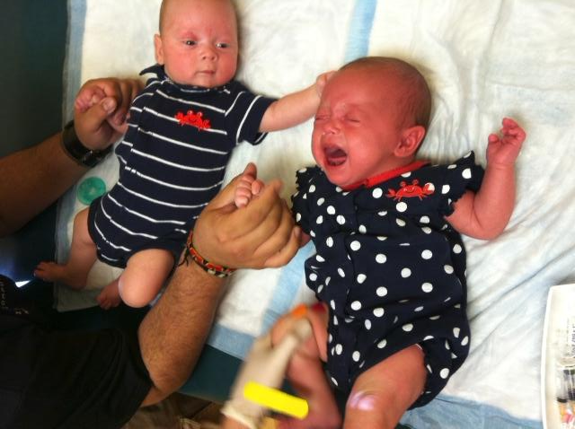
Will it hurt?
It may hurt, because it is an injection, but for most people it is minimal.
Refer further questions to the Supervising Pharmacist for additional post-vaccine patient counseling and education.
Notes:
What can we say…it is a mild poking, pinching sensation

Slide 77
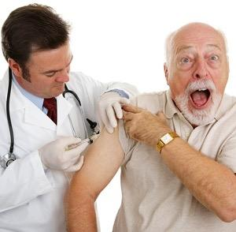
So why does it hurt so much?
Vaccines may include a variety of ingredients including antigens, stabilizers, adjuvants, antibiotics, and/or preservatives.
They may also contain residual by-products from the production process.
All of the above ingredients can cause pain during or after the injection.
World Health Organization: https://vaccine-safety-training.org/vaccine-components.html

Slide 78
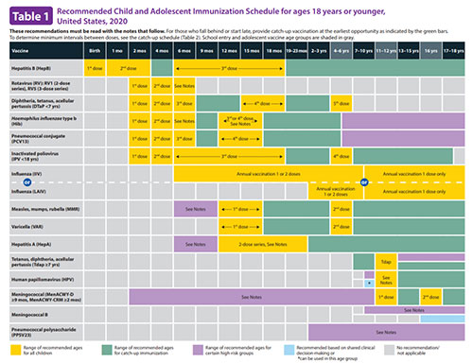
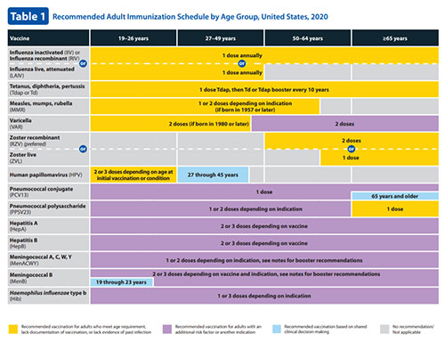
What other vaccines do I need?
-The answer to this question, depends on the patient’s age, past vaccines, and medical condition(s).
-The ACIP has immunization schedules (updated every January) that will assist the Supervising Pharmacist in prescribing additional immunizations that are best for the patient.
CDC Immunization Schedules Resource: https://www.cdc.gov/vaccines/schedules/hcp/index.html
Notes:
Sometimes patient will ask if they can get other vaccines at the flu shot clinic.
They will not be able to do this at the free flu shot clinics but can make appointments for other shots.

Slide 79
Catch up vaccine schedule
Due to COVID-19, we are anticipating that many patients will come in to the pharmacy needing to catch up or receive a late vaccine.
For children ages 4 months to 18 years, a catch up schedule exists, please refer these questions to your Supervising Pharmacist.
One general principle of vaccines is that if there is a late vaccination in the series (i.e. Hepatitis B Vaccination Series), then the late vaccination is acceptable and the series does not need to be restarted, however, please refer these questions to your Supervising Pharmacist.
Note: There may be exceptions to this principle with certain vaccines such as oral typhoid or COVID-19 vaccines.
CDC Catch Up Vaccine Schedule: https://www.cdc.gov/vaccines/schedules/hcp/imz/catchup.html

Slide 80
summary
Pharmacy Technicians, with training and certification, are qualified to give immunizations to new Mexicans.
Pharmacy Technicians play a vital role both in the pharmacy and to their communities.
Pharmacy Technicians can vaccinate safely and effectively for patients.
Pharmacy Technicians can assist in increasing vaccination rates in New Mexico.
Increased effort will be ongoing, so that this may be sustained as Board of Pharmacy law, even after emergency orders have expired.

Slide 81
Next steps
Please complete the home study (open-book) assessment exam (70% or better is required).
You will have two attempts to take the home-study assessment exam.
If you do not pass after both attempts, the NMPhA will work with your Supervising Pharmacist to determine next steps for you.
The live training course will have a zoom link, which you will be emailed to you, and will include discussion, a post course (open-book) assessment quiz (70% or better is required), and an injection technique assessment form (which you are responsible for returning completed).
You will have two attempts to take the post course assessment quiz.
If you do not pass after both attempts, the NMPhA will work with your Supervising Pharmacist to determine next steps for you.

