Slide 1
A comprehensive review of contraceptive methods using case study To focus on pharmacy settings
Jen Robinson, CNP, CNM, MS
Anna White MSN, CNM

Slide 2
objectives
Review combined contraceptive methods and progestin injection prescribed by pharmacists
Discuss the latest evidence on emergency contraception
Review counseling around LARC methods

Slide 3
Disclosures
Jen Robinson, CNP, CNM, MS (she, her) has the following financial relationships to disclose:
Merck Nexplanon trainer
Anna White MSN, CNM(she, her)
No financial relationships to disclose.
Notes:
Jen starts

Slide 4
The University of New Mexico’s LARC Mentoring Program
Notes:
Emphasize our work is to increase access, and we are not pharmacists!

Slide 5
Reproductive Justice
Why is this important?
The ability to make personal decisions about whether and when to have a child is a human right regardless of income, race or ethnicity.
Delicate balance between protecting unfettered access to contraceptive options and preventing abuse, and being encouraging versus coercing.
SisterSong LARC Statement Principles
https://docs.google.com/document/d/1ID4cEuaV1oSAXSWdJmSi4YMs5TLCGhnomjOX0In5odU/edit
Notes:
The ability to make personal decisions about whether and when to have a child is a human right regardless of income, race or ethnicity.
Delicate balance between protecting unfettered access to contraceptive and preventing abuse, and being encouraging versus coercing.
When providing reproductive care, it is essential to ensure patient’s choices are not only fully informed but completely voluntary.

Slide 6
Special thanks to
Alexandra Herman, PharmD
&
Amy Bachyrycz, PharmD
of UNM College of Pharmacy.
Notes:
They are on this presentation to support/help answer pharmacy related questions
Have Alex & Amy introduce themselves

Slide 7
Basic Zoom Settings
Notes:
I also want to point out that you can adjust how big the slides are by moving the vertical bar, just to the right of the slides.
Usually, this bar is in the middle of your screen, but you can move it further to the Right to make the slides bigger.
Or you can move it Left to make the speaker or participants bigger.
Finally, we want to encourage you to turn your video on during the training, so we can see each other, if you feel comfortable doing so.
You can do that by clicking on the “Start Video” button in the bottom left of your screen.
However, if you are having trouble with the video quality, you may want to turn your video off.

Slide 8
How to Annotate
Navigate to the “View Options” pull down menu at the top of the screen.
Select “Annotate” and a tool bar will open.
We will be using the “Stamp” and “Text” options the most.

Slide 9
Map from elizon.com

Slide 10
Case Study
Margaret is a 16 y/o nulliparous cis gender female at your pharmacy and is interested in contraception
She has no prior health concerns
BMI 32
Smoking 1 pack/day
Notes:
Whats your priority

Slide 11
Notes:
Jen last slide for now

Slide 12
Guidance for contraceptive care
2016
2016
2015
Notes:
REMIND PARTICIPANTS TO HAVE APP DOWNLOADED OR PULL FROM WEB – SPR INCLUDED IN APP
Talking points:
For more than a decade, the US Centers for Disease Control and Prevention and the Office of Population Affairs have conducted rigorous reviews to provide these evidence-based recommendations about contraceptive care. We’ve based this training on these recommendations, and in some cases we provide even more up-to-date evidence.
Includes the Medical Eligibility Criteria for Contraceptive Use, the Selected Practice Recommendations for Contraceptive Use, and the Quality Family Planning handbook.
How many are familiar with each of these?
All available at CDC website: www.cdc.gov/reproductivehealth/UnintendedPregnancy/Contraception_Guidance.htm

Slide 13
CDC Medical Eligibility Criteria
CDC Medical Eligibility for Initiating Contraception
Method can be used without restriction | 1
Advantages generally outweigh risks | 2
Method not recommended unless more appropriate methods not acceptable | 3
Absolute contraindication, avoid use | 4
Search: “CDC Contraception”
Notes:
BRIEF REVIEW
Talking Points:
The MEC has an app for phones and tablets - search Medical Eligibility Criteria for Contraception in your App Store.
There’s a summary chart for the MEC that’s in your handbook.
About to look at some slides that show the CDC Medical Eligibility Criteria for contraceptive initiation, so let’s do a quick orientation.
Level 1 = Green. A contraceptive method can be initiated or used without restriction
Level 2 = Light Green. Advantages of a method generally outweigh the risks
Level 3 = Pink = Relative contraindication, not recommended if another more appropriate method is available and acceptable to the patient. Using a method rated as 3 requires careful clinical judgment, access to clinical services, and careful follow-up. (Planned Parenthood Standards & Guidelines identify these women as “Special Conditions.”)
Level 4 = Red = Absolute contraindication.
Encourage participants to look at summary chart (“antimicrobial therapy”) in handbooks for this example: Antibiotics all level 1 except rifampin. (Level 3 CHC, POP; Level 2 Implant).

Slide 14
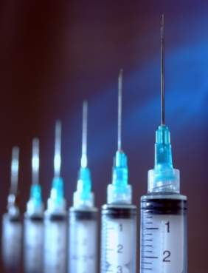
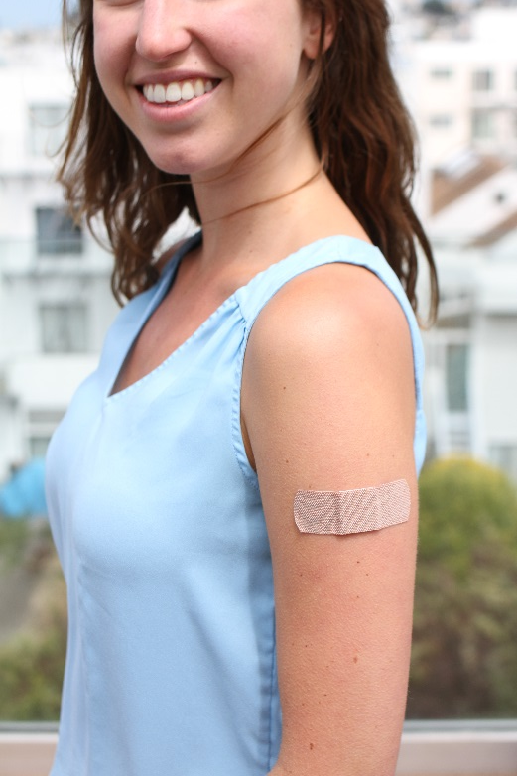
Injection (DMPA)
Depot Medroxyprogesterone Acetate
Intra-muscular or subcutaneous injection every 3 months
70% experience amenorrhea by 12 months
Less PID, fibroids, endometrial cancer
Trussel J. Contraceptive Technology. 2011.
Cromer BA. Am J Obstet Gynecol. 2005.
Trussel J. Contraception. 2004.;
Westhoff C. Contraception. 2003. et al.
Notes:
Talking Points
3-month injectable (Depo-Provera): A 1-mL crystalline suspension of 150 mg of DMPA is injected intramuscularly into the deltoid or gluteus maximus muscle every 11–13 weeks.
Mechanism of Action:
As with other progestins it not only prevents ovulation; it also reduces ovarian production of estradiol.
Candidates:
DMPA is a good choice for women who want reversible, nondaily contraception
DMPA does not require daily use. The convenience and high efficacy rate of DMPA have made this contraceptive method increasingly popular with teens--the percentage of teens who had used DMPA increased from 10% in 1995 to 21% in 2002.
Clinical situations in which estrogen is contraindicated include complicated migraine headaches, diabetes, smokers aged >age 35, and postpartum women. DMPA can be initiated immediately postpartum because it does not contain estrogen--it does not affect breastfeeding.
The amenorrhea the majority of DMPA users experience may improve conditions such as menorrhagia, dysmenorrhia, and iron deficiency anemia. At least one-half of users develop amenorrhea within 12 months. Amenorrhea may be a desired lifestyle change. DMPA also can decrease the risk of dysfunctional menstrual bleeding in women who are overweight.
Women who do not wish to conceive immediately after discontinuing it.
Advantages:
Reduces the risk of endometrial cancer by up to 80%, with continuing protection after discontinuation.
Reduces risk of PID and uterine leiomyomata
Can decrease the number and severity of crises in patients with sickle cell anemia.
Contraindication:
Known or suspected malignancy of the breast (WHO Medical Eligibility Criteria for Contraceptive Use, 3rd edition 2004).
Disadvantages:
Weight gain: The data suggests that weight gain with DMPA varies from person to person.
Menstrual irregularities: Most women have an altered menstrual cycle with DMPA, including irregular bleeding and spotting, and rarely heavy bleeding, for at least the first 3 months of use. These menstrual changes decrease over time. By one year, up to 70% of women have amenorrhea.
Bone mineral density (as discussed in Mikayla case study)
Return to fertility: The median time to conception for those who do conceive is 10 months following the last injection.
CDC updated its recommendations in 2012 to indicate that data are inconclusive as to whether women using DMPA might be at increased risk for HIV acquisition, and that these women should be strongly advised to always also use either female or male condoms and take other HIV preventive measures. [CDC 2012]
References
ACOG practice bulletin. No. 73: Use of hormonal contraception in women with coexisting medical conditions. Obstet Gynecol 2006;107:1453–72.
Cromer BA, Lazebnik R, Rome E, et al. Double-blinded randomized controlled trial of estrogen supplementation in adolescent girls who receive depot medroxyprogesterone acetate for contraception. Am J Obstet Gynecol. 2005;192(1):42-47.
Cullins VE. Noncontraceptive benefits and therapeutic uses of depot medroxyprogesterone acetate. J Reprod Med. 1996;41(5 Suppl):428-433. Review.
FDA Talk Paper. Black box warning added concerning long-term use of Depo-Provera contraceptive injection. US Food and Drug Administration web site. Available at: http://www.fda.gov/bbs/topics/ANSWERS/2004/ANS01325.html.
Kaunitz AM. Current concepts regarding use of DMPA. J Reprod Med. 2002;47(9 Suppl):785-789.
Kaunitz AM, Arias R, McClung M. Bone density recovery after depot medroxyprogesterone acetate injectable contraception use. Contraception 77 (2008) 67-76.
Kaunitz A, Shields W. Depo-Provera’s black box: time to reconsider? Contraception. 2005;72(3): 165-167.
Leeman L. Medical barriers to effective contraception. Obstet Gynecol Clin N Amer. 34 (2007) 19-29.
Rosenberg L et al. Bone status after cessation of use of injectable progestin contraceptives. Contraception 2007 Dec; 76:425.
Thomas DB, Ray RM. Depot-medroxyprogesterone acetate (DMPA) and risk of invasive adenocarcinomas and adenosquamous carcinomas of the uterine cervix. WHO Collaborative Study of Neoplasia and Steroid Contraceptives. Contraception. 1995;52(5):307-312.
Trussel J. Contraceptive efficacy. In Hatcher RA, Trussel J, Nelson AL, Cates W, Stewart FH, Kowal D. Contraceptive Technology: 20th revised ed. New York, NY: Ardent Media, 2011.
Trussel J. Contraceptive failure in the United States. Contraception. 2004;70(2):89-96.
US Approved Prescribing Information for DMPA Contraceptive Injection, Pharmacia & Upjohn Co. www.pharmacia.com 1999.
Westhoff C. Depot-medroxyprogesterone acetate injection (Depo-Provera®): a highly effective contraceptive option with proven long-term safety. Contraception. 2003;68(2):75-87.
WHO Medical Eligibility Criteria for Contraceptive Use, 3rd edition 2004.
World Health Organization. WHO statement on hormonal contraception and bone health. Available at: http://www.who.int/reproductive-health/family_planning/bone_health. html.
Centers for Disease Control and Prevention (CDC). Update to CDC's U.S. Medical Eligibility Criteria for Contraceptive Use, 2010: revised recommendations for the use of hormonal contraception among women at high risk for HIV infection or infected with HIV. MMWR Morb Mortal Wkly Rep. 2012 Jun 22;61(24):449-52
---
Original content for this slide submitted by ARHP’s Clinical Advisory Committee for Choosing a Birth Control Method in May 2009. Original funding received from Bayer, Duramed and Schering Plough. Updates were made possible by funding received from Bayer Healthcare Pharmaceuticals, Conceptus, Inc., and Teva Pharmaceuticals educational grants. This slide is available at www.arhp.org/core.

Slide 15
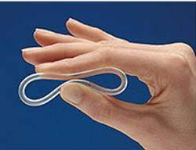
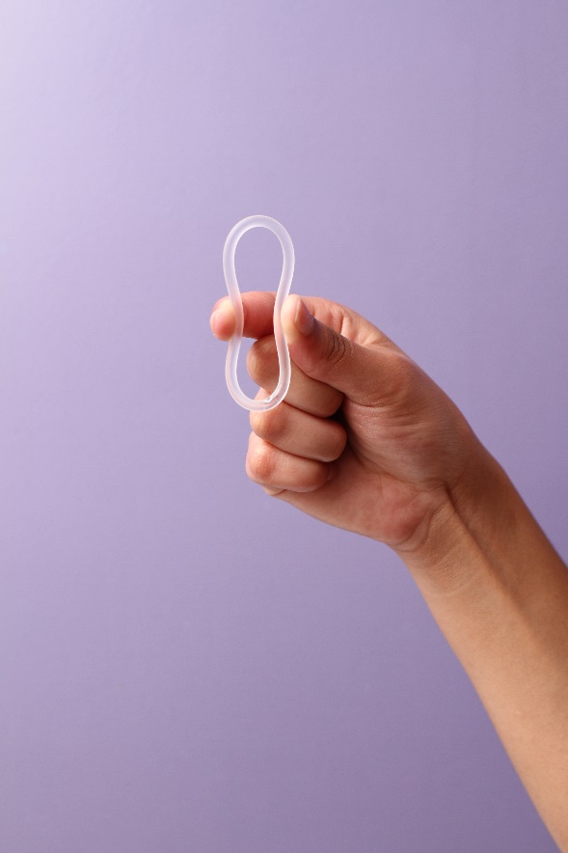
Vaginal Ring
Contains estrogen and progestin
Flexible ring that is placed in the vagina
Used 3 weeks/out 1 week
4 weeks of medication in each ring
Continuous use: Can be changed once every 4 weeks
NuvaRing Prescribing Information. Organon. 2001
Timmer CJ. Clin Pharmacokinet. 2000
Herndon EJ. Am Fam Physician. 2004
Dieben TO. Obstet Gynecol. 2002
Linn ES. Int J Fertil. 2003
Notes:
Talking Points
Ring is flexible, transparent, and colorless to nearly colorless.
Ring comes in one size that fits most women; no fitting is required. One ring is inserted into the vagina per cycle and is to remain in place continuously for 3 weeks, followed by a ring-free week.
When inserted, the ring delivers ~ 120 μg of etonorgestrel and 15 μg of ethinyl estradiol/day to the systemic circulation over a 3-week period. After insertion, maximum serum concentrations of etonorgestrel and ethinyl estradiol are achieved in approximately 1 week and show a gradual linear decline thereafter.
Women not previously using hormonal contraception should insert the ring on or before day 5 of the cycle, counting the first day of menstruation as day 1. Back-up contraception is recommended for the first 7 days of ring use.
Women switching from a combination OC may insert the ring any time within 7 days after the last combined estrogen/progestin OC and no later than the day that a new cycle of pills would have been started. No back-up method is needed.
Mechanism of Action:
Similar to COC’s mechanism of action.
The ring inhibits ovulation and sperm motility, fertilization, and implantation.
Candidates:
Women who desire the convenience of a 3-week regimen, as well as those who have difficulty using a daily method.
Women who want to regulate their periods.
The hormonal benefits of the vaginal ring are similar to those of the contraceptive skin patch and pill.
No data are available regarding the efficacy of the vaginal contraceptive ring in women of heavier body weight.
Ring improves vaginal flora, leading to reduced frequency of bacterial vaginosis.
A multicenter trial showed a low incidence of gastrointestinal problems, such as nausea and vomiting.
Advantages:
Convenient, once a month use
Privacy
Cycle control, few women experience untimely spotting or bleeding
Contraindications:
Same as those for combination OCs (except those related to intestinal absorption problems)
Significant pelvic relaxation
Vaginal obstruction
Unable to touch genitalia
Disadvantages:
Possibility of leukorrhea and vaginitis
Hormone-related side effects associated with use of the vaginal ring, such as headache and nausea, are similar to those seen with OCs, although more study is needed. Local adverse effects associated with use of the vaginal ring include leukorrhea, vaginitis, and a slight risk (1%) of device expulsion. The ring is rarely felt during intercourse.
Counseling:
The ring is easy to insert; there is no wrong way to insert it.
The ring can be placed anywhere in the vagina, but the deeper it’s placed, the less likely it will be felt.
After 3 weeks, remove the ring for one week and then insert a new ring.
Patients need to be cautioned that the ring can be inadvertently expelled from the vagina while removing a tampon or during bowel and bladder emptying, especially with straining or constipation. Often women are not aware that the device has been expelled.
If the ring falls out, it should be rinsed with warm water and reinserted within 3 hours.
References
Brunei V, Pontello V, Luisi S, Petraglia F. An open-label, multicentre trial to evaluate the vaginal bleeding pattern of the combine contraceptive vaginal ring NuvaRing. Eur J Obstet Gynecol Reprod Biol. 2008.
Dieben TO, Roumen FJ, Apter D. Efficacy, cycle control, and user acceptability of a novel combined contraceptive vaginal ring. Obstet Gynecol. 2002;100:585-93.
Herndon EJ, Zieman M. New contraceptive options. Am Fam Physician. 2004;69:853-860.
Lete I, Doval JL, Perez-Campos E, et al. Factors affecting women’s selection of a combined hormonal contraceptive method: the TEAM-06 Spanish cross-sectional study. Contraception. 2007;76:77-83.
Linn ES. Progress in contraception: new technology. Int J Fertil. 2003;48:182-91.
NuvaRing Prescribing Information. Organon Inc., West Orange, NJ; 2001.
Roumen FJME, Apter D, Mulders TMT, Dieben TOM. Efficacy, tolerability and acceptability of a novel contraceptive vaginal ring releasing etonogestrel and ethinyl oestradiol. Hum Reprod. 2001;16:469-75.
Timmer CJ, Mulders TMT. Pharmacokinetics of etonogestrel and ethinylestradiol released from a combined contraceptive vaginal ring. Clin Pharmacokinet. 2000;39:233-42.
Trussel J. Contraceptive efficacy. In Hatcher RA, Trussel J, Nelson AL, Cates W, Stewart FH, Kowal D. Contraceptive Technology: 20th revised ed. New York, NY: Ardent Media, 2011.
Vaginal ring. Mayo Clinic. January 2008. http://www.mayoclinic.com/health/birth-control/BI99999/PAGE=BI00017
---
Original content for this slide submitted by ARHP’s Clinical Advisory Committee for Choosing a Birth Control Method in May 2009. Original funding received from Bayer, Duramed and Schering Plough. Updates were made possible by funding received from Bayer Healthcare Pharmaceuticals, Conceptus, Inc., and Teva Pharmaceuticals educational grants. This slide is available at www.arhp.org/core.

Slide 16
The Patch
Contains estrogen and progestin
Applied once a week
Use 3 weeks, off 1 week
Abrams LS. Fertil Steril. 2002.
Ortho Evra Prescribing Information.
Archer DF. Fertil Steril. 2002.
Zacur HA, et al. Fertil Steril. 2002.
Zieman M. Fertil Steril. 2002.
Archer DF. Contraception. 2004.
Audet MC. JAMA. 2001.
Notes:
Talking Points
The beige-colored, transdermal contraceptive patch is applied once a week to the abdomen, buttock, upper outer arm, or upper torso.
The patch delivers 150 μg of norelgestromin/20 μg of ethinyl estradiol daily to systemic circulation. Serum concentrations of norelgestromin and ethinyl estradiol within the range generally seen with oral norgestimate 250 μg/ethinyl estradiol 35 μg are maintained for up to 10 days, suggesting that clinical efficacy would be maintained even if a scheduled change is missed for as long as 2 full days.
Three consecutive 7-day patches (21 days) are applied, followed by 1 patch-free week per cycle.
Use of the patch should be initiated during the first 24 hours of menses; no back-up is recommended. However, if use is initiated after day 1 of the menstrual cycle, a nonhormonal back-up method is recommended.
The contraceptive efficacy of the transdermal patch is comparable to that of combination OCs. In clinical trials, fewer than 3% of patches were replaced due to partial (2.9%) or complete (1.8%) detachment. Adhesion is not affected by heat, humidity, or exercise.
Candidates:
Patients who want an easy, nondaily method.
Patients with dysmenorrhea and menorrhagia
Patients who are concerned about interference with nausea or vomiting.
Advantages:
Weekly form of birth control
Rapid reversibility
Non-contraceptive benefits are similar to those of COCs
Contraindications :
Same as those for combination OCs.
Disadvantages:
Because the patch contains estrogen and progestin, side effects associated with its use are probably similar to OCs, although more study is needed. One study determined that compared to COC users, patch users were more likely to report breast discomfort, dysmenorrhea, nausea, and vomiting, but that patch users had better compliance than OC users. The side effects usually dissipate within the first 2 months of use.
Increased exposure to estrogen, which may increase the risk of side effects
Application site reactions.
Breast tenderness. Breast tenderness is greater in the first few cycles of use and dissipates over time.
Contraceptive failures may be increased among women weighing 90 kg (198 lbs) or more.
Venous thromboembolism (VTE) risk associated with the Evra contraceptive patch:
The FDA created a bolded warning for Evra in 2005.
In January 2008 the Evra label added new study results showing twice the VTE risk for the patch compared with OCs.
The risk of thromboembolism is significantly higher in pregnancy than from the patch.
A recent study estimated VTE incidence for women of reproductive age as 5–10 per 10,000 women-years, compared with 0.5–1 VTE per 10,000 women-years for hormonal contraception.
The risk of VTE is small, and twice this small risk is still small.
Counseling:
Educate patient on application and removal of patch
Avoid placing patch in areas that receive a lot of friction, such as bra straps
Place on buttocks, abdomen, upper torso (excluding breasts), or upper arm
Apply to clean, dry skin
Once removed, fold patch closed to reduce release of hormones
Do not flush in the waste system. Dispose of it in the garbage.
References
Abrams LS, Skee D, Natarajan J, Wong FA. Pharmacokinetic overview of Ortho Evra™/Evra™. Fertil Steril. 2002;77( Suppl 2):S3-12.
ACOG Committee on Practice Bulletins. No. 73. Use of Hormonal Contraception in Women with Coexisting Medical conditions. Obstet Gynecol 2006;107:1453-72..
Archer DF, Bigrigg A, Smallwood GH, et al. Assessment of compliance with a weekly contraceptive patch (Ortho Evra/Evra) among North American women. Fertil Steril. 2002;77(Suppl 2):S27-31.
Archer DF, Cullins V, Creasy GW, Fisher AC. The impact of improved compliance with a weekly contraceptive transdermal system (Ortho Evra®) on contraceptive efficacy. Contraception. 2004;69:189-195.
Audet M-C, Moreau M, Koltun WD, et al. Evaluation of contraceptive efficacy and cycle control of a transdermal contraceptive patch vs an oral contraceptive. A randomized controlled trial. JAMA 2001;285:2347-54.
Drugtopics.modernmedicine.com. Available at: http://drugtopics.modernmedicine.com/drugtopics/Drug+Topics+Daily+News/New-esti...d-to-Ortho-Evra-PI/ArticleStandard/Article/detail/486039?cont. Accessed February 28, 2008.
Heinemann LAJ, Dinger JC. Rage of published estimates of venous thromboembolism incidence in young women. Contraception. 2007;75:328-36.
Leeman L. Medical barriers to effective contraception. Obstet Gynecol Clin N Am. 2007;34:19-29.
Lopez LM, Grimes DA, Gallo MF, Schulz KF. Skin patch and vaginal ring versus combined oral contraceptives for contraception. Cochrane Database Syst Rev 2008;(1).
Ortho Evra™ Prescribing Information, Ortho-McNeil Pharmaceutical, Raritan, NJ; November 2001.
Sibai BM, Odlind V, Meador ML, Shangold GA, Fisher AC, Creasy GW. A comparative and pooled analysis of the safety and tolerability of the contraceptive patch (Ortho Evra™/ Evra™). Fertil Steril. 2002;77(2 Suppl 2):S19-26.
Toglia MR, Nolan TE. Venous thromboembolism during pregnancy: a current review of diagnosis and management. Obstet Gynecol Surv. 1999;54:29-14.
Trussel J. Contraceptive efficacy. In Hatcher RA, Trussel J, Nelson AL, Cates W, Stewart FH, Kowal D. Contraceptive Technology: 20th revised ed. New York, NY: Ardent Media, 2011.
WHO Medical Eligibility Criteria for Contraceptive Use, 3rd edition 2004.
---
Original content for this slide submitted by ARHP’s Clinical Advisory Committee for Choosing a Birth Control Method in May 2009. Original funding received from Bayer, Duramed and Schering Plough. Updates were made possible by funding received from Bayer Healthcare Pharmaceuticals, Conceptus, Inc., and Teva Pharmaceuticals educational grants. This slide is available at www.arhp.org/core.

Slide 17
After describing the patch, ring, depo and pill. Pt. Decides she wants the pill.
She states that her friend only has her period once every three months and says “can I get something like that?”
Which pill do you prescribe her?

Slide 18
CDC Medical Eligibility for Initiating Contraception
Condition |  | Copper IUD | LNG-IUS | Implant | DMPA | POP | Pill, patch, ring
High blood pressure | <159 / <99 | 1 | 1 | 1 | 2 | 1 | 3
 | >160 / >100 or w/ vascular disease | 1 | 2 | 2 | 3 | 2 | 3/4
Migraine with aura |  | 1 | 1 | 1 | 1 | 1 | 4
Smoking | Age <35 | 1 | 1 | 1 | 1 | 1 | 2
 | Age > 35, <15 cigarettes/day | 1 | 1 | 1 | 1 | 1 | 3
 | Age > 35, > 15 cigarettes/day | 1 | 1 | 1 | 1 | 1 | 4
Blood clots | Past or current blood clot | 1/2 | 2 | 2 | 2 | 2 | 4
Diabetes Mellitus (DM) | History of GDM | 1 | 1 | 1 | 1 | 1 | 1
 | Nonvascular NIDDM or IDDM | 1 | 2 | 2 | 2 | 2 | 2
 | DM with Vascular disease or > 20yrs | 1 | 2 | 2 | 3 | 2 | 3/4
Notes:
Jen – last slide for now

Slide 19
Monophasic vs multiphasic
MONOPHASIC are typically preferable due to:
Ease of use
Consistent hormone dose
Multiphasic COCs
require more careful adherence to a specific sequential order in which to take the pills each cycle
cannot be transitioned to continuous or extended-cycle use the way that monophasic pills can if the patient desires
concerns that the changing hormone levels in multiphasic COCs could exacerbate mood symptoms in susceptible women (eg, those with premenstrual syndrome or premenstrual dysphoric disorder)

Slide 20
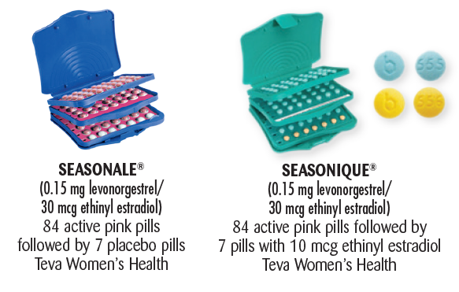
Cyclic vs extended use
Frequency of withdrawal bleeding desired by patient is key
monthly withdrawal bleeding
every three months (84/7 formulations)
no withdrawal bleeds (365 day formulations).
Edelman AB, Gallo MF, Jensen JT, et al. Continuous or extended cycle vs. cyclic use of combined oral contraceptives for contraception. Cochrane Database Syst Rev 2005; :CD004695.

Slide 21
Ethinyl estradiol dose
Women should be prescribed a COC with 35 mcg of ethinyl estradiol or less.
The data regarding safety of 20 mcg versus 25, 30, or 35 mcg ethinyl estradiol COCs suggest less risk with 20 mcg formulas but are not strong enough to endorse higher safety with 20 mcg pills
COCs containing 50 mcg of ethinyl estradiol should not be used for contraception but are available for the acute treatment of uterine bleeding.

Slide 22
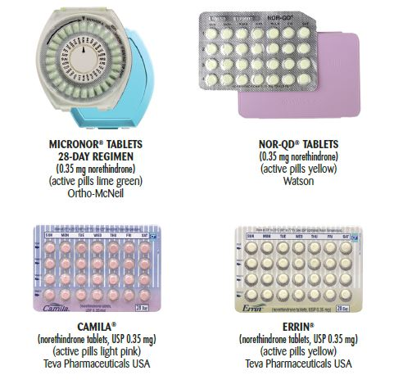
Progestin type
All COCs are antiandrogenic when the effects of both estrogen and progestin are considered.
Acne
Heavy menses
Dysmenorrhea
PMS/PMDD
There may be a slightly increased risk with newer progestins (gestodene, desogestrel, and drospirenone) compared with levonorgestrel; however, the absolute risk is extremely low for all COCs. The evidence is not compelling enough to change prescribing patterns.
de Bastos M, Stegeman BH, Rosendaal FR, et al. Combined oral contraceptives: venous thrombosis. Cochrane Database Syst Rev 2014; :CD010813.

Slide 23
Generic vs brand name
Affordability
Brand names are typically more expensive and have higher co-pay

Slide 24
Contraindications: Combined Hormonal Contraceptives
Clotting disorders
History of deep vein thrombosis or pulmonary embolism
Migraine with aura or focal neurological deficit
Uncontrolled hypertension
Ischemic heart disease
Active liver disease
USMEC 2016
Notes:
Talking Points
Most healthy women are potential candidates for COCs.
There are a few WHO Category 3 conditions for which COCs are usually not used unless there are no other contraceptive methods available and/or acceptable because of the increased risk of complications.
These conditions include the female who is <21 days postpartum, lactating (6 weeks-6 months), has gallbladder disease, is on medications that may interfere with COC efficacy, or has undiagnosed abnormal vaginal/uterine bleeding.
Women who have WHO Category 4 conditions are advised against COC use.
These include a current or past history of:
deep vein thrombosis or pulmonary embolism
cerebrovascular accident\
coronary (or ischemic) heart disease
complicated structural heart disease (eg, pulmonary hypertension, atrial fibrillation or history of subacute bacterial endocarditis)
Pregnancy
lactation <6 weeks postpartum
complicated diabetes mellitus (e.g., retinopathy, neuropathy, nephropathy)
breast cancer
headaches (including migraine headaches) with focal neurologic symptoms\
liver disease (including liver cancer, benign hepatic adenoma, active viral hepatitis, severe cirrhosis)
surgery involving the lower extremities and/or prolonged immobilization
severe hypertension (160+/100+ mm Hg or with vascular complications).
Reference
World Health Organization (WHO). Improving Access to Quality Care in Family Planning: Medical Eligibility Criteria for Contraceptive Use, 2nd edition. Geneva, Switzerland: World Health Organization, 2000
---
Original content for this slide submitted by ARHP’s Clinical Advisory Committee for Choosing a Birth Control Method in May 2009. Original funding received from Bayer, Duramed and Schering Plough. Updates were made possible by funding received from Bayer Healthcare Pharmaceuticals, Conceptus, Inc., and Teva Pharmaceuticals educational grants. This slide is available at www.arhp.org/core.
24

Slide 25
21/7 vs 24/4
24/4
emerging evidence about increased efficacy (especially for obese women)
decreased hormone withdrawal side effects during the hormone-free interval
London A, Jensen JT. Rationale for eliminating the hormone-free interval in modern oral contraceptives. Int J Gynaecol Obstet 2016; 134:8.

Slide 26
ACHES – warning signs/side effects
Abdominal pain
Chest pain
Headaches
Eye problems
Severe leg pain
Blood clot in pelvis or liver
Pulmonary embolism/heart attack/angina
Stroke/retinal vein thrombosis
Thrombophlebitis/deep vein thrombosis
http://www.contraceptivetechnology.org/wp-content/uploads/2015/06/ACHES-figure.pdf

Slide 27
When and why to switch to a different OCP
If the patient has been referred for additional evaluation with a health provider, it may be reasonable to change medication until appointment takes place.
Consider increasing dose of ethinyl estradiol to 35 mcg pills
Consider use of 24/4 formulation, if not already in use
Consider progesterone only options (such as Norethindrone acetate 5 mg and Provera 10 mg) as short term courses to manage bleeding complications
Important to assess need for contraception and possible need for barrier methods

Slide 28
When to refer to a clinician/clinic
Heavy or prolonged vaginal bleeding
Pregnancy
STIs
Anemia
Cancer
Patient experiencing undesired side effects
Difficulty with adherence to medication
UpToDate

Slide 29
https://www.reproductiveaccess.org/resource/pill-user-guide/

Slide 31
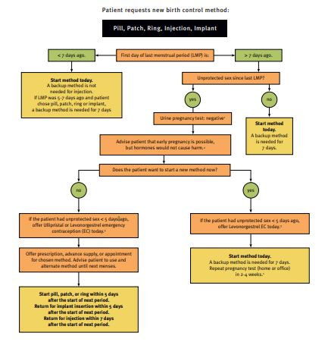
Quick start
CDC SPR 2016
https://www.reproductiveaccess.org/resource/quick-start-algorithm/

Slide 32
Management of breakthrough bleeding on OCPs
AAFP 2002

Slide 33
After describing all of the different aspects of the pill, you suddenly realized that you didnt ask her LMP or last episode of unprotected intercourse
Pt. States that she had unprotected intercourse 3 days ago
Again, her BMI is 32

Slide 34
Emergency contraception chart

Slide 35
ECP loses efficacy with increased BMI
Healthy weight
Overweight
Obese
LNG efficacy
UPA efficacy
CuT IUD efficacy
Copper T IUD remains nearly 100% effective for these patients
Glasier A et al. Contraception. 2011.
Notes:
Talking Points:
Levonorgestrel (LNG) EC pills and ulipristal acetate are four times less effective for obese patients compared to normal weight patients [Glasier 2011].
LNG EC is less effective with increasing days since unprotected sex, and only effective before ovulation [Noé 2011].
There are few contraindications to the Copper T IUD—only copper allergy, reproductive tract cancers, or a current infection.
Your clinic has be able to offer same-day insertions, and accommodate last-minute appointments.
References:
Glasier A, Cameron ST, Blithe D, et al. Can we identify women at risk of pregnancy despite using emergency contraception? Data from randomized trials of ulipristal acetate and levonorgestrel. Contraception 2011; 84(4):363-7.
Noé G, Croxatto HB, Salvatierra AM, et al. Contraceptive efficacy of emergency contraception with levonorgestrel given before or after ovulation. Contraception 2011; 84(5):486-92.
-Centers for Disease Control. United States medical eligibility criteria for contraceptive use, 2016. MMWR Vol. 65 / No. 3

Slide 36
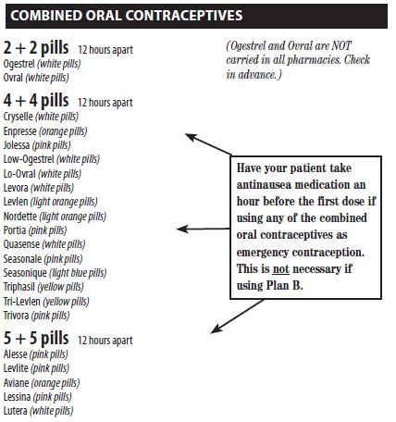
Using OCPs as emergency contraception
Hatcher et al, 2018
https://ec.princeton.edu/questions/dose.html#dose

Slide 37
Cost of EC vs COC
EC lower cost with online coupon
LNG 1.5 mg as low as $10
UA 30 mg as low as $43
OTC vs. with prescription
COC lower cost with online coupon
28 pill pack as low as $8.45
Extended OC pack (91 tab) lowest $47
ACA - Mandated coverage with no cost-sharing

Slide 38
Which form of EC do you prescribe patient?

Slide 39
Low Knowledge of IUDs and the Implant
Less than half of young women have heard of LARC
Two-thirds do not know safety or effectiveness
Health care providers are primary source of information on LARC
Many providers have not integrated these methods into counseling, especially in primary care settings
Kaye K et al. The Fog Zone. 2009
Fleming KL et al. Contraception 2010
Barrett M el al. J Pediatr Adolesc Gynecol 2012
Harper C et al. Family Medicine 2012
Notes:
Talking Points:
Studies of women ages 14-29 in a variety of clinical settings and surveys have shown:
less than half had even heard of IUDs or implants
almost none know about the copper IUD for emergency contraception
if they had heard of IUDs, nearly two thirds did not know about their safety or effectiveness
a majority cite their healthcare providers as a primary source of information about contraception.
Yet many providers have not integrated LARC into routine counseling.
References:
- Fleming KL, Sokoloff A, Raine TR. Attitudes and beliefs about the intrauterine device among teenagers and young women. Contraception 2010;82(2):178-82.
Barrett M, Soon R, Whitaker AK, Takekawa S, Kaneshiro B. Awareness and knowledge of the intrauterine device in adolescents. J Pediatr Adolesc Gynecol 2012; 25(1):39-42.
Kaye K, Suellentrop K, Sloup C. The Fog Zone. Washington, DC: The National Campaign to Prevent Teen and Unplanned Pregnancy; 2009.
Whitaker AK, et al. Adolescent and young women’s knowledge of and attitudes toward the intrauterine device. Contraception 2008; 78(3): 211-7.
Harper CC, et al Evidence-based IUD practice: family physicians and obstetrician-gynecologists. Family Medicine 2012; 44(9): 637-45.

Slide 40
Copper IUD is the most effective emergency contraceptive (EC)
Nearly 100% effective as emergency contraception
More effective than EC pills for longer
Effective for patients >165 lbs.
Provides ongoing contraception when desired -- No back-up needed!
Cleland K et al. Human Reproduction. 2012
Glasier A et al. Contraception. 2011
Envall N, Acta Ob/Gyn Scan. 2016
Notes:
Talking Points:
Most effective emergency contraceptive available.
A review of 42 studies shows it is nearly 100% effective [Cleland et al. 2010], as compared to about 85% overall effectiveness for EC pills (Plan B, Next Choice and Ella).
Among women seeking EC, those receiving an IUD had half the pregnancies of women receiving EC pills (5 v. 12%, aOR = 0.5) within 1 year [Turok 2014]. 1 year continuation is high (80%) [Schwarz 2014].
Can be inserted up to 5 days after unprotected intercourse, and may be effective any time there is a negative pregnancy test [Turok 2013].
Effective even for obese clients or those who have sex again—both of which significantly decrease the effectiveness of levonorgestrel emergency contraception [Glasier et al. 2012]. One manufacturer of a Plan B equivalent in Europe changed the label to recommend women try some other EC if they weigh more than 165 lbs [NorLevo label 2013].
Significantly more women who chose Cu-IUD for EC (83%) used an effective method for contraception at the 6-month follow up, compared to women opting for UPA (58%). [Envall 2016]
References:
Cleland K, et al. The efficacy of intrauterine devices for EC: a systematic review of 35 years of experience. Human Reproduction 2012 July; 27(7): 1994-2000.
-Envall N, Groes Kofoed N, Kopp-Kallner H. Use of effective contraception 6 months after emergency contraception with a copper IUD or ulipristal acetate - a prospective observational cohort study. Acta Obstetricia et Gynecologica Scandinavica 95(8):887-893, 2016.
Glasier A, et al. Can we identify women at risk of pregnancy despite using EC? Data from randomized trials of ulipristal acetate and levonorgestrel. Contraception 2011 Oct; 84(4): 363-7.
Turok DK, Godfrey EM, Wojdyla D, et al. Copper T380 intrauterine device for EC: highly effective at any time in the menstrual cycle. Hum Reprod 2013; 28(10): 2672-6.
Turok DK, Jacobson JC, Dermish AI, et al. EC with a copper IUD or oral levonorgestrel: an observational study of 1-year pregnancy rates. Contraception 2014; 89(3): 222-8.
Schwarz EB, Papic M, Parisi SM, et al. Routine counseling about intrauterine contraception for women seeking emergency contraception. Contraception 2014; 90(1): 66-71
Cheng L, et al. Interventions for emergency contraception (Review). Cochrane Database of Systematic Reviews 2008; 2: CD001324.

Slide 41
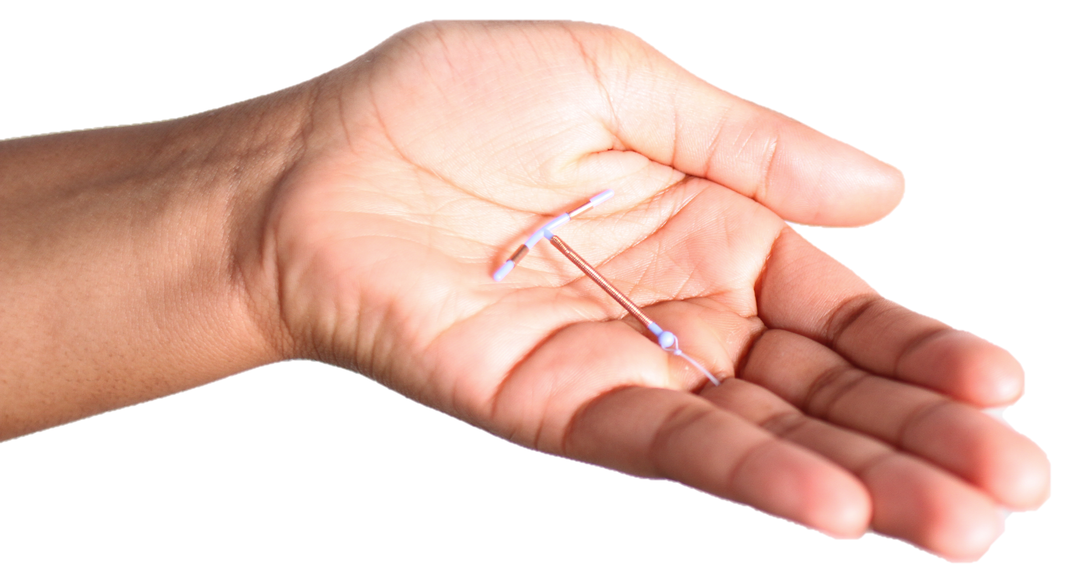
Copper T 380a IUD, ParaGard®
Works for at least 12 years
Nearly 100% effective
Only highly effective non-hormonal method
FDA label for ParaGard. Revised 9/1/2005.
Notes:
BRIEF REVIEW
Talking Points:
Copper-releasing IUD FDA-approved in 1988.
FDA-approved for 10 years, but research and PPFA Standards and Guidelines show it’s effective for12 years.
Mechanism is action is that the copper ions prevent sperm from swimming and may also affect the unfertilized ova.
Most effective non-hormonal reversible contraceptive available.

Slide 42
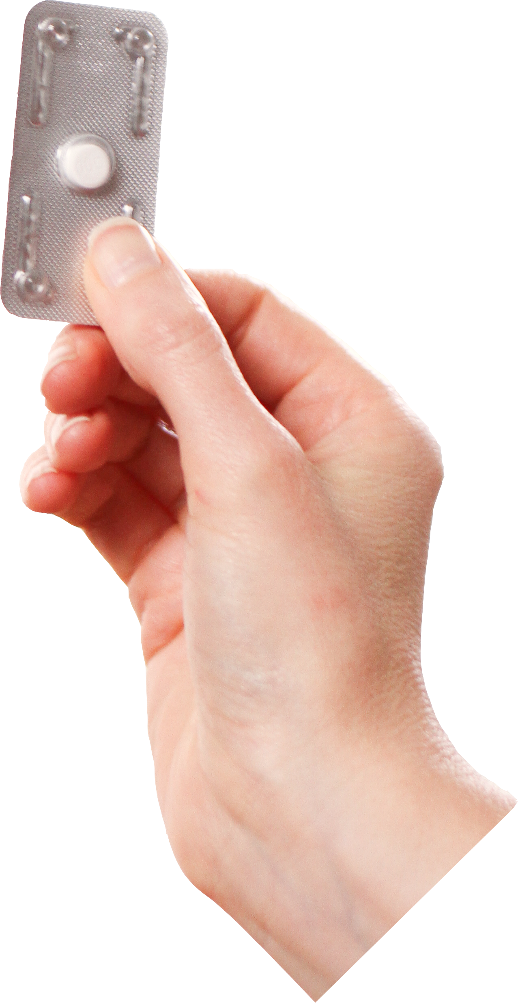
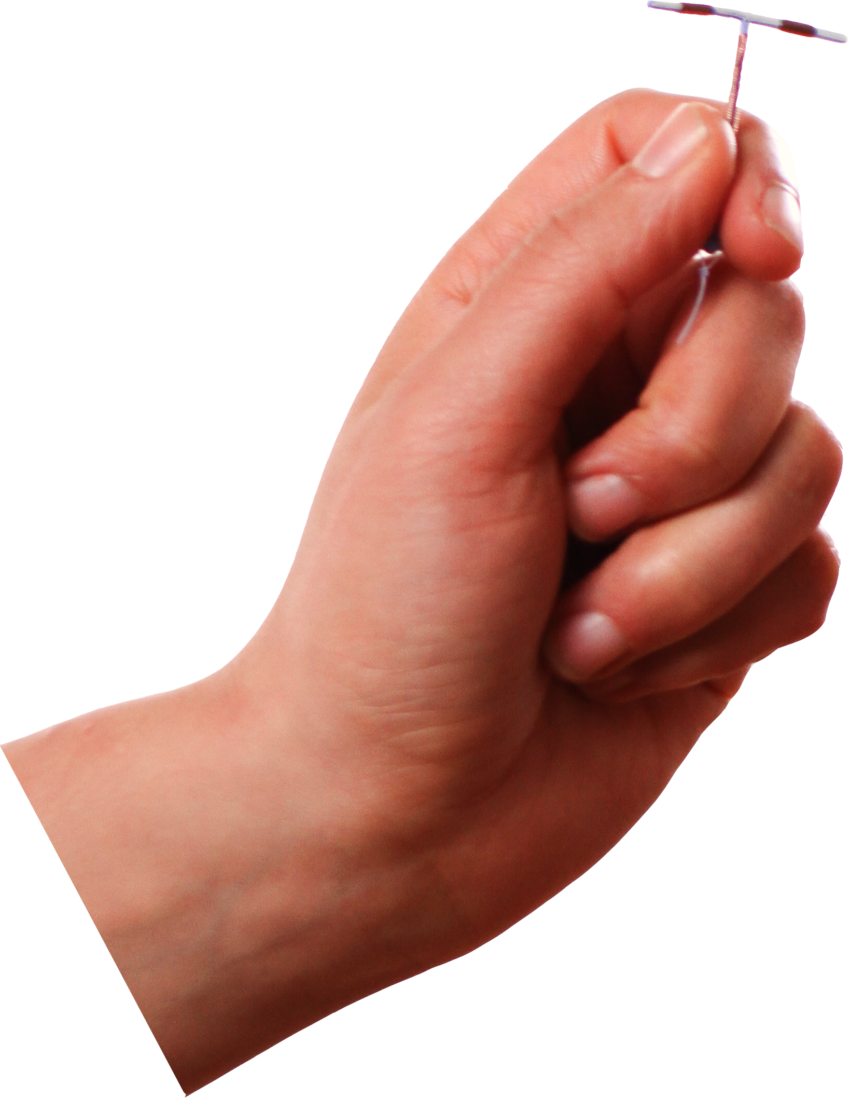
Emergency Contraception (EC) Types
IUD
EC Pills
Cu IUD
LNG 52 mg IUD
+/- LNG ECP
Progestin (LNG)
“Plan B”
Ulipristal Acetate (UPA)
“Ella”
Notes:
Talking Points – Emphasize that Skyla & Kyleena not options for EC
Research on Cu IUD as EC goes back to the mid 1970’s, but has always been off label.
More recent study shows efficacy and preference for LNG 52 mg IUD with concomitant use of oral LNG 1.5 mg for EC. Use of this combination may increase the number of patients initiating highly effective contraception at the time of their EC visit. (As of 2018, RCT pending for LNG-IUD as EC without LNG ECP).
FDA approved Plan B in 1999.
FDA approved Ella in 2010
FDA approved Plan B One Step OTC in 2013.
LNG-IUD as EC:
RCT assessed IUD preference among women presenting for EC and the probability of pregnancy among concurrent LNG ECP plus LNG 52 mg IUD EC users.
Participants seeking EC who desired an IUD preferentially chose oral LNG 1.5 mg with the LNG 52 mg IUD over the Cu IUD. Neither group had EC treatment failures.
1 year continuation rates were similar in both groups (just over 2/3).
Consideration should be given to LNG IUD insertion with (or without) oral LNG 1.5 mg for EC. Per Turok at Forum 2017, RCT is pending for LNG IUD without LNG ECP; anecdotal experience supports high efficacy for this practice.
References
Turok DK, Sanders JN, Thompson IS, Royer PA, Eggebroten J, Gawron LM. Preference for and efficacy of oral levonorgestrel for emergency contraception with concomitant placement of a levonorgestrel IUD: a prospective cohort study. Contraception. 2016 Jun;93(6):526-32.
Sanders JN, Turok DK, Royer PA, Thompson IS, Gawron LM, Storck KE. One-year continuation of copper or levonorgestrel intrauterine devices initiated at the time of emergency contraception. Contraception. 2017 Aug;96(2):99-105.

Slide 43
IUD Mechanism of Action
Primary: prevention of fertilization
Decreasing sperm motility and capacitation
Decreasing sperm and egg survival
Secondary (LNG IUDs)
Thickening of cervical mucous
IUDs are not an abortifacient (won't disrupt implanted pregnancy)
Tubal flush studies find no fertilized eggs
No transient elevations in hCG
IUD users have low rates of intrauterine and ectopic pregnancies
UpToDate. 2015
Stanford & Mikolajczyk. Am J Obstet Gynecol. 2002
Ortiz & Croxatto. Contraception. 2007
Notes:
Talking Points:
Free copper and copper salts released cause oxidation and enhance the cytotoxic inflammatory reaction within the endometrium which is toxic to sperm and ova.
Sperm capacitation is the last biochemical step in sperm maturation (removing the glycoprotein coat and seminal proteins that would allow sperm penetration of ovum)
NIH and ACOG define a pregnancy as when a fertilized egg successfully implants in the uterus and begins to develop into a healthy embryo.
References:
-UpToDate, Intrauterine contraception: Devices, candidates, and selection, Updated Dec 22, 2015.
-Stanford JB, Mikolajczyk RT. Mechanisms of action of intrauterine devices: update and estimation of postfertilization effects. Am J Obstet Gynecol 2002; 187:1699.
-Ortiz ME, Croxatto HB. Copper-T intrauterine device and levonorgestrel intrauterine system: biological bases of their mechanism of action. Contraception 2007; 75:S16.
-Ortiz ME, Croxatto HB, Bardin CW. Mechanisms of action of intrauterine devices. Obstet Gynecol Surv 1996; 51:S42.
-Seleem S, Hills FA, Salem HT, et al. Mechanism of action of the intrauterine contraceptive device: evidence for a specific biochemical deficiency in the endometrium. Hum Reprod 1996; 11:1220.
-Ammälä M, Nyman T, Strengell L, Rutanen EM. Effect of intrauterine contraceptive devices on cytokine messenger ribonucleic acid expression in the human endometrium. Fertil Steril 1995; 63:773.
-Sivin I, Stern J. Health during prolonged use of levonorgestrel 20 micrograms/d and the copper TCu 380Ag intrauterine contraceptive devices: a multicenter study. International Committee for Contraception Research (ICCR). Fertil Steril 1994; 61:70.
-Wilcox AJ, Weinberg CR, Armstrong EG, Canfield RE. Urinary human chorionic gonadotropin among intrauterine device users: detection with a highly specific and sensitive assay. Fertil Steril 1987; 47:265.

Slide 44
Method satisfaction
1-year satisfaction
83.7%
% of respondents indicating that they were either “very satisfied” or “somewhat satisfied” with their method.
Peipert J et al. Obstet Gynecol. 2011
Notes:
Patients are generally more satisfied with these methods as a whole than they are with shorter-acting methods, which contributes to the high continuation rates we see with IUDs and the implant.
Obstet Gynecol. 2011 May; 117(5): 1105–1113.
Continuation and Satisfaction of Reversible Contraception
Jeffrey F. Peipert, MD, PhD, Qiuhong Zhao, MS, Jenifer E. Allsworth, PhD, Emiko Petrosky, MD, Tessa Madden, MD, MPH, David Eisenberg, MD, MPH, and Gina Secura, PhD, MPH

Slide 45
IUD Selection and Individual Preferences
Cu-T Paragard® | LNG 52 mg Mirena® / Liletta® | LNG 13.5-19.5 mg Skyla® / Kyleena®
Want regular menses Don’t want hormones Want EC | Want light menstrual flow Amenorrhea 30% Want non-contraceptive benefits (for painful or heavy menses; uterine protection) Want EC (w/ LNG ECP) | Want less menstrual flow Amenorrhea 10% Want low-dose LNG IUD Need smaller IUD
Madden T et al. UpToDate. 2018
Notes:
Note amenorrhea rates are in 1st year.
References:
Madden T et al, UpToDate Candidates and Selection, 2018.

Slide 46
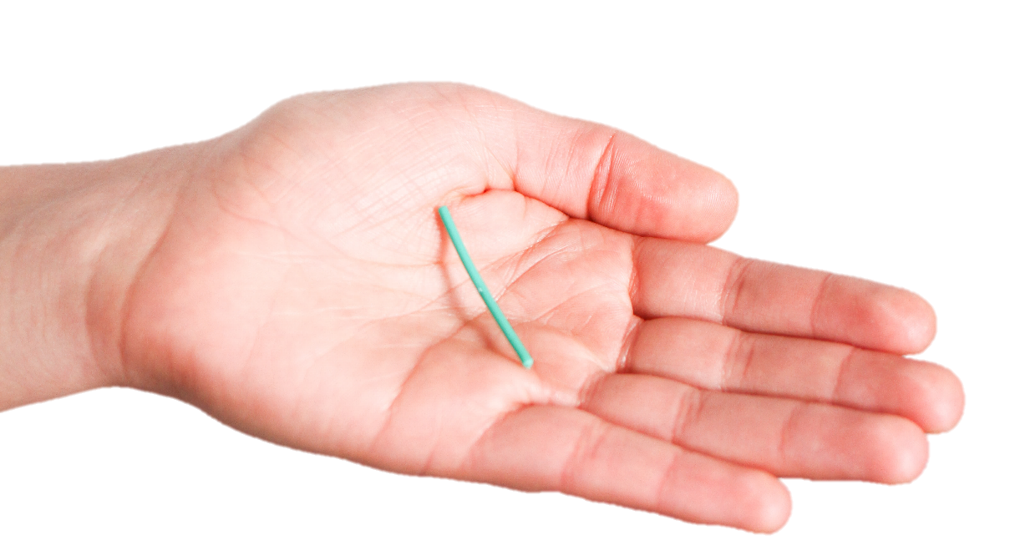
Single-rod etonogestrel (ENG) implant, Nexplanon®
Works for 3-5 years
Nearly 100% effective
Prevents ovulation, thickens cervical mucus
Low-dose progestin, no estrogen
No effect on bone density
Now radio-opaque
McNicholas. AJOG. 2017
FDA label for Nexplanon. Revised 7/2014
Levine et al. Contraception. 2008
Notes:
BRIEF REVIEW
Talking Points:
Etonogestrel-impregnated ethylene vinyl acetate rod approved in 2006.
This implant is only one matchstick-sized rod. (Average time for insertion is 30 seconds, and removal is 4 minutes.)
FDA-approved for 3 years, although evidence from a WHO study shows it is effective up to 5 years (McNicholas 2017)
PPFA is extrapolating from the data to begin allowing implant for up to 5 years in 2018.
Hormone is a progestin. After initial spike in blood levels of ENG, steady, low dose is emitted over 3 years.
No estrogen!
No effect on bone mineral density.
References:
Ali, M et al. (2016). Extended Use Up to 5 Years of Etonogestrel-Releasing Subdermal Contraceptive Implant. Human Reproduction 31, 2491–2498.
Levine JP, Sinofsky FE, Christ MF. U.S. Implanon Study Group. Assessment of Implanon™ insertion and removal. Contraception 2008; 78(5): 409-17.
McNicholas C, Swor E, Wan L, Peipert JF. Prolonged use of the etonogestrel implant and levonorgestrel intrauterine device: 2 years beyond Food and Drug Administration-approved duration. Am J Obstet Gynecol. 2017 Jun;216(6):586.e1-586.e6.
McNicholas C, Maddipati, R, Zhao, Q, Swor, E, Peipert, J. Use of the Etonogestrel Implant and Levonorgestrel Intrauterine Device Beyond the U.S. Food and Drug Administration–Approved Duration Obstet Gynecol. 2015; 125(3): 599–604

Slide 47
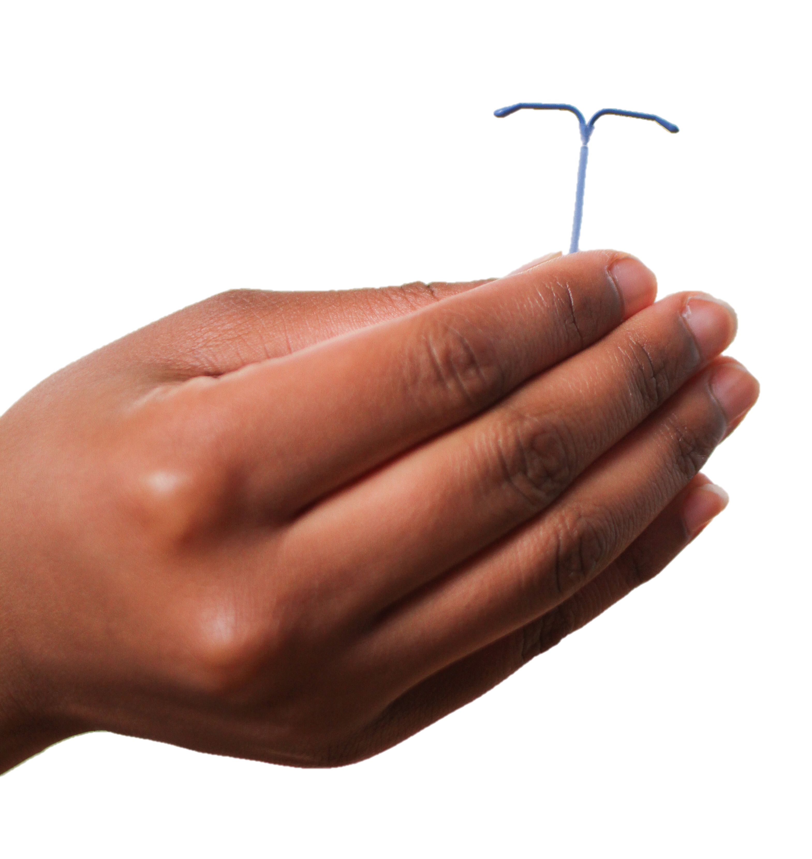
Levonorgestrel-releasing IUDs, Mirena®, Liletta®, Skyla®, & Kyleena®
Works for at least:
Liletta & Mirena 5-7 years
Kyleena 5 years
Skyla 3 years
Nearly 100% effective
Low-dose progestin, no estrogen
Range of non-contraceptive benefits
FDA label for Mirena. Revised 7/21/2008
FDA label for Skyla. Revised 1/09/2013
FDA label for Liletta. Revised 8/2017
Notes:
BRIEF REVIEW
Levonorgestrel-releasing IUD Mirena approved in 2000. Skyla introduced in 2013. Liletta introduced in 2015.
For both devices, hormone is a progestin. Studies show that patients using these IUDs have low levels of the hormone circulating in their blood—it mostly acts locally in the uterus.
Mirena is FDA approved for up to 5 years; evidence supports use up to 7 years in women age 25 or up at the time of insertion [Wu 2014]
Liletta is FDA approved for 6 years; pharmacologic levels similar to Mirena supports it use up to 7 years. [Creinin 2016, McNicholas 2017]
PPFA is extrapolating from the data to begin allowing both Mirena and Liletta to 7 years in 2018.
Both act mainly by thickening the cervical mucus, preventing sperm from meeting an egg.
No estrogen! Therefore none of the contraindications for estrogen, e.g. migraines, hypertension or smoking.
Suppresses menstruation, making periods lighter, less painful, less frequent.
Improves anemia. Mirena is indicated for treatment of menorrhagia.
Differences between these IUDs:
Skyla has a slightly smaller frame and slightly narrower inserter. Not clear whether there is a clinically significant difference for insertion or use.
It was tested among women who have not had a child, so the manufacturer is able to advertise Skyla directly to them.
Skyla has a slightly lower dose of progestin, which results in different bleeding patterns—we’ll get into those details later.
References:
-Creinin, M et al. (2016). Levonorgestrel Release Rates Over 5 Years with the Liletta® 52-mg Intrauterine System. Contraception 94, 353 - 356.
-McNicholas C, Swor E, Wan L et al. (2017). Prolonged Use of the Etonogestrel Implant and Levonorgestrel Intrauterine Device: 2 Years Beyond Food and Drug Administration–Approved Duration. American Journal of Obstetrics & Gynecology 586, 1-6.
-Wu JP, Pickle S. Extended use of the intrauterine device: a literature review and recommendations for clinical practice. Contraception 2014; 89(6): 495-503.

Slide 48
Hatcher et al 2018

Slide 49
Can adolescents and patients who have no children use an IUD?
Yes
High satisfaction and continuation rates
Veldhuis H. Eur J Gen Pract. 2004.
Suhonen S et al. Contraception. 2004.
Thonneau P et al. Human Reprod. 2006. ACOG Committee Opinion 539. Obstet Gynecol. 2012.
Notes:
Lauren – how to address satisfaction vs continuation rates!?
Talking Points:
Other misperceptions grew from the idea that IUDs are too risky, e.g. IUDs are not suitable for women who have not yet had a child.
Restricting nulliparous women’s access to IUDs is not evidence-based.
No evidence that nulliparous women find IUDs less acceptable: effectiveness and continuation rates are similar for nulliparous and multiparous women, regardless of age.
Expulsion rates may be slightly higher, particularly among adolescents [Madden 2014], but this is not a reason to restrict access.
References:
- Veldhuis HM, Voss AG, Lagro-Janssen AL. Complications of the intrauterine device in nulliparous & parous women. European Journal of General Practice 2004; 10(3): 82-7.
- Suhonen S, et al. Clinical performance of a levonorgestrel-releasing intrauterine system and oral contraceptives in young nulliparous women: a comparative study. Contraception 2004; 69(5): 407-12.
- Thonneau P, et al. Risk factors for IUD failure: results of a large multicentre case-control study. Human Reprod 2006; 21(10): 2612-6.
ACOG. Committee opinion no. 539: adolescents and long-acting reversible contraception: implants and intrauterine devices. Obstet Gynecol. 2012 Oct;120(4):983-8.
-Madden T, McNicholas C, Zhao Q, Secura GM, Eisenberg DL, Peipert JF. Association of age and parity with intrauterine device expulsion. Obstet Gynecol 2014: 124(4): 718-26.

Slide 50
Confidential services in NM for minors
Are her services confidential?
Can she consent for her reproductive health services?
Where can patients obtain confidential services?
Minor consent laws:
https://www.guttmacher.org/state-policy/explore/overview-minors-consent-law

Slide 51
What are your barriers and solutions around minor consent and confidentiality for reproductive health services?
Chat!
Notes:
Invite chat, unmute, raised hands for questions, sharing barriers and solutions about minor consent and confidentiality for repro health services

Slide 52
Summary
1
Keep individual patient priorities at the forefront during contraceptive counseling.
Focus on building rapport and the process of counseling rather than on a specific outcome or specific method.
2
3
Emergency contraception pills lose efficacy with increasing BMI
Notes:
Thank the group for their participation and ask if it was helpful.
Remind them that it’s best to practice with each other rather than on real clients!
Focus on building rapport and the process of counseling rather than on any specific method or specific outcome.
Keep individual patient priorities at the forefront during contraceptive counseling.
Patients can have their IUD removed any time, for any reason.
8/25/2020

Slide 53
One thing you learned
One thing you felt
One thing you will do after today

Slide 54
Thank you!
Questions? Please contact us:
Andrea Andersen, Program Manager
aanderse@salud.unm.edu

