Slide 1
Integrating Medication Safety in Pharmacy Practice
Leslie Sanchez, PharmD
New Mexico Pharmacists Association 91st Annual Convention
September 2020

Slide 2
Objectives
Pharmacist Objectives:
List the keys elements of a medication safety program
Describe culture of safety and why it is necessary for a successful medication safety program
Describe the medication management process and the role of medication safety in this process
Explain the hierarchy of effectiveness of risk-reduction strategies
Identify opportunities for proactive medication risk assessment
Pharmacy Technician Objectives
Explain the impact medication errors have on patient morbidity and mortality
List risk factors for medication errors
Describe culture of safety and the reason it is necessary for a successful medication safety program
Describe the medication management process and be able to identify opportunities to improve medication safety in this process
Explain the difference between Failure Mode Events Analysis and Root Cause Analysis

Slide 3
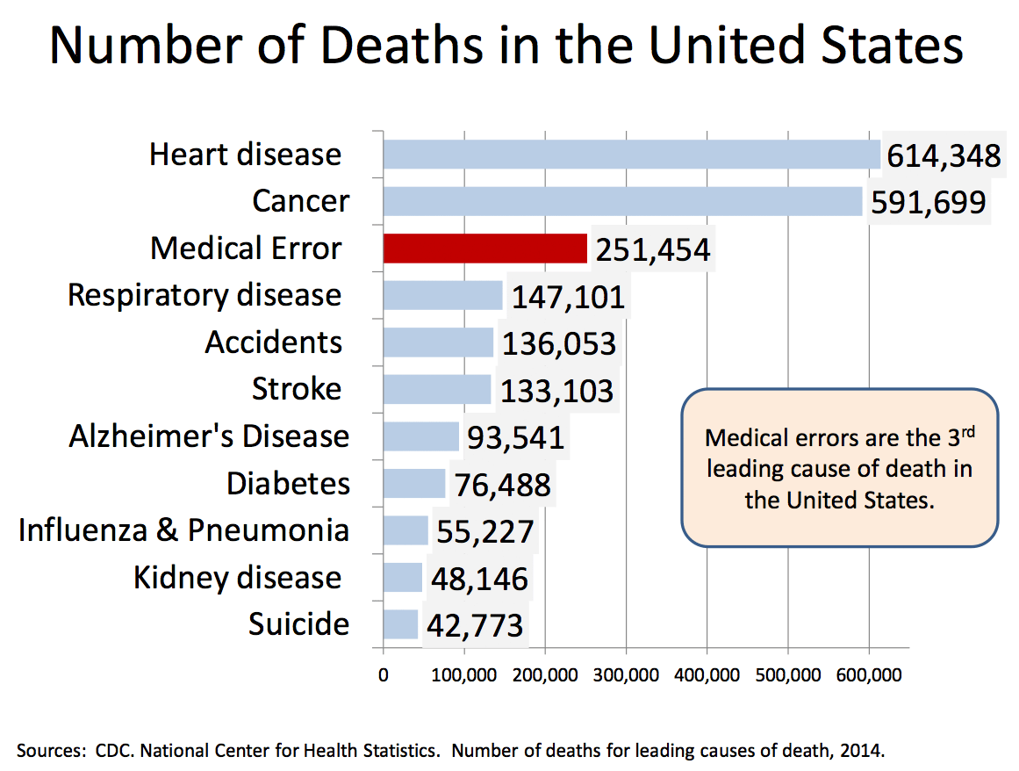
Medical Error – 3rd Leading Cause of Death in the US

Slide 4
Medication Safety
“Medicine used to be simple, ineffective, and relatively safe. Now it is complex, effective, and potentially dangerous.”
- Professor Sir Cyril Chantler
Medication safety is defined as freedom from preventable harm with medication use.
Medication safety issues impact health outcomes and quality of life, length of stay in a healthcare facilities, hospital admissions, readmission rates, clinic and emergency room visits, and overall costs to the healthcare system.
Notes:
(ISMP Canada, 2007).

Slide 5
Adverse Drug Event
An adverse drug event (ADE) is harm associated with any dose of a drug, whether the dose is “normally used in man” or not.
Preventable ADE = harm caused by the use of a drug as the result of an error
Non-Preventable ADE = drug-induced harm occurring with appropriate use of medication.
Mediation error is any preventable event that may cause or lead to inappropriate medication use or patient harm.
Notes:
NCC MERP
ADEs can be described as preventable or non-preventable
Non-Preventable ADE is drug-induced harm occurring with appropriate use of medication (e.g., adverse drug reactions and allergic reactions).
Preventable ADE is harm caused by the use of a drug as the result of a medication error.

Slide 6
Relationship Between Medication Errors and ADEs
Notes:
NCC MERP
ADEs can be described as preventable or non-preventable
Non-Preventable ADE is drug-induced harm occurring with appropriate use of medication (e.g., adverse drug reactions and allergic reactions).
Preventable ADE is harm caused by the use of a drug as the result of a medication error.

Slide 7
Impact of ADEs
In inpatient settings, ADEs:
Account for an estimated 1 in 3 of all hospital adverse events
Affect about 2 million hospital stays each year
Prolong hospital stays by 1.7 to 4.6 days
In outpatient settings, ADEs account for:
Over 3.5 million physician office visits
An estimated 1 million emergency department visits
Approximately 125,000 hospital admissions
Annually in the United States, 7,000 to 9,000 people die as a result of a medication error.
Cost associated with medication errors annually exceeds $40 billion
Notes:
https://health.gov/our-work/health-care-quality/adverse-drug-events Stats are from US Department of Health and Human Services – Office of Disease Prevention and Health Promotion
40% stat was from CDC https://www.cdc.gov/medicationsafety/basics.html
Explain the impact medication errors have on patient morbidity and mortality.
Taché SV, Sönnichsen A, Ashcroft DM. Prevalence of adverse drug events in ambulatory care: a systematic review. Ann Pharmacother. 2011;45(7-8):977-989. doi:10.1345/aph.1P627
Tariq RA, Vashisht R, Scherbak Y. Medication Errors. [Updated 2020 Jun 15]. In: StatPearls [Internet]. Treasure Island (FL): StatPearls Publishing; 2020 Jan-. Available from: https://www.ncbi.nlm.nih.gov/books/NBK519065/

Slide 8
ADEs Likely to Increase
Development of new medicines
Discovery of new uses for older medicines
Aging American population
Increased use of medicines for disease treatment and prevention
Expansion of insurance coverage for prescription medicines
Notes:
https://www.cdc.gov/medicationsafety/basics.html

Slide 9
The People Behind the Statistics

Slide 10
Pharmacy Compounding Error
For ~18 months, a young child had been receiving a 3 gram (20 mL) dose of tryptophan 150 mg/mL suspension by mouth at bedtime to treat a complex sleep disorder. A refill of the tryptophan prescription was ordered and picked up from the compounding pharmacy that had prepared the suspension in the past. That night, the child was given the usual dose of medication; the next morning, the child was found deceased in bed. A post-mortem toxicology test identified lethal levels of baclofen.
Notes:
https://www.ismp-canada.org/download/safetyBulletins/2017/ISMPCSB2017-05-Tryptophan.pdf
ISMP Canada Volume 17 Issue 5 May 25, 2017

Slide 11
Look-Alike Sound-Alike Error
An outpatient pharmacy accidentally dispensed the antipsychotic thiothixene (Navane) instead of the prescribed anti-hypertensive medication amlodipine (Norvasc) to a 71-year old patient. The patient took the wrong medication for three months, leading to physical and psychological harm including ambulatory dysfunction, tremors, mood swings, and personality changes.
Notes:
PATIENT SAFETY The alarming reality of medication error: a patient case and review of Pennsylvania and National data Brianna A. da Silva, MD* and Mahesh Krishnamurthy, MD, FACP, SFHM Internal Medicine Residency Program, Easton Hospital, Academic Affiliate of Drexel University, Easton, PA
Received: 29 March 2016; Revised: 21 June 2016; Accepted: 28 June 2016; Published: 7 September 2016
Journal of Community Hospital Internal Medicine Perspectives 2016. # 2016 Brianna A. da Silva and Mahesh Krishnamurthy. This is an Open Access article distributed under the terms of the Creative Commons Attribution-NonCommercial 4.0 International License (http://creativecommons.org/licenses/by-nc/ 4.0/), permitting all non-commercial use, distribution, and reproduction in any medium, provided the original work is properly cited. 1 Citation: Journal of Community Hospital Internal Medicine Perspectives 2016, 6: 31758 - http://dx.doi.org/10.3402/jchimp.v6.31758

Slide 12
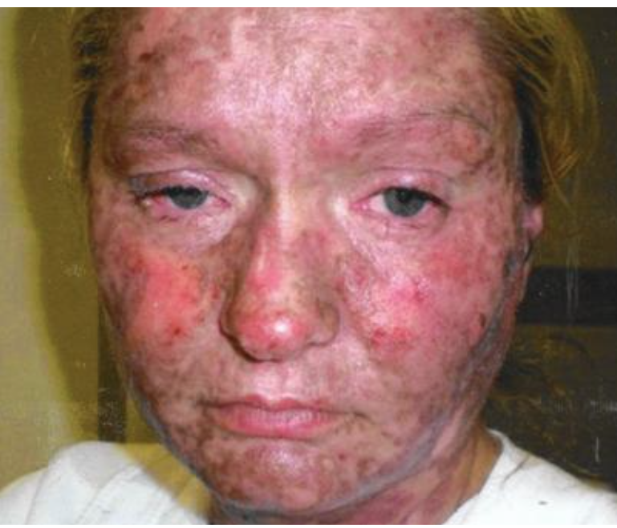
Drug Interaction Error
Becki Conway was prescribed full doses of Lamictal and Depakote for bipolar disorder
Pharmacy was alerted of drug interaction but filled the prescriptions and didn’t counsel patient
2 weeks later Becki went to urgent care due to sore throat, dry cough, irritated sinuses and chest pain
Transferred to ED for cardiac workup; given Benadryl for rash and discharged home
Went to a clinic the following day and provider recognized the drug interaction and Stevens- Johnson Syndrome
Notes:
Concurrent use of LAMOTRIGINE and VALPROIC ACID may result in increased elimination half-life of lamotrigine leading to lamotrigine toxicity (fatigue, drowsiness, ataxia) and an increased risk of life-threatening rashes

Slide 13
Second Victims
Healthcare professionals who experience difficulties in coping with their emotions after a patient safety incident
Often suffer from loss of confidence, fear of litigation or reputation damage, guilt, and anger
Worst cases progress to PTSD or suicide
Reported incidence of professionals who have experienced a negative emotional response following an incident range from 30% to 77%
Notes:
Mira JJ, Carrillo I, Guilabert M, et al. The Second Victim Phenomenon After a Clinical Error: The Design and Evaluation of a Website to Reduce Caregivers’ Emotional Responses After a Clinical Error. Eysenbach G, ed. Journal of Medical Internet Research. 2017;19(6):e203. doi:10.2196/jmir.7840.
Susan Scott, who leads the for YOU program at the University of Missouri Health System, emphasizes:
Only 10% of second victims require specialized mental health services
Most professionals in the first moments after an incident need:
to talk to a colleague
be relieved of care obligations for the time being
feel respect and empathy from others
feel supported by their institution

Slide 14
Key Elements to Integrate Medication Safety
Promote a Culture of Safety and Just Culture
Acquire the Traits of High Reliability Organizations
Know the basic key strategies for medication safety
Know high-risk medications and populations in your practice setting and mitigate the risks

Slide 15
Culture of Safety
The safety culture of an organization is the product of individual and group values, attitudes, perceptions, competencies, and patterns of behavior that determine the commitment to, and the style and proficiency of, an organization’s health and safety management. Advisory Committee on the Safety of Nuclear Installations
Having core values and behaviors that demonstrate a collective and sustained commitment to emphasize safety over competing goals. Such cultures value openness and mutual trust, provide appropriate resources for safe staffing, learn from errors, assess for weaknesses, display transparency and are accountable. The American Nurses Association
Notes:
Describe culture of safety and the reason it is necessary for a successful medication safety program.

Slide 16
Culture of Safety
Culture is “How we do things here.”
Safety Culture is “How can we change HOW we do things to make care safer.”
Notes:
Conversations that start with “how” vs “who” tend to be better received and more productive

Slide 17
Communication
Foster a culture of open and respectful communication
Lead by example
Establish a code of conduct that specifies unacceptable behaviors and enforce it
Reward outstanding examples of collaborative teamwork, respectful communication, and positive interpersonal skills
Respectfully listen to staff and patients
Mindfulness throughout an organization considers, but moves beyond, events and occurrences
If most of your interactions are related to negative situations then there is room for improvement

Slide 18
Just Culture
A just culture is one that has a clear and transparent process for evaluating errors and separating events arising from flawed system design or inadvertent human error from those caused by reckless behavior, defined as a behavioral choice to consciously disregard what is known to be a substantial or unjustifiable risk.
- ASHP Policy 1021 Just Culture and Reporting Medication Errors

Slide 19
Just Culture
Emphasizes learning rather than blame
Learning from errors provides us with the opportunity to improve our systems, processes, and behavior
Team members openly discuss and report events, process improvements or system issues without fear of reprisal
Individuals are treated fairly
Feedback and coaching of individuals is constructive
Team members are held accountable for their performance in accordance with job responsibilities and organizational values

Slide 20
Just Culture
Does not focus on the severity of the outcome
Is not “blame-free” which means no one is accountable
Does not tolerate conscious disregard of clear risks to patients
Does not tolerate gross misconduct

Slide 21
Outcome Based Response
Do not respond to a situation based on the outcome.

Slide 22
Culture Killing Phrases
“Who would do that…”
“They should have known….”
“Most people would have…”
“Why would they think….”
“No one else would….”
Add your own….

Slide 23
Key Features of a Culture of Safety
Blameless and voluntary reporting
Perform detailed analysis of accidents and near misses
Open communication and disclosure regarding safety and accidents
Story telling, especially about ADEs
Proactively prevent harm from occurring
Top-down commitment to safety with accountability not simply limited to front-line providers
Trust exists throughout the organization
Focus on continuous improvements and system design
Notes:
Chassin MR, Loeb JM. High-Reliability Health Care: Getting There from Here. The Milbank Quarterly, Vol. 91, No.3, 2013 (pp.459-490)
AHRQ Patient Safety Network. High Reliability. https://psnet.ahrq.gov/primers/primer/31/high-reliability. Last updated November 2017.
Weick KE, Sutcliffe KM. Managing the Unexpected. 2nd ed. San Francisco: Jossey-Bass.

Slide 24
High Reliability Organizations
Organizations that operate in complex, high-hazard domains for extended periods without serious accidents or catastrophic failures. The concept of high reliability is attractive for health care, due to the complexity of operations and the risk of significant and even potentially catastrophic consequences when failures occur in health care.
Foster an environment of collective mindfulness – all workers look for and report small problems or unsafe conditions before they pose a substantial risk to the organization.
Notes:
*AHRQ Patient Safety Network. High Reliability. https://psnet.ahrq.gov/primers/primer/31/high-reliability. Last updated November 2017.
**Weick KE, Sutcliffe KM. Managing the Unexpected. 2nd ed. San Francisco: Jossey-Bass.

Slide 25
Traits of High Reliability Organizations
Preoccupation with failure
Reluctance to simplify
Sensitivity to operations
Deference to expertise
Resilience

Slide 26
Preoccupation with Failure
Everyone is aware of and thinking about the potential for failure
Understand new threats emerge regularly from situations that no one imagined could occur, so all personnel actively think about what could go wrong and are alert to small signs of potential problems
What does this look like?
Constantly share and de-stigmatize failure
Support innovation and new ideas
Identify what is working correctly – if a process fails, look at areas it is successful
Don’t quit after a few months – lead employees to see it is attainable

Slide 27
Reluctance to Simplify
Resist simplifying their understanding of work processes and how and why things succeed or fail in their environment
Seek underlying rather than surface explanations
What does this look like?
Examine data/metrics
Willingness to challenge long-held beliefs
Ask questions and don’t stop at the surface

Slide 28
Sensitivity to Operations
Constant awareness of how processes and systems affect the organization; what is and isn’t working
What does this look like?
Transparency through improved communication and data sharing
Leadership involvement and rounding
Don’t assume

Slide 29
Deference to Expertise
Listen to people who have the most developed knowledge of the task at hand, regardless of hierarchy or seniority
What does this look like?
Do not say “I already know that.”
Redefine meetings – place and time
All staff are comfortable speaking up about potential safety problems

Slide 30
Resilience
Assume the system is at risk for failure, and practice performing rapid assessments of and responses to challenging situations
What does this look like?
Teams cultivate situation assessment and cross monitoring
Emphasize skill development

Slide 31
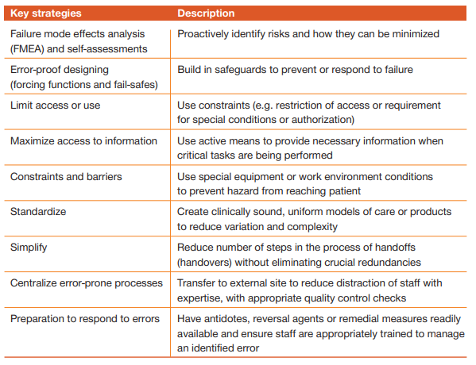
Key Strategies for Medication Safety
Notes:
Medication Safety in High-Risk Situations. Geneva: World Health Organization; 2019 (WHO/UHC/SDS/2019.10). Licence: CC BY-NC-SA 3.0 IGO.

Slide 32
Medication Use Process
Any step in the medication process from ordering the medication to monitoring after administration
Ordering/Prescribing
Documenting
Transcribing
Dispensing
Administering
Monitoring
Most medication errors occur during ordering/prescribing in both the inpatient and outpatient setting
Notes:
Describe the medication management process and be able to identify opportunities to improve medication safety in this process.
Describe the medication management process and the role of medication safety in this process.

Slide 33
Medication Safety Resources
Primary literature
Institute for Safe Medication Practices (ISMP)
https://www.ismp.org/
Purdue University has a medication safety program as well as a list of medication safety organizations with links
https://medsafety.pharmacy.purdue.edu/medication-safety-tools
Pennsylvania Patient Safety Authority
http://patientsafety.pa.gov/
World Health Organization
The third WHO Global Patient Safety Challenge: Medication Without Harm
https://www.who.int/patientsafety/medication-safety/en/
Centers for Disease Control Medication Safety Program
https://www.cdc.gov/medicationsafety/index.html
forYOU at the University of Missouri is a great resource with information on Second Victims
https://www.muhealth.org/about-us/quality-care-patient-safety/office-of-clinical-effectiveness/foryou

Slide 34
Proactive Assessment: Failure Mode Effects Analysis (FMEA)
Proactive analysis technique used to prevent problems before they occur
Designed to analyze potential failures of systems, components of the system and the effects of the failures
The focus is what could go wrong versus what did go wrong
Steps:
Identify high risk process and assemble team
Diagram the process in high level steps
Brainstorm potential failures and what the effects may be
Prioritize failures in terms of criticality
Identify root causes of the failures
Redesign the process
Analyze and test the new process
Implement and monitor the redesigned process

Slide 35
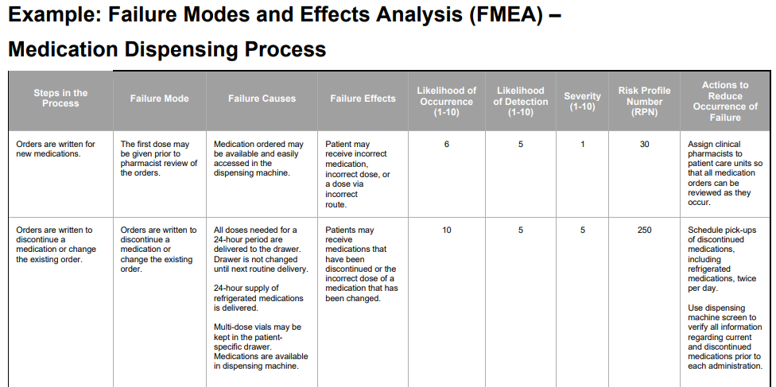

Slide 36
Optimize Efficiency
Maximize access to information
Standardize
Simplify
Centralize error-prone processes

Slide 37
Safe Limits and Constraints
Error-proof design
Limit access or use
Constraints and barriers

Slide 38
Reasonable Response
Preparation to respond to errors
Immediate response
Event investigation and review

Slide 39
High-Risk medications and Patient Populations

Slide 40
Populations at Higher Risk for ADEs
Children (less than 18 yo)
5% to 27% of all pediatric medication orders result in a medication error
Elderly (greater than 65 yo)
This group comprises only 12% of the US population, yet it accounts for ~30% of prescription drugs consumed in the US
Estimates as high as 40% of medication orders for patients greater than 65 yo result in an error
Notes:
Interventions to reduce pediatric medication errors: a systematic review 2014

Slide 41
Risk Factors for ADEs
Antidiabetic agents, oral anticoagulants, antiplatelet agents, and opioid pain medications account for more the 50% of ED visits for ADEs in Medicare patients
Polypharmacy—taking 5 or more medications – is one of the strongest risk factors for ADEs
Transitions of care – patients recently discharged from an acute care setting
Limited health literacy
Cognitive conditions, such as memory problems
Multiple providers prescribing medications
Notes:
https://psnet.ahrq.gov/primer/medication-errors-and-adverse-drug-events

Slide 42
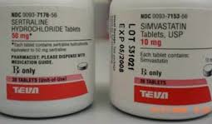
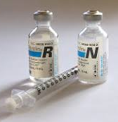
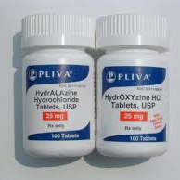
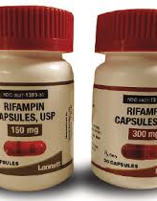
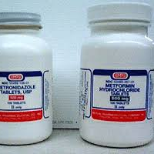
Look-Alike Sound-Alike Medications

Slide 43
High-Risk Medications
High-risk (high-alert) medications are drugs that bear a heightened risk of causing significant patient harm when they are used in error. Although mistakes may or may not be more common with these medications, the consequences of an error are clearly more devastating to patients.
Mnemonic “A PINCH”
Notes:
Medication Safety in High-risk Situations. Geneva: World Health Organization; 2019 (WHO/UHC/SDS/2019.10). Licence: CC BY-NC-SA 3.0 IGO.

Slide 44
Adverse Drug Events from Opioid Analgesics
In 2013, the rate of overdose deaths involving opioid analgesics remained higher than the rate of deaths involving heroin, but the rate of deaths involving heroin had almost tripled from 2010.
In 2015, more than 15,000 people died from overdoses involving prescription opioids.
Goal: identify ways to eliminate unnecessary prescribing of opioid analgesics without reducing the quality of care for patients who legitimately need pain management.
Notes:
CDC Prescription Drug Overdose: Data Overview. Available at: http://www.cdc.gov/drugoverdose/data/index.html
CDC Guideline for Prescribing Opioids for Chronic Pain — United States, 2016. Available at: http://www.cdc.gov/mmwr/volumes/65/rr/rr6501e1.htm

Slide 45
Adverse Drug Events from Insulin
From 2007 to 2011, there were ~100,000 ED visits/year in the US for insulin-related hypoglycemia or errors when taking insulin. Of these:
Nearly two-thirds of patients had symptoms of severe hypoglycemia, such as shock, seizures, or loss of consciousness.
Almost one-third of the emergency department visits resulted in hospitalization.
Older adults are most vulnerable to insulin-related hypoglycemia leading to emergency room visits.
1 in 8 insulin-treated patients 80 years or older visited the ED for hypoglycemia or errors. Compared to insulin-treated patients 45 to 64 years old, those 80 years or older were:
Twice as likely to visit the ED for insulin-related hypoglycemia or an error when taking insulin
Five times more likely to be hospitalized
Meal-related mishaps and taking the wrong insulin product were the most common reasons for emergency room visits from insulin-related hypoglycemia or errors.
Notes:
Geller AI, Shehab N, Lovegrove MC, Kegler SR, Weidenbach KN, Ryan GJ, Budnitz DS. National estimates of insulin-related hypoglycemia and errors leading to emergency department visits and hospitalizationsexternal icon. JAMA Intern Med2014;174:678-86.
Meal-planning is a well-recognized component of diabetes education. However, among the emergency department visits with information on what caused the visit, a meal-related mishap was the most common factor in nearly half of the cases. Common meal-related mishaps include:
Not eating shortly after taking rapid-acting insulin, such as insulin aspart or insulin lispro.
Not adjusting insulin doses when eating less.
The second most common factor was patients taking the wrong insulin product, documented in nearly one-quarter of visits with information on what led to the visit. The most frequently reported type of product error was confusing rapid-acting and long-acting insulin products. In these cases, more than half the time a patient intended to take a long-acting insulin product (such as insulin detemir or insulin glargine) but took a rapid-acting one instead.

Slide 46
Adverse Drug Events from Anticoagulants
Among older adults, oral anticoagulants are the most common causes of adverse drug events (ADEs) leading to emergency room visits and emergent hospitalizations.
From 2013 - 2014, warfarin was responsible for:
Warfarin accounted for 32% of emergency room visits for all ADEs among older adults (≥65 years of age), and 36% of estimated emergent hospitalizations for all ADEs among older adults
Warfarin, rivaroxaban, and dabigatran were among the top 10 most common causes of ADEs resulting in emergency department visits among older adults
In 2017:
Bleeding from oral anticoagulants resulted in approximately 235,000 emergency department visits
Older adults (≥65 years of age) were involved in ~ 80% of DOAC-related bleeding visits and 77% of warfarin-related bleeding visits
DOACs contributed to ~40% of oral anticoagulant bleeding visits
Notes:
Shehab N, Lovegrove MC, Geller AI, Rose KO, Weidle NJ, Budnitz DS. US Emergency Department Visits for Outpatient Adverse Drug Events, 2013-2014.external icon JAMA 2016;316(20):2115-2125.
Geller AI, Shehab N, Lovegrove MC, Rose KO, Weidle NJ, Goring SK, Budnitz DS. Emergency Visits for Oral Anticoagulant Bleedingexternal icon J Gen Intern Med 2019 Oct 29.

Slide 47
Adverse Drug Events from Antibiotics
Annually in 2013 and 2014, in the US, there were ~200,000 ED visits for adverse events related to antibiotics
Antibiotics are responsible for ~16% of ED visits for ADEs each year.
Antibiotics are involved in more ED visits for ADEs than any other class of drugs in patients under 50 years old
In children less than or equal to 5 years old, antibiotics cause ~56% of ED visits for ADEs
~ 82% of ED visits for ADEs from antibiotics are due to allergic reactions
Notes:
Shehab N, Lovegrove MC, Geller AI, Rose KO, Weidle NJ, Budnitz DS. US Emergency Department Visits for Outpatient Adverse Drug Events, 2013-2014. JAMA. 2016;316(20):2115-2125. doi:10.1001/jama.2016.16201
Shehab N, Lovegrove MC, Geller AI, Rose KO, Weidle NJ, Budnitz DS. US emergency department visits for outpatient adverse drug events, 2013-2014external iconexternal icon. JAMA 2016;316:2115-25.
Shehab N, Patel PR, Srinivasan A, Budnitz DS. Emergency department visits for antibiotic-associated adverse events.external icon Clin Infect Dis 2008;47:735-43.
Linder JA. Antibiotics for treatment of acute respiratory tract infections: decreasing benefit, increasing risk, and the irrelevance of antimicrobial resistance. Clin Infect Dis 2008;47:744-6.
Antibiotics are one of the most prescribed medication classes in the United States, which contributes to the high number of emergency department visits for adverse drug events from these medications. But, even after accounting for how often antibiotics are prescribed, there is a substantial risk of an emergency department visit for an antibiotic-associated adverse drug event. From 2004-2006, there was approximately one in 1,000 risk that a person prescribed an antibiotic would require a visit to the emergency department because of an antibiotic side effect [2]. But it is estimated that there is only one in 4,000 chance that an antibiotic would prevent a serious complication from an upper respiratory infection [3]. An allergic reaction is the most common type of antibiotic-associated adverse drug event, so minimizing unnecessary antibiotic use is the best way to reduce the risk of adverse drug events from antibiotics.

Slide 48
Prioritization: Ask Questions
What are the most severe accidents that could happen?
High-Risk Medications
High-Risk Populations
Complex processes that are not utilized often
Emergency situations
Look-Alike Sound-Alike medications
What do we do to prevent the worst accidents?
What are the remaining vulnerabilities in terms of technology, organization/systems and staff?
Do these become more dangerous in certain circumstances?
Training of staff – tiers
What other systems or processes may be impacted by this?
Is this a process that can be maintained?
Do those involved recognize potential dangers and do they have contingency plans?
Transitions of care and hand-off between the HC team are vulnerable areas for accidents to occur. What can we do to improve this?

Slide 49
Conclusion
A safety culture is the foundation for medication safety
Focus on “how” rather than “who”
Build trust through consistency and avoiding responses based on outcomes
Avoid Killer phrases
Proactively assess
ISMP: Self Assessments and Quarterly Action Agendas
FMEA
Routinely review information from patient safety and medication safety organizations
Join list serves applicable to your area of practice
Understand the medication use process and think about the whole process when evaluating systems
Apply safety strategies in system design
Know high-risk populations and work to mitigate risk in these groups through better system design
Know high-risk medications or situations and work to mitigate the risks

Slide 50
Questions?

